Slide 1
A plausible explanation for the strong near-IR continuum emission
in NGC 7023 reflection nebulae: the recurrent fluorescence
Ozan Lacinbala¹, Florent Calvo², Emmanuel Dartois¹, Cyril Falvo^{1,2}, Pascal Parneix¹, Aude Simon³, Thomas Pino¹
¹Institut des Sciences Moléculaires d’Orsay, CNRS, Université Paris-Saclay
²LIPhy, CNRS, Université Grenoble-Alpes
³LCPQ, CNRS, Université de Toulouse
PCMI biannual colloquium – Paris – October, 26th 2022

Slide 2
Main result
Near-IR continuum emission observed in various interstellar environments can be modeled by the recurrent fluorescence from ~ C₃₀ - C₆₀ cage carbon cluster gas
Recurrent fluorescence takes place during the radiative relaxation induced by starlight-photon absorption

Slide 3
Carbon clusters - Photophysical processes - Modelisation - Results: near-IR emission
Outline
Theoretical investigation of C_{n} (n=24, 42, 60) carbon clusters radiative emission
Investigation over a large sample of carbon clusters
Carbon clusters in this work
Photophysical processes – Modelisation
Collective emission of carbon clusters in isolated conditions

Slide 4
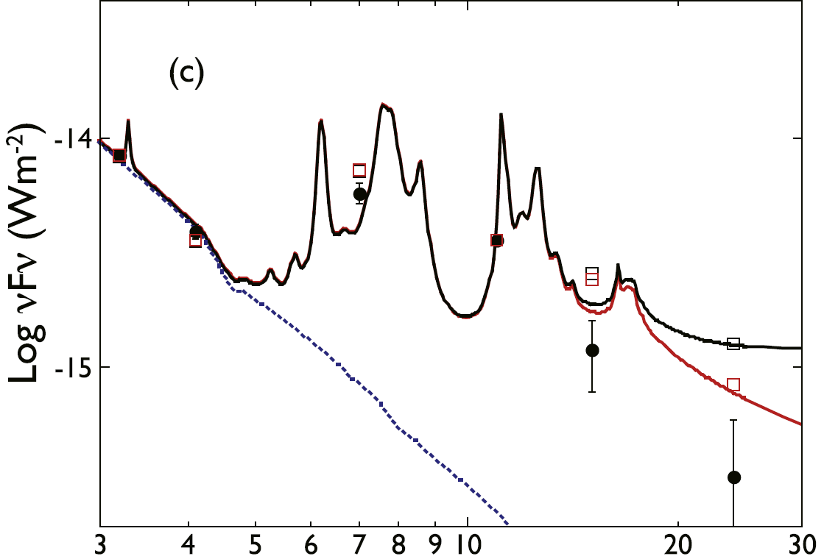
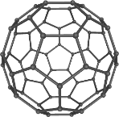
Carbon clusters - Photophysical processes - Modelisation - Results: near-IR emission
Large interstellar molecules
AIBs suggest the existence of Polycyclic Aromatic
Hydrocarbon-like ensemble (PAH-like)
IR (vibrational) emission induced
by electronic excitation
Detected large molecules in the ISM:
$C_{60}$ and $C_{60}^{+}$buckminsterfullerene
$C_{70}$
J. Cami et al., Science (2010)
K. Sellgren et al., ApJ (2010)
E.K. Campbell et al., Nature (2015)
Fullerene formation unknown
⟶ presence of large carbon cluster ?
Large carbon clusters have the
same photophysics as that of PAHs
AIBs from NGC 2782 galaxy
T. Onaka et al., ApJ (2018)
Log $νF_{ν}$ (W·m⁻²)
Our question:
What should be the collective emission signature of cosmic
large C_{n} carbon clusters ?
Wavelength (µm)

Slide 5
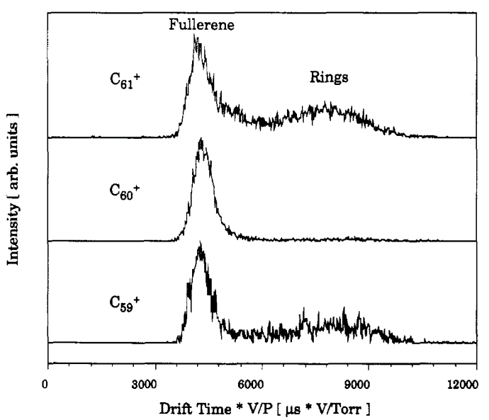
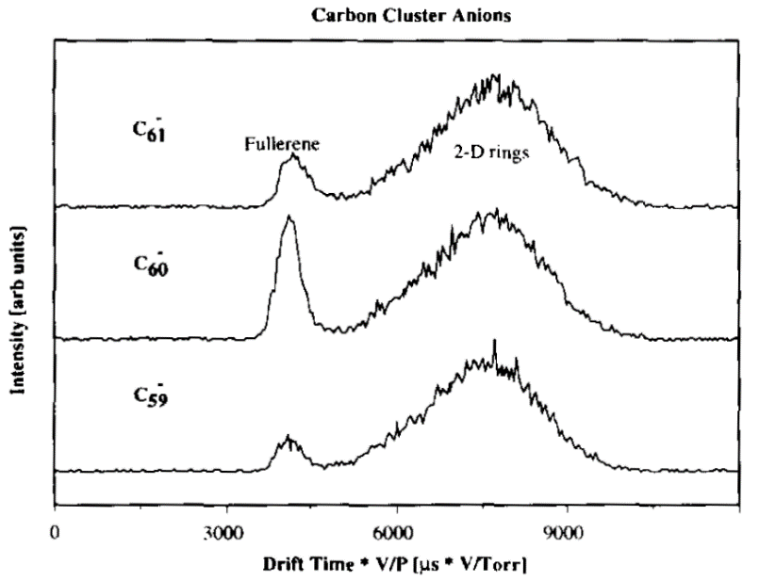
Carbon clusters - Photophysical processes - Modelisation - Results: near-IR emission
Large carbon clusters in the laboratory
Cationic
Anionic
G. von Helden et al., J.Phys.Chem (1993)
N.G Gotts et al., Int. J. Mass Spectrom (1995)
Various isomers detected by
graphite laser ablation technique
in ion mobility experiments
Large carbon clusters are products of incomplete combustion $→$ Soot precursors ?
Maybe in shock-induced decomposition of buckminsterfulleren

Slide 6
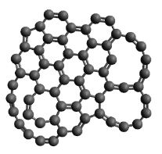
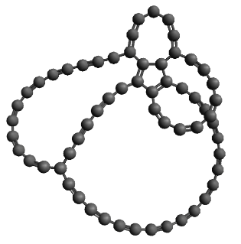
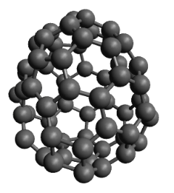
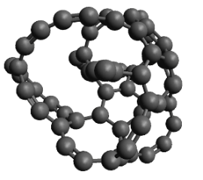
Carbon clusters - Photophysical processes - Modelisation - Results: near-IR emission
Investigated large carbon clusters in this work
Recent theoretical works:
Diversity of C₂₄, C₄₂ and C₆₀ carbon clusters ($\sim$ 10⁵ isomers) and their structural
and chemical properties through order parameters M. Bonnin et al., Phys.Rev. A (2019)
Vibrational and electronic structures for each isomer C. Dubosq et al., A&A (2019), C. Dubosq et al., A&A (2020)
Family classification: cages, flakes, pretzels, branched
C₆₀ carbon cluster examples:
cage
flake
pretzel
branched

Slide 7
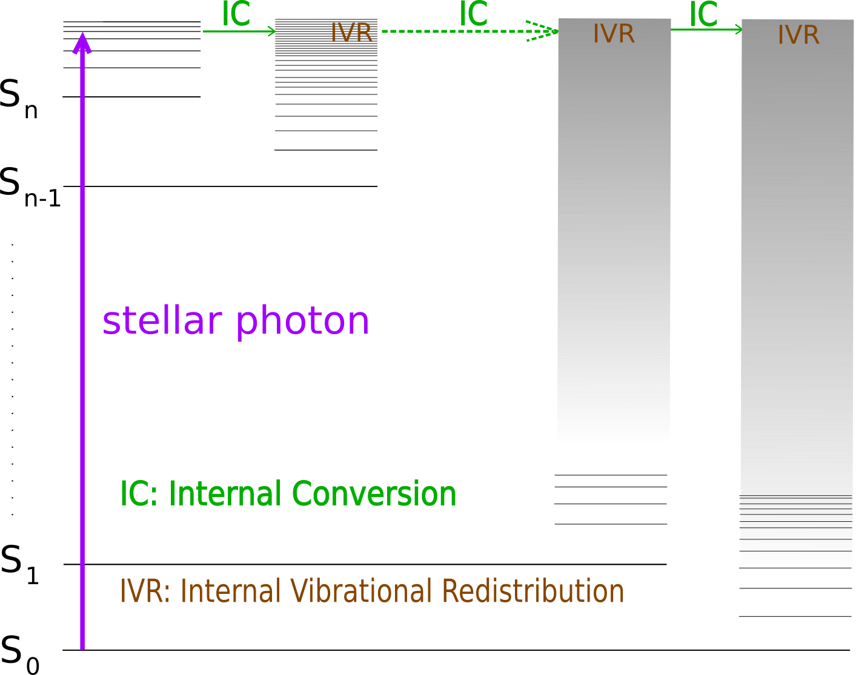
Carbon clusters - Photophysical processes - Modelisation - Results: near-IR emission
Recurrent fluorescence and vibrational emission in isolated conditions
$k_{rec},k_{vib}$ << $k_{IC}$, $k_{IIC}$,$k_{IVR}$
radiative
radiationless
${10}^{3}$- ${10}^{−1} s^{−1}$
${10}^{14}$- ${10}^{8} s^{−1}$

Slide 8
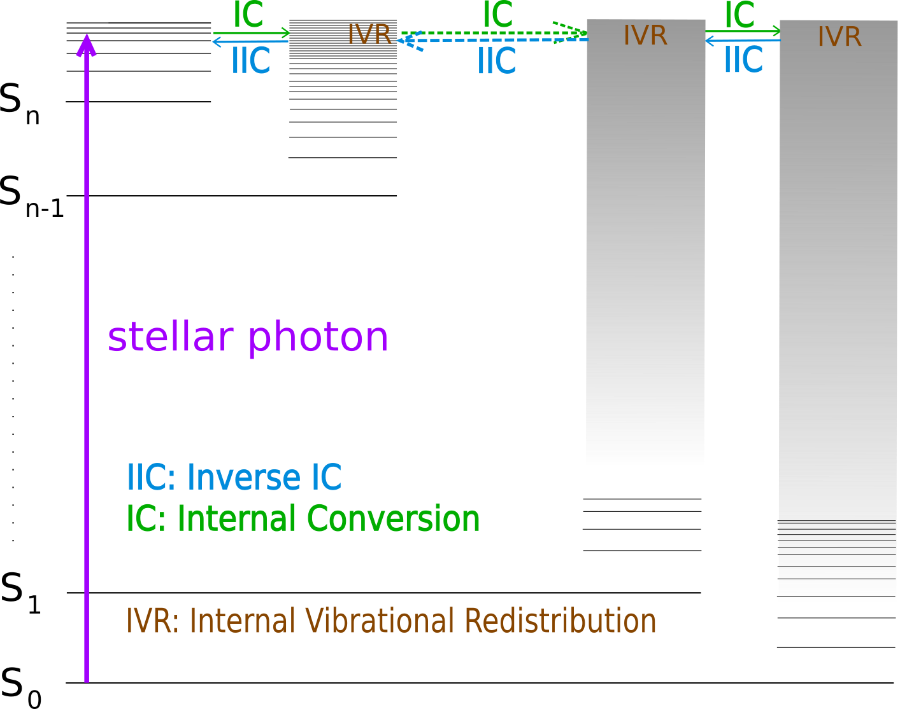
Carbon clusters - Photophysical processes - Modelisation - Results: near-IR emission
Recurrent fluorescence and vibrational emission in isolated conditions
$k_{rec},k_{vib}$ << $k_{IC}$, $k_{IIC}$,$k_{IVR}$
radiative
radiationless
${10}^{3}$- ${10}^{−1} s^{−1}$
${10}^{14}$- ${10}^{8} s^{−1}$

Slide 9
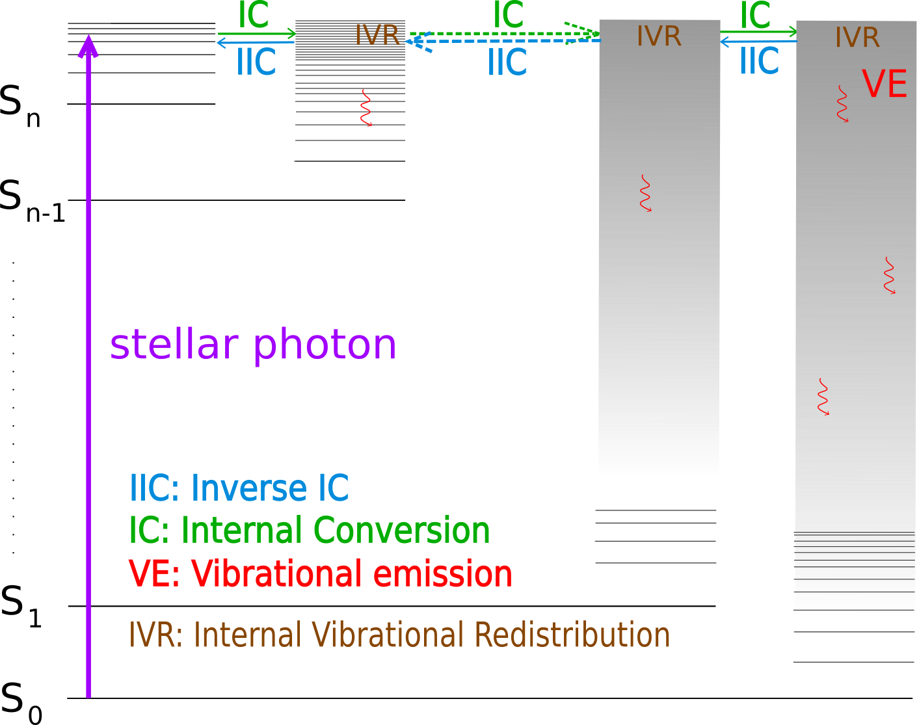
Carbon clusters - Photophysical processes - Modelisation - Results: near-IR emission
Recurrent fluorescence and vibrational emission in isolated conditions
$k_{rec},k_{vib}$ << $k_{IC}$, $k_{IIC}$,$k_{IVR}$
radiative
radiationless
${10}^{3}$- ${10}^{−1} s^{−1}$
${10}^{14}$- ${10}^{8} s^{−1}$

Slide 10
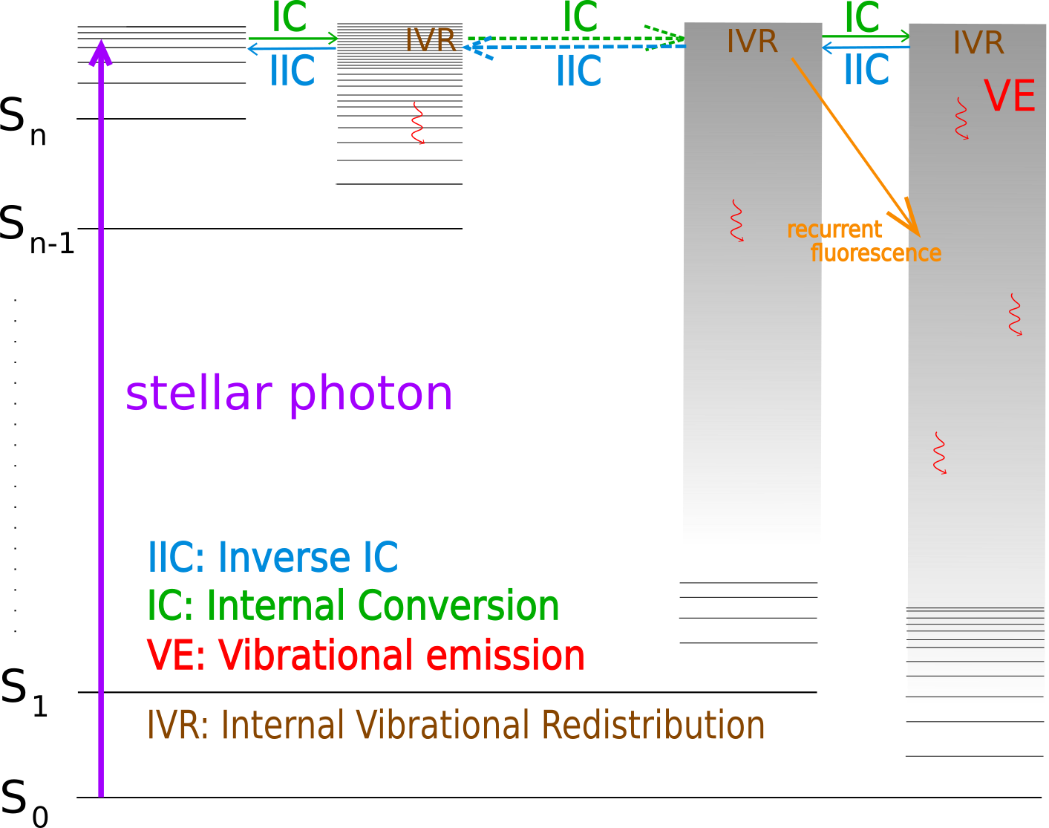
Carbon clusters - Photophysical processes - Modelisation - Results: near-IR emission
Recurrent fluorescence and vibrational emission in isolated conditions
$k_{rec},k_{vib}$ << $k_{IC}$, $k_{IIC}$,$k_{IVR}$
radiative
radiationless
${10}^{3}$- ${10}^{−1} s^{−1}$
${10}^{14}$- ${10}^{8} s^{−1}$
A. Léger et al., PRL (1988)
Experimental observations of recurrent fluorescence:
S. Martin et al. PRL, 2013 ($C_{14}H_{10}^{+}$)
J. Bernard et al., NIMB, 2020 ($C_{10}H_{8}^{+}$,${ C}_{14}H_{10 }^{+}$, $C_{16}H_{10}^{+}$)
G. Itoh et al. PRL, 2014 ($C_{6}^{−}$,$C_{6}H^{−}$)
Y. Ebara et al. PRL, 2016 ($C_{6}^{−}$)
M. Saito et al. PRA, 2020 ($C_{10}H_{8}^{+}$)

Slide 11
Carbon clusters - Photophysical processes - Modelisation - Results: near-IR emission
Recurrent fluorescence and vibrational emission in isolated conditions
$k_{rec},k_{vib}$ << $k_{IC}$, $k_{IIC}$,$k_{IVR}$
radiative
radiationless
${10}^{3}$- ${10}^{−1} s^{−1}$
${10}^{14}$- ${10}^{8} s^{−1}$
A. Léger et al., PRL (1988)
Experimental observations of recurrent fluorescence:
S. Martin et al. PRL, 2013 ($C_{14}H_{10}^{+}$)
J. Bernard et al., NIMB, 2020 ($C_{10}H_{8}^{+}$,${ C}_{14}H_{10 }^{+}$, $C_{16}H_{10}^{+}$)
G. Itoh et al. PRL, 2014 ($C_{6}^{−}$,$C_{6}H^{−}$)
Y. Ebara et al. PRL, 2016 ($C_{6}^{−}$)
M. Saito et al. PRA, 2020 ($C_{10}H_{8}^{+}$)
What is the resulting emission spectrum
of large carbon clusters ?

Slide 12
Carbon clusters - Photophysical processes - Modelisation - Results: near-IR emission
Recurrent fluorescence and vibrational emission in isolated conditions
Main hypothesis to calculate emission rates:
internal energy is always statistically distributed among all vibronic states
Vibrational emission (VE)
Spontaneous VE of one photon from $v^{th}$ vibrational quanta of $i^{th}$ mode :
No overtones or combination bands
Recurrent fluorescence (RF)
RF rate from the $n^{th}$ electronic states:
RF rates are computed for the first 50 excited electronic states
No n$→m (m≠$ $0)$ electronic transitions
(vibrational harmonic approximation)
$$A_{rec}^{n→0}(E)= A_{f}^{n → 0}×P_{n}(E)$$
$$A_{i}\left(E\right)= \sum_{v=0}^{v_{max}}{v}A_{i}^{1 → 0}×P_{i,v}(E)$$
Once all emission rates are known, we simulate the collective emission spectrum by Monte Carlo method

Slide 13
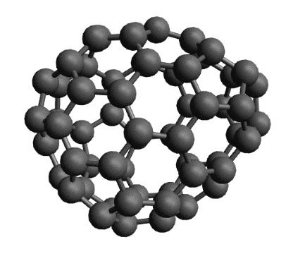
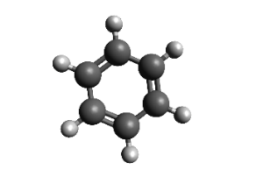
Carbon clusters - Photophysical processes - Modelisation - Results: near-IR emission
Recurrent fluorescence (RF) and Vibrational emission (VE) - Comparison
 | $C_{60}$ cage isomer (arbitrarily chosen) | Benzene
1st excited electronic state | 0.55 eV | 4.8 eV
$k_{VE}$ ($s^{−1}$) | 19 | 53
$k_{RF}$ ($s^{−1}$) | 22 | $$7∙{10}^{−6}$$
at 6.4 eV
internal energy
$$k_{RF} \sim k_{VE}$$
$$k_{RF}≪k_{VE}$$

Slide 14
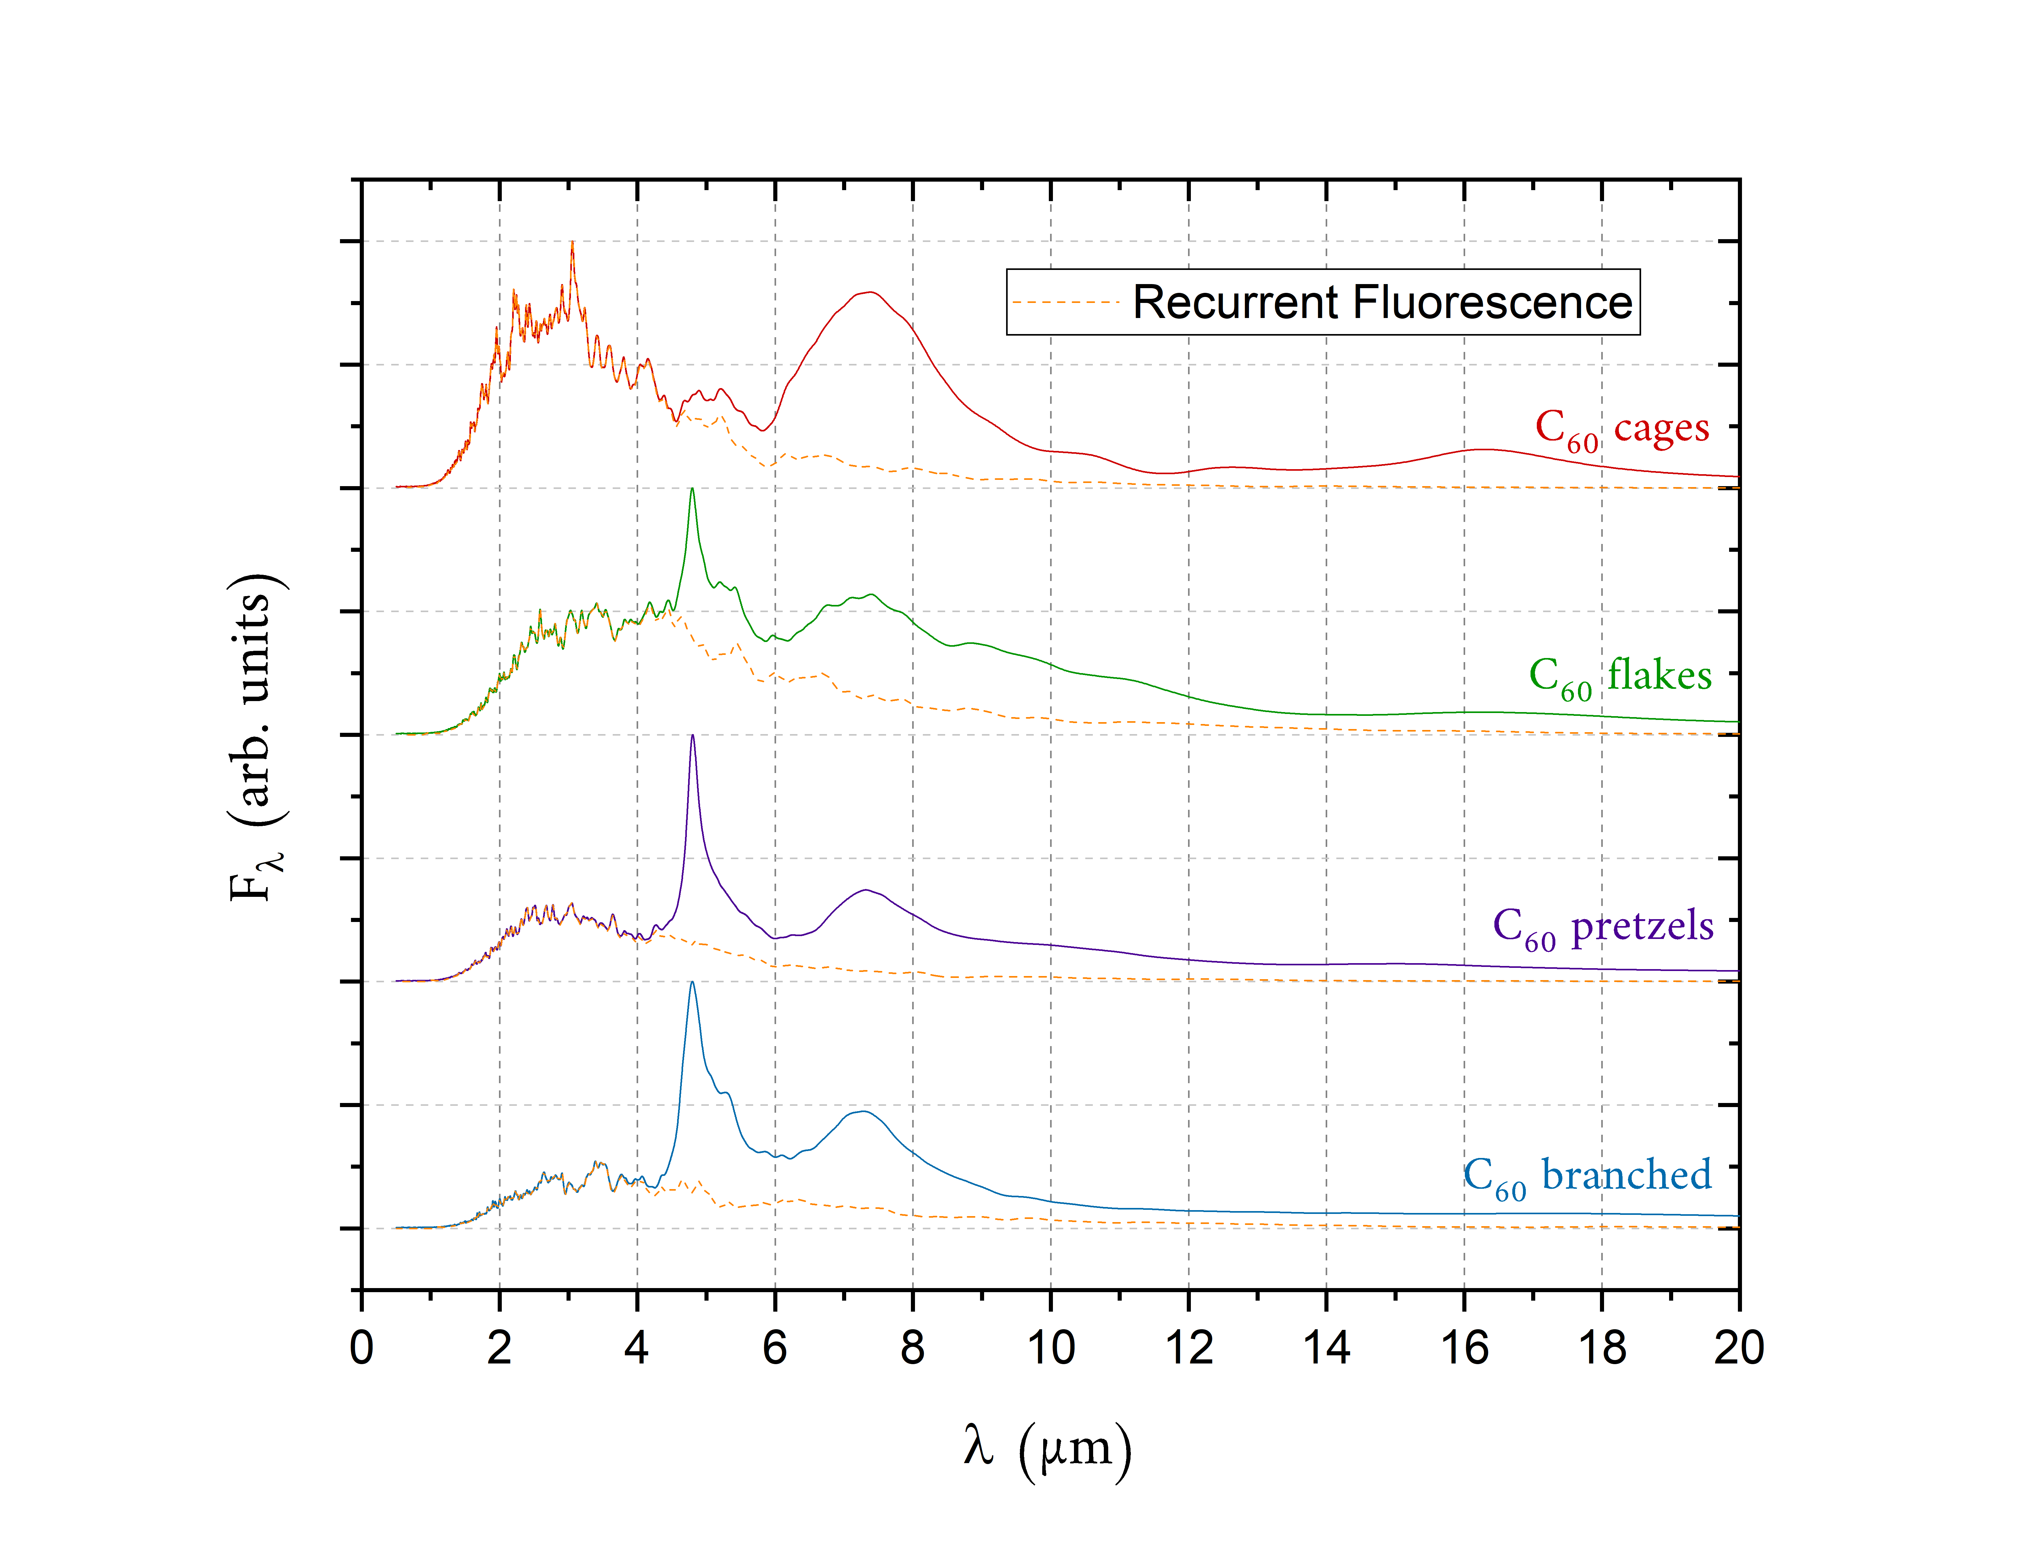
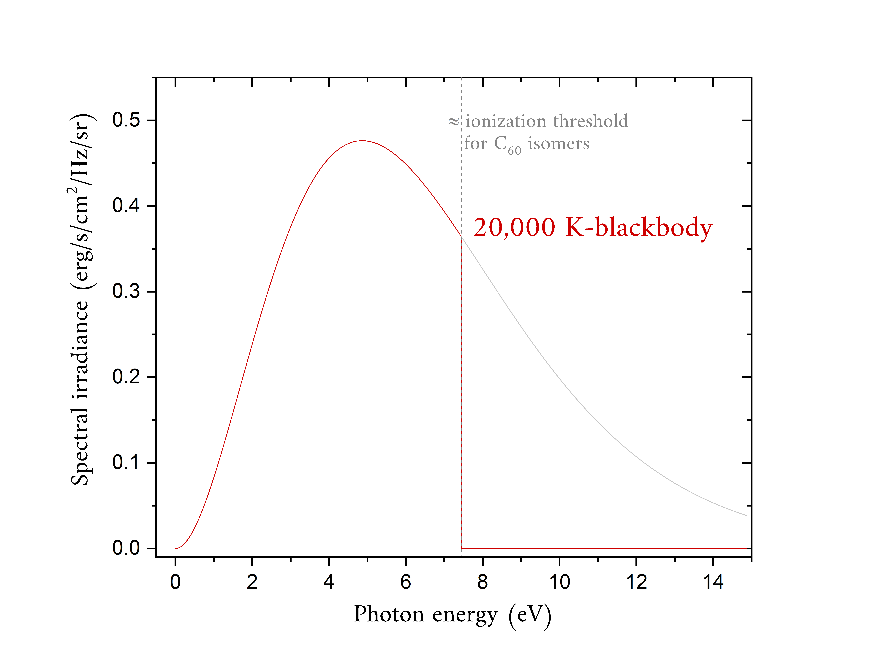
Carbon clusters - Photophysical processes - Modelisation - Results: near-IR emission
Near-IR continuum emission of carbon clusters
Normalized C₆₀ emission intensity induced by irradiation
from a 20 000 K blackbody (star)
Spectral Energy Distribution of
the exciting 20 000 K star
Emission from carbon clusters
should be mainly due to cages
1000 isomers for each family:
Flat population because the ISM is
out-of-equilibrium.

Slide 15
Carbon clusters - Photophysical processes - Modelisation - Results: near-IR emission
Near-IR continuum emission of carbon clusters
Normalized C₆₀ emission intensity induced by irradiation
from a 20 000 K blackbody (star)
Spectral Energy Distribution of
the exciting 20 000 K star
Emission from carbon clusters
should be mainly due to cages
Vibrational C≡C stretching
bands emission at 4.75 µm
is not astrophysically
observed
1000 isomers for each family:
Flat population because the ISM is
out-of-equilibrium.

Slide 16
Carbon clusters - Photophysical processes - Modelisation - Results: near-IR emission
Near-IR continuum emission of carbon clusters
Normalized C₆₀ emission intensity induced by irradiation
from a 20 000 K blackbody (star)
Spectral Energy Distribution of
the exciting 20 000 K star
Emission from carbon clusters
should be mainly due to cages
Near-IR emission
Vibrational C≡C stretching
bands emission at 4.75 µm
is not astrophysically
observed
1000 isomers for each family:
Flat population because the ISM is
out-of-equilibrium.

Slide 17
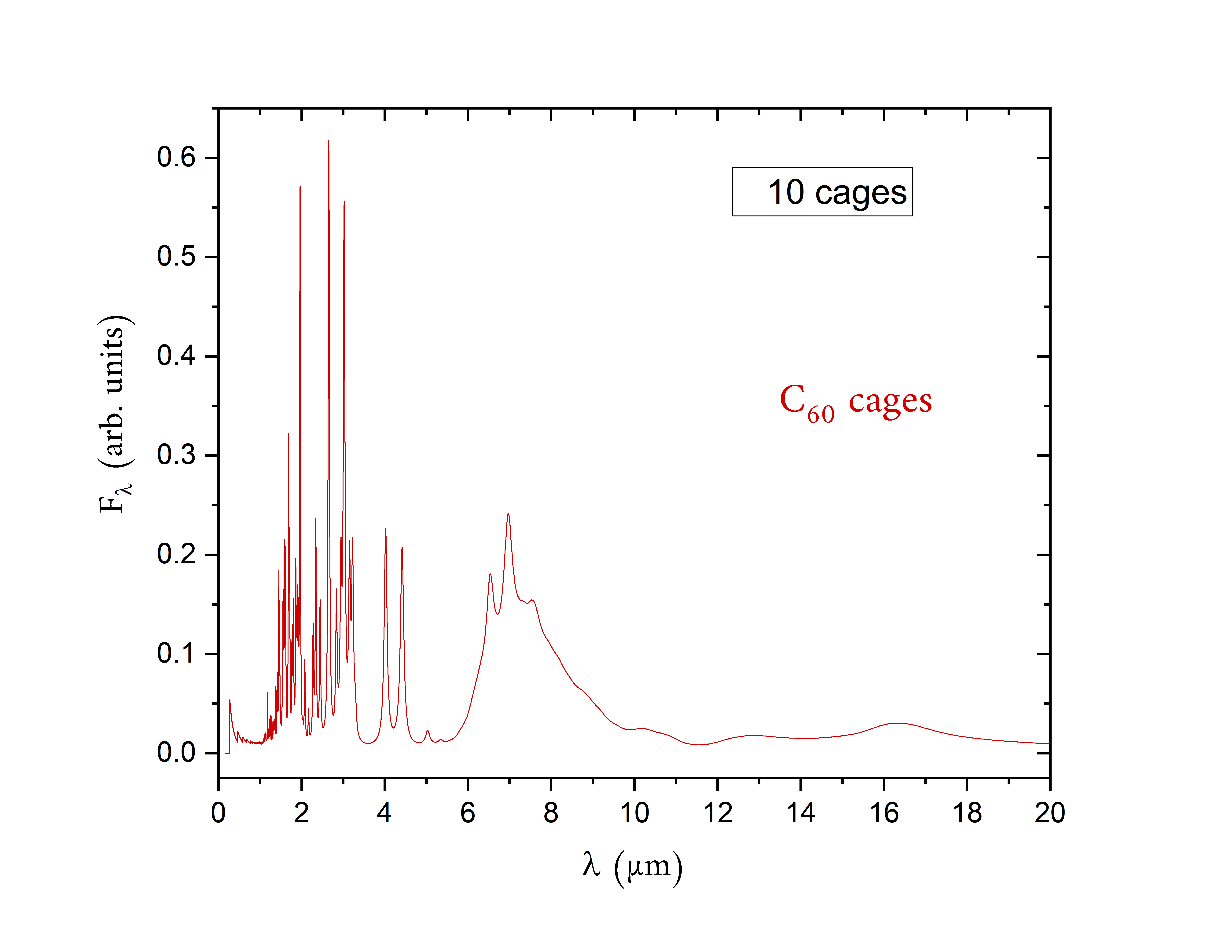
Carbon clusters - Photophysical processes - Modelisation - Results: near-IR emission
Near-IR continuum emission of carbon clusters
Normalized C₆₀ emission intensity induced by irradiation
from a 20 000 K blackbody (star)
Profile of the emission spectra of C₆₀ cages
by increasing the number of clusters
Emission from carbon clusters
should be mainly due to cages
Near-IR emission
Vibrational C≡C stretching
bands emission at 4.75 µm
is not astrophysically
observed

Slide 18
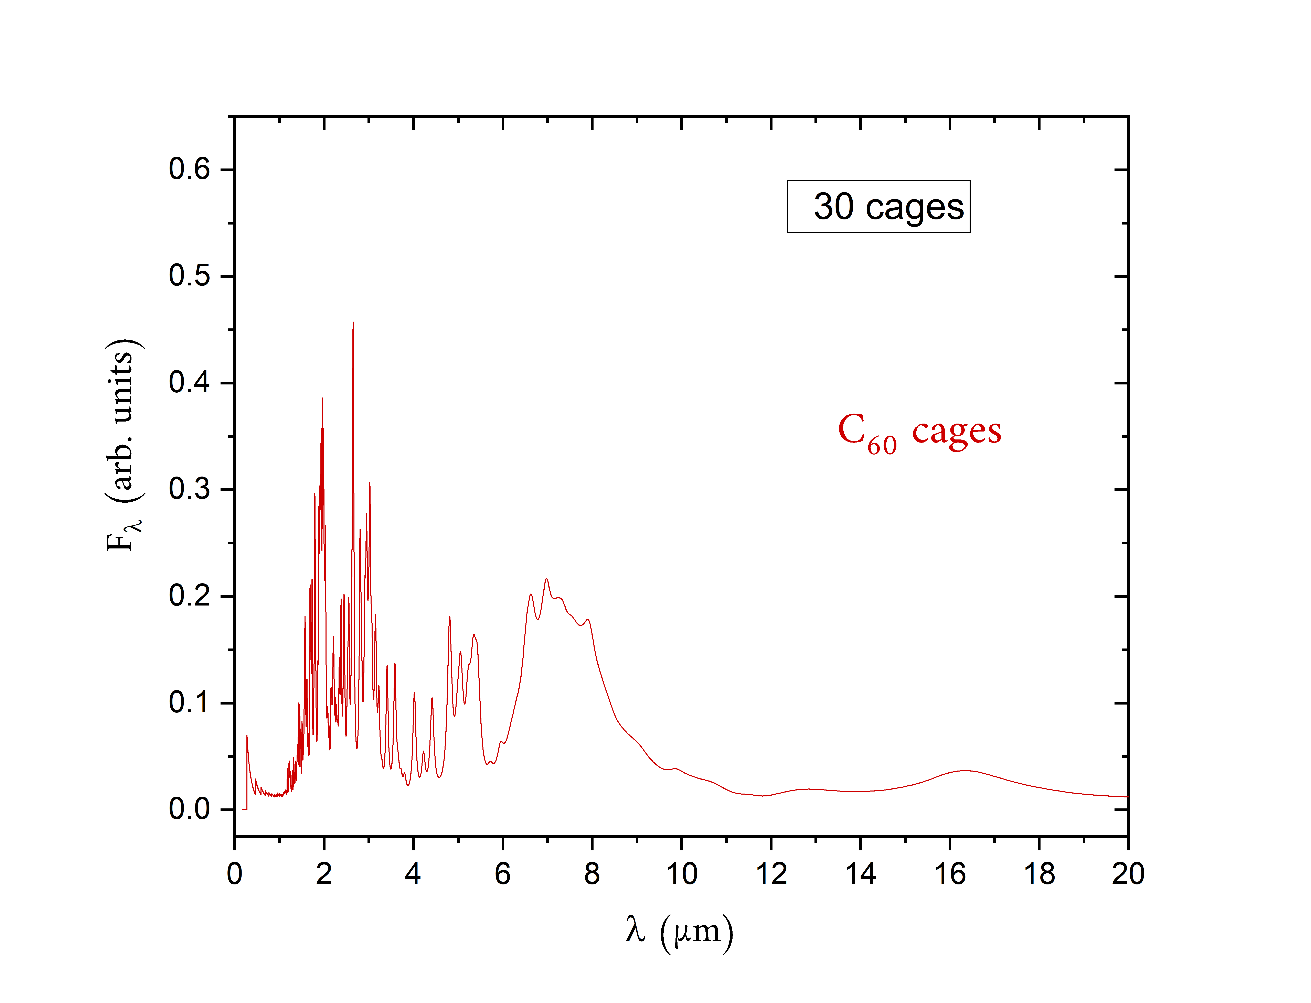
Carbon clusters - Photophysical processes - Modelisation - Results: near-IR emission
Near-IR continuum emission of carbon clusters
Normalized C₆₀ emission intensity induced by irradiation
from a 20 000 K blackbody (star)
Profile of the emission spectra of C₆₀ cages
by increasing the number of clusters
Emission from carbon clusters
should be mainly due to cages
Near-IR emission
Vibrational C≡C stretching
bands emission at 4.75 µm
is not astrophysically
observed

Slide 19
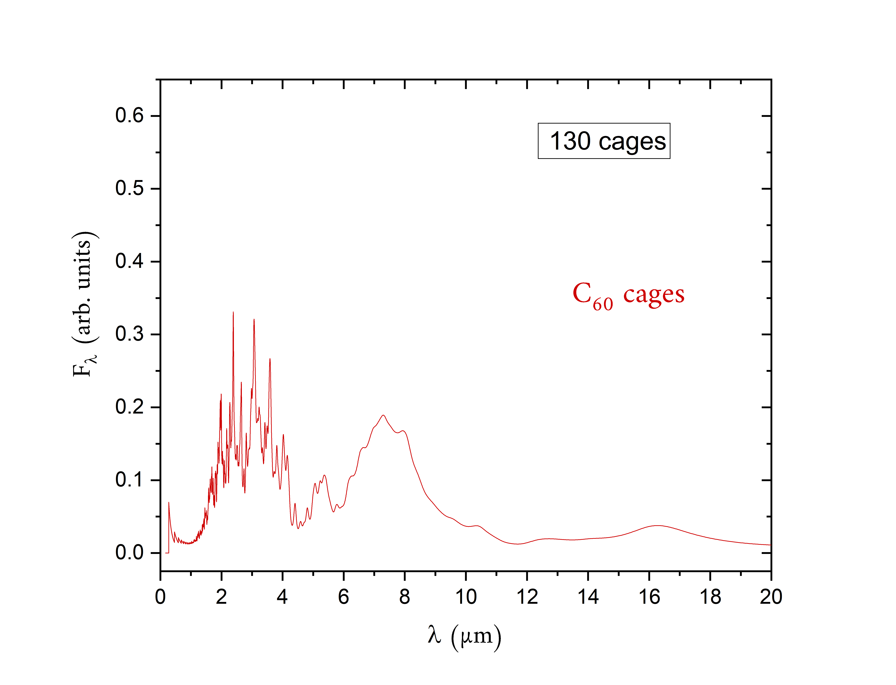
Carbon clusters - Photophysical processes - Modelisation - Results: near-IR emission
Near-IR continuum emission of carbon clusters
Normalized C₆₀ emission intensity induced by irradiation
from a 20 000 K blackbody (star)
Profile of the emission spectra of C₆₀ cages
by increasing the number of clusters
Emission from carbon clusters
should be mainly due to cages
Near-IR emission
Vibrational C≡C stretching
bands emission at 4.75 µm
is not astrophysically
observed

Slide 20
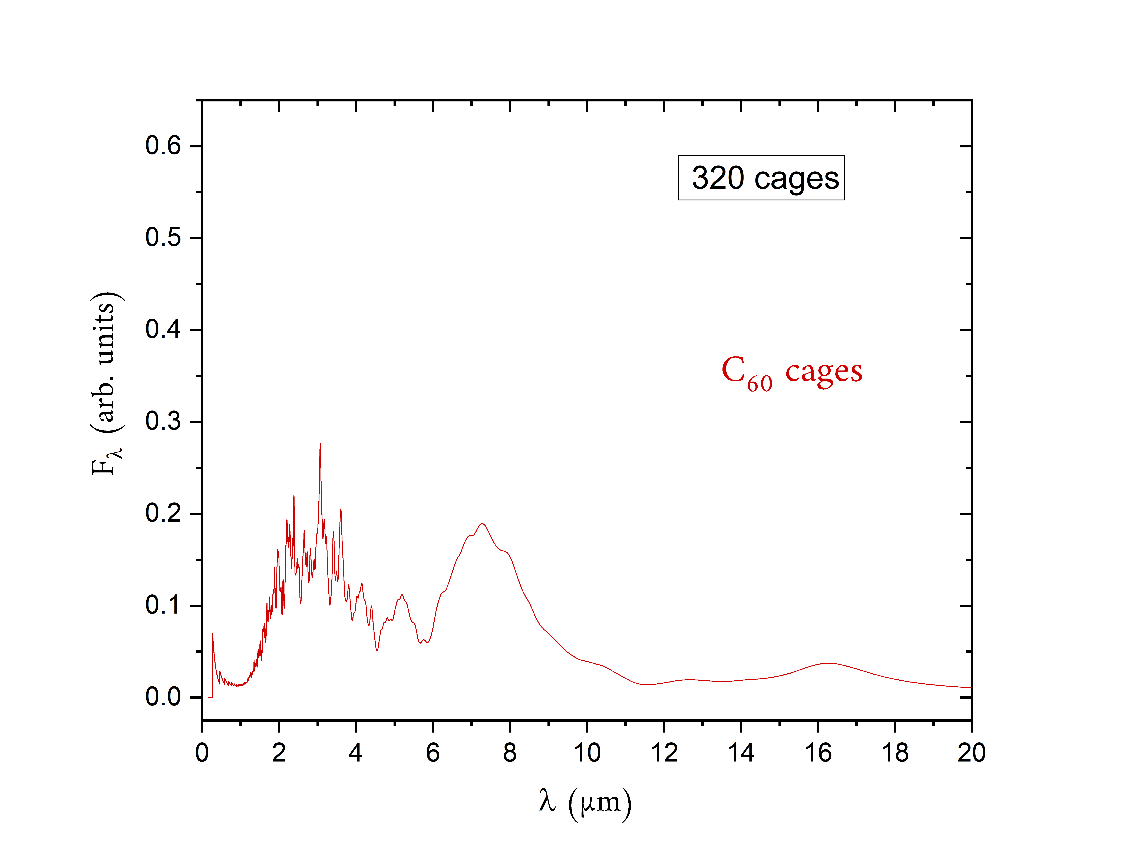
Carbon clusters - Photophysical processes - Modelisation - Results: near-IR emission
Near-IR continuum emission of carbon clusters
Normalized C₆₀ emission intensity induced by irradiation
from a 20 000 K blackbody (star)
Profile of the emission spectra of C₆₀ cages
by increasing the number of clusters
Emission from carbon clusters
should be mainly due to cages
Near-IR emission
Vibrational C≡C stretching
bands emission at 4.75 µm
is not astrophysically
observed

Slide 21
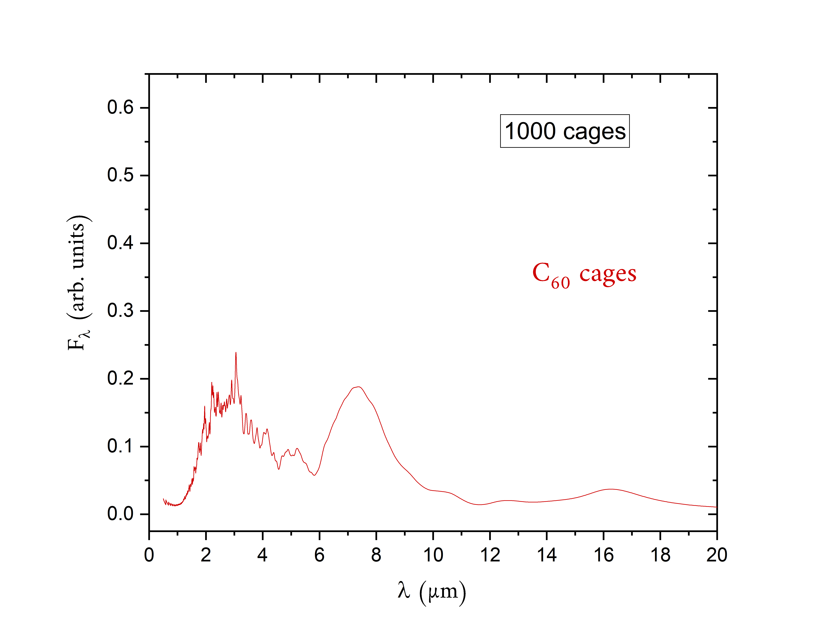
Carbon clusters - Photophysical processes - Modelisation - Results: near-IR emission
Near-IR continuum emission of carbon clusters
Normalized C₆₀ emission intensity induced by irradiation
from a 20 000 K blackbody (star)
Profile of the emission spectra of C₆₀ cages
by increasing the number of clusters
Emission from carbon clusters
should be mainly due to cages
Near-IR emission
Vibrational C≡C stretching
bands emission at 4.75 µm
is not astrophysically
observed

Slide 22
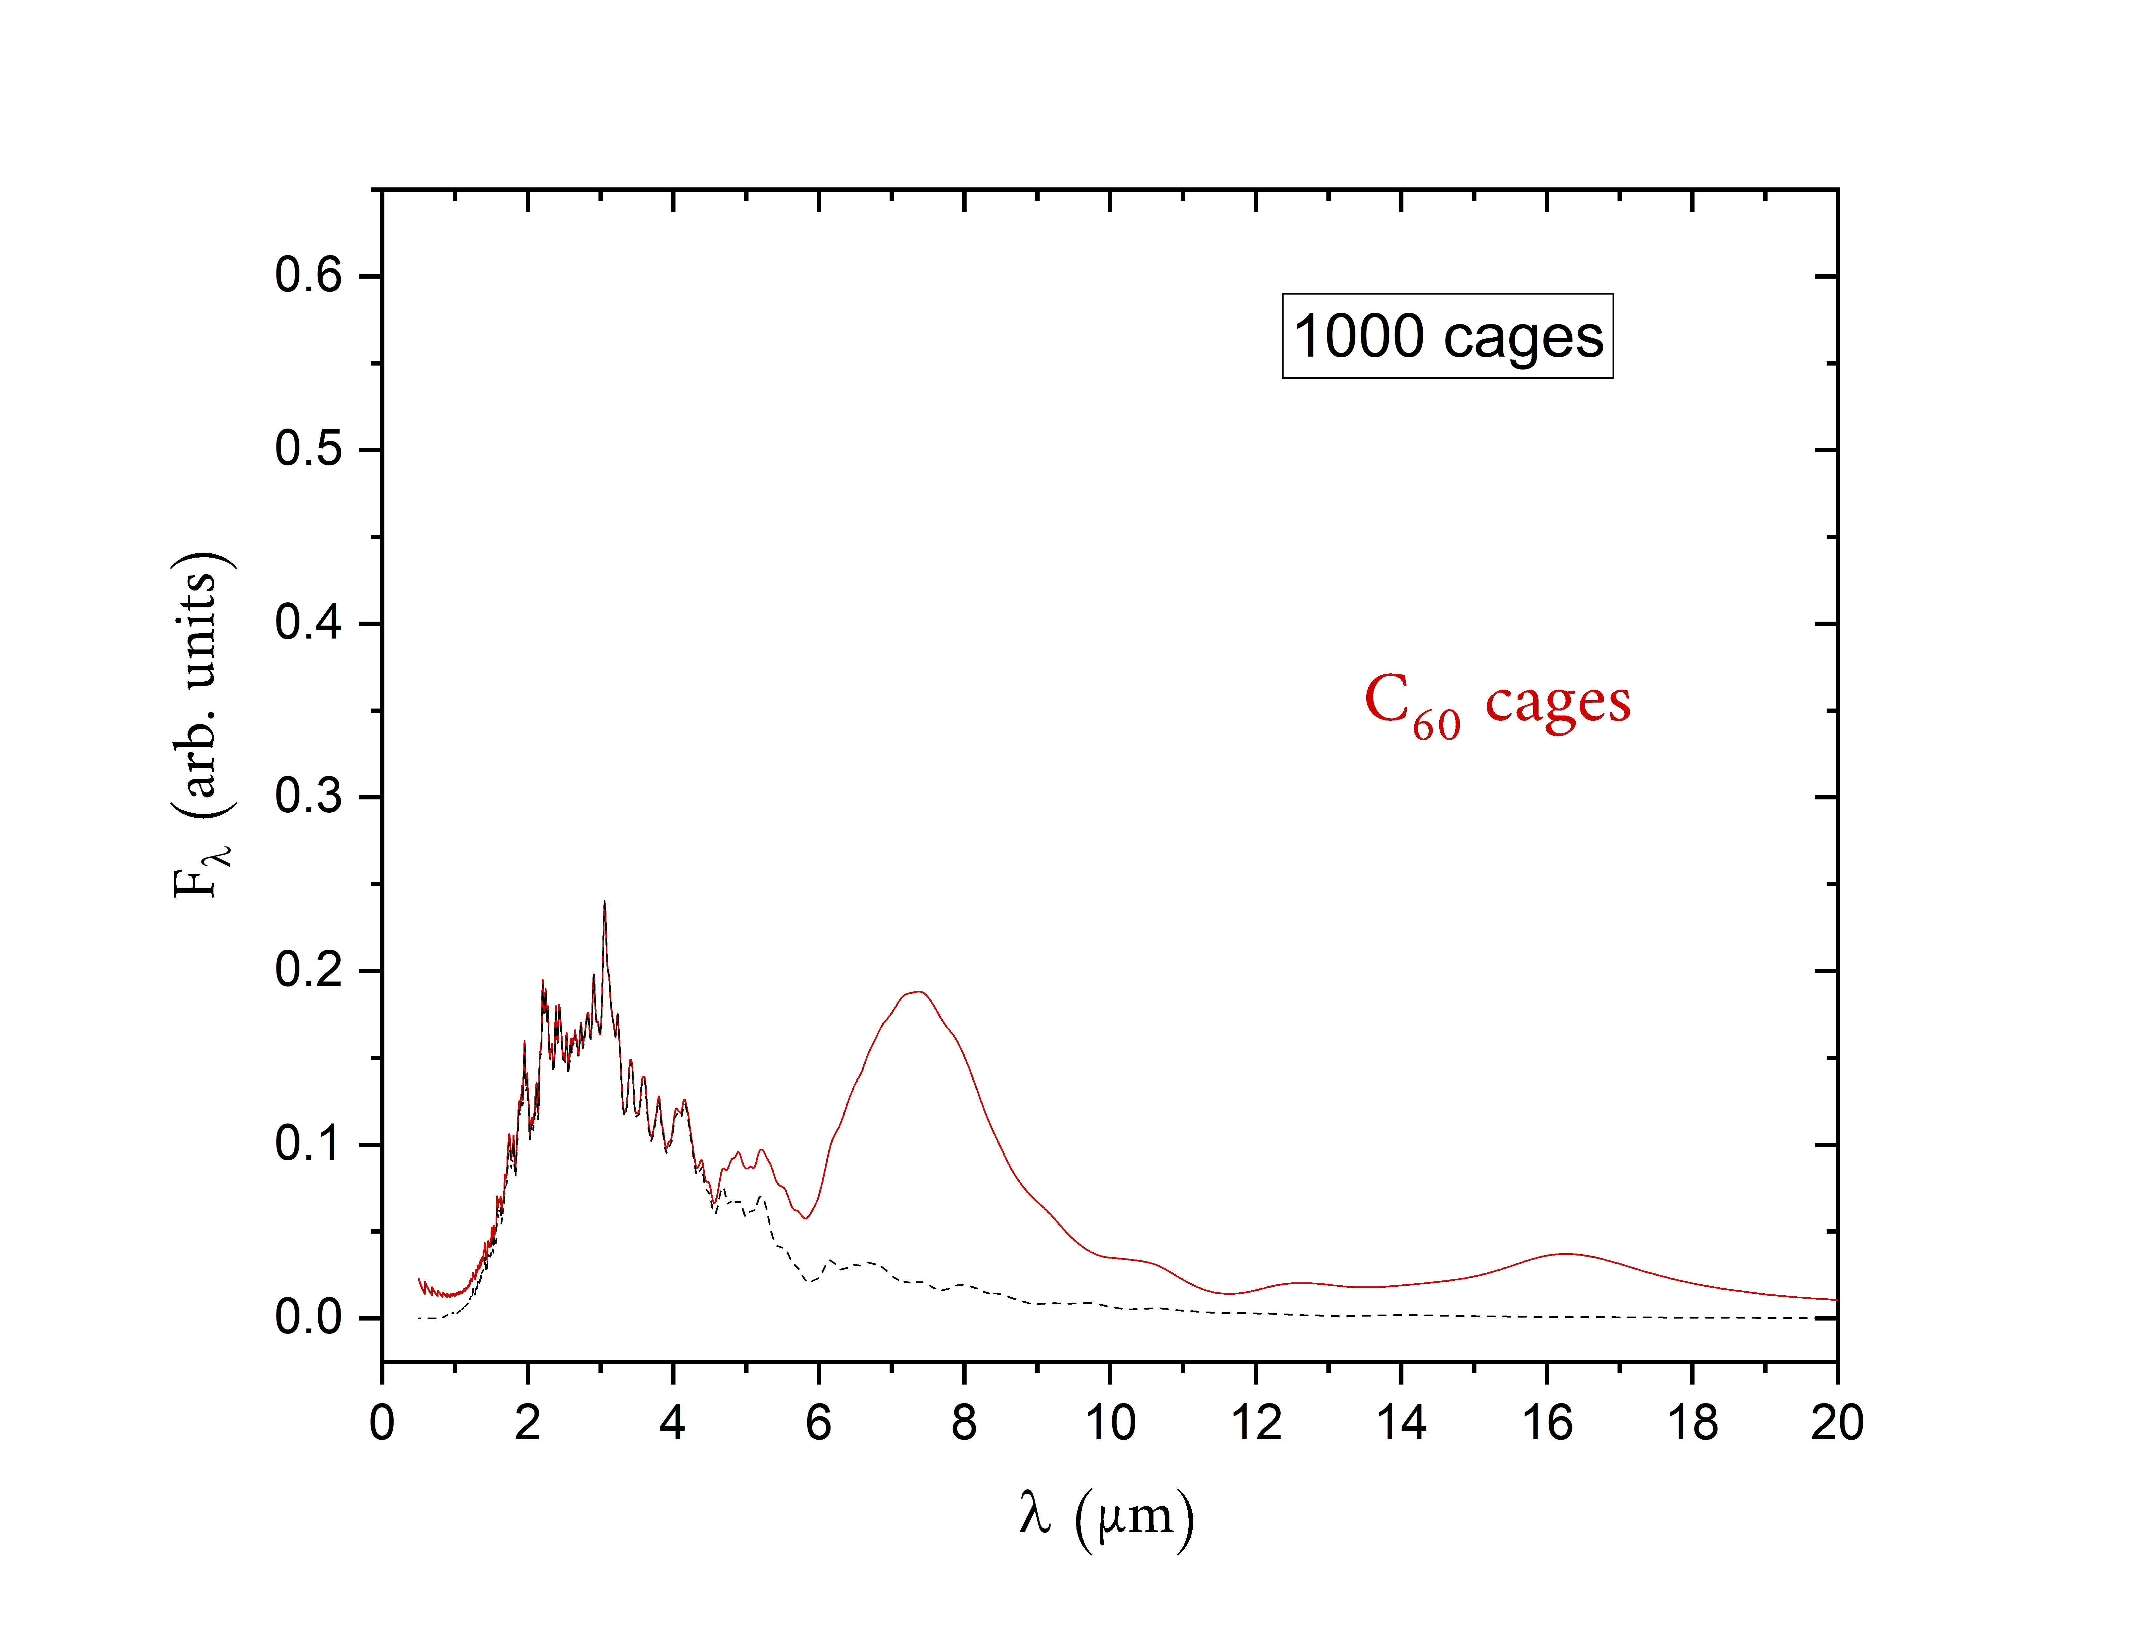
Carbon clusters - Photophysical processes - Modelisation - Results: near-IR emission
Near-IR continuum emission of carbon clusters
Normalized C₆₀ emission intensity induced by irradiation
from a 20 000 K blackbody (star)
Profile of the emission spectra of C₆₀ cages
by increasing the number of clusters
Emission from carbon clusters
should be mainly due to cages
Near-IR emission
Vibrational C≡C stretching
bands emission at 4.75 µm
is not astrophysically
observed

Slide 23
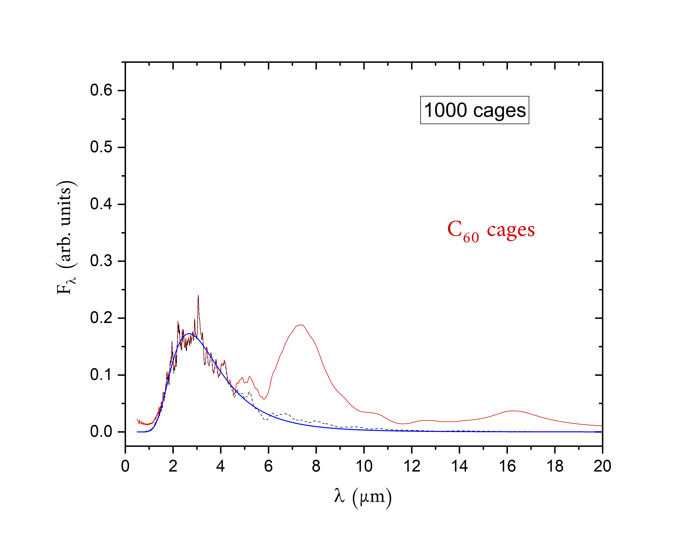
Carbon clusters - Photophysical processes - Modelisation - Results: near-IR emission
Near-IR continuum emission of carbon clusters
Normalized C₆₀ emission intensity induced by irradiation
from a 20 000 K blackbody (star)
Profile of the emission spectra of C₆₀ cages
by increasing the number of clusters
Emission from carbon clusters
should be mainly due to cages
Near-IR emission
Vibrational C≡C stretching
bands emission at 4.75 µm
is not astrophysically
observed

Slide 24
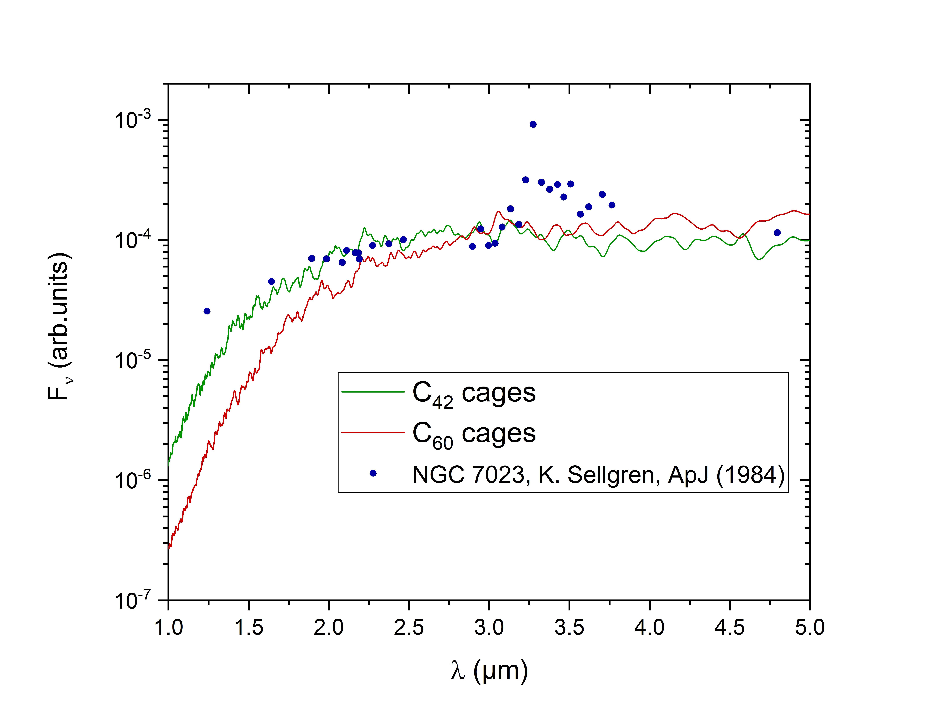
Carbon clusters - Photophysical processes - Modelisation - Results: near-IR emission
Near-IR continuum emission of carbon clusters
Spectral intensity emission from simulation
and NGC 7023 reflection nebulae
K. Sellgren introduced the stochastic heating of « Very Small Grains »
to account for the near-IR continuum emission in NGC 7023
Does the near-IR continuum emission in NGC 7023 due
to recurrent fluorescence from large cage carbon clusters ?
plateau
Spectral
intensity
Near-IR continuum emission in other environments :
Lin49 PN Otsuka et al., MNRAS, 2016
M1-11 PN Otsuka et al., ApJ, 2013
NGC 7727, 2782 Galaxies Onaka et al., ApJ 2018

Slide 25
Carbon clusters - Photophysical processes - Modelisation - Results: near-IR emission
Near-IR continuum emission of carbon clusters
Spectral intensity emission from simulation
and NGC 7023 reflection nebulae
K. Sellgren introduced the stochastic heating of « Very Small Grains »
to account for the near-IR continuum emission in NGC 7023
Does the near-IR continuum emission in NGC 7023 due
to recurrent fluorescence from large cage carbon clusters ?
plateau
If cage carbon clusters are the carriers then
30 ≲ number of carbon atoms ≲ 60
Spectral
intensity
Near-IR continuum emission in other environments :
Lin49 PN Otsuka et al., MNRAS, 2016
M1-11 PN Otsuka et al., ApJ, 2013
NGC 7727, 2782 Galaxies Onaka et al., ApJ 2018
We can estimate carbon clusters abundance
in the observed region

Slide 26
Carbon clusters - Photophysical processes - Modelisation - Results: near-IR emission
Carbon clusters abundance estimation
K. Sellgren’s observation indicates that $F_{ν}^{obs}(2 µm)=6000$ mJy
and our calculation gives $F_{ν}^{th}\left(2 µm\right)=11.6×n_{C60}^{2/3}$ mJy
$$F_{ν}^{obs}\left(2 µm\right)=F_{ν}^{th}(2 µm)$$
Furthermore,
$n_{H} \sim {10}^{5} {cm}^{−3}$ P. Martini et al., ApJ (1999)
$n_{Carbone}=2.4∙{10}^{−4} n_{H}$ J. Cardelli et al., ApJ (1996)
$C_{60}^{}$ Buckminsterfullerene
in NGC 7023:
0.1 – 0.6 %
K.Sellgren et al., ApJ (2010)
1% of interstellar carbon of the observed region is locked up in $C_{60}$ cages

Slide 27
Carbon clusters - Photophysical processes - Modelisation - Results: near-IR emission
Carbon clusters abundance estimation
K. Sellgren’s observation indicates that $F_{ν}^{obs}(2 µm)=6000$ mJy
and our calculation gives $F_{ν}^{th}\left(2 µm\right)=11.6×n_{C60}^{2/3}$ mJy
$$F_{ν}^{obs}\left(2 µm\right)=F_{ν}^{th}(2 µm)$$
Furthermore,
$n_{H} \sim {10}^{5} {cm}^{−3}$ P. Martini et al., ApJ (1999)
$n_{Carbone}=2.4∙{10}^{−4} n_{H}$ J. Cardelli et al., ApJ (1996)
$C_{60}^{}$ Buckminsterfullerene
in NGC 7023:
0.1 – 0.6 %
K.Sellgren et al., ApJ (2010)
1% of interstellar carbon of the observed region is locked up in $C_{60}$ cages
0.5% of interstellar carbon of the observed region locked up in $C_{42}$ cages

Slide 28
Carbon clusters - Photophysical processes - Modelisation - Results: near-IR emission
Carbon clusters abundance estimation
K. Sellgren’s observation indicates that $F_{ν}^{obs}(2 µm)=6000$ mJy
and our calculation gives $F_{ν}^{th}\left(2 µm\right)=11.6×n_{C60}^{2/3}$ mJy
$$F_{ν}^{obs}\left(2 µm\right)=F_{ν}^{th}(2 µm)$$
Furthermore,
$n_{H} \sim {10}^{5} {cm}^{−3}$ P. Martini et al., ApJ (1999)
$n_{Carbone}=2.4∙{10}^{−4} n_{H}$ J. Cardelli et al., ApJ (1996)
Size distribution: carbon clusters should mainly contain between 30 and 60 carbon atoms
(0.5-1% of interstellar carbon locked up)
$C_{60}^{}$ Buckminsterfullerene
in NGC 7023:
0.1 – 0.6 %
K.Sellgren et al., ApJ (2010)
1% of interstellar carbon of the observed region is locked up in $C_{60}$ cages
0.5% of interstellar carbon of the observed region locked up in $C_{42}$ cages

Slide 29
Carbon clusters - Photophysical processes - Modelisation - Results: near-IR emission
Conclusion
The near-IR emission in NGC 7023 could be due to recurrent fluorescence from ~ C₃₀-C₆₀ large carbon clusters
Individual carbon clusters emit a molecular emission spectrum. However, the collective emission spectra is a blackbody-like emission spectrum
Recurrent fluorescence has an influence on vibrational band ratios
Recurrent fluorescence from carbon clusters cannot account for the Extended Red Emission
In the future: Recurrent fluorescence from large PAH species and correlation with AIBs.
Lacinbala et al. J. Chem. Phys. 2022

Slide 30
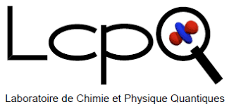
Université de Toulouse:
Aude Simon
Mathias Rapacioli
Université Grenoble-Alpes:
Florent Calvo
PhD Supervisor: Thomas Pino
Université Paris-Saclay:
Pascal Parneix
Cyril Falvo
Emmanuel Dartois
Western Ontario University:
Jan Cami
ANR PACHYNO

Slide 31
Introduction - Photophysical processes - ISM context - Temperature fixed context - Conclusion
RF and VE - Rate expressions - kinetic MC
Kinetic Monte Carlo method (2)
Probability distribution of time duration $τ$ between two successive events:
At each kinetic Monte Carlo step, the time duration $τ$is also randomly selected.
$P\left(τ;E\right)=k(E)e^{−k(E)τ}$
$$k(E)=\sum_{i ∈ all pathways}{k_{i}(E)}$$
with
Vibrational de-excitation
Recurrent fluorescence
Isomerization
Dissociation
This gives the kinetics of the relaxation

Slide 32
Introduction - Photophysical processes - ISM context - Temperature fixed context - Conclusion
RF and VE - Rate expressions - kinetic MC
Monte Carlo method
$$Σ(E)$$
$$k_{1}(E)$$
Emitted photons:
$$⋱$$
$$⋱$$
$$k_{i}(E)$$
$$k_{N}(E)$$

Slide 33
Introduction - Photophysical processes - ISM context - Temperature fixed context - Conclusion
RF and VE - Rate expressions - kinetic MC
Monte Carlo method
$$Σ(E)$$
$$k_{1}(E)$$
Emitted photons:
$$⋱$$
$$⋱$$
$$hν_{i}$$
$$k_{i}(E)$$
$$k_{N}(E)$$
$$Σ(E−hν_{i})$$
Randomly selected

Slide 34
Introduction - Photophysical processes - ISM context - Temperature fixed context - Conclusion
RF and VE - Rate expressions - kinetic MC
Monte Carlo method
$$Σ(E)$$
$$k_{1}(E)$$
Emitted photons:
$$⋱$$
$$⋱$$
$$hν_{i}$$
$$hν_{j}$$
$$k_{i}(E)$$
$$k_{N}(E)$$
$$Σ(E−hν_{i})$$
$$k_{1}(E−hν_{i})$$
$$⋱$$
$$⋱$$
Randomly selected
$$k_{j}(E−hν_{i})$$
$$k_{N}(E−hν_{i})$$
Randomly selected

Slide 35
Introduction - Photophysical processes - ISM context - Temperature fixed context - Conclusion
RF and VE - Rate expressions - kinetic MC
Monte Carlo method
$$Σ(E)$$
$$k_{1}(E)$$
Emitted photons:
$$⋱$$
$$⋱$$
$$hν_{i}$$
$$hν_{j}$$
etc
$$⋮$$
$$k_{i}(E)$$
1 MC trajectory
$$k_{N}(E)$$
$$Σ(E−hν_{i})$$
$$k_{1}(E−hν_{i})$$
$$⋱$$
$$⋱$$
Randomly selected
$$k_{j}(E−hν_{i})$$
$$k_{N}(E−hν_{i})$$
etc…
Randomly selected
until there is no more internal energy

Slide 36
Introduction - Photophysical processes - ISM context - Temperature fixed context - Conclusion
RF and VE - Rate expressions - kinetic MC
Monte Carlo method
$$Σ(E)$$
$$k_{1}(E)$$
Emitted photons:
$$⋱$$
$$⋱$$
$$hν_{i}$$
$$hν_{j}$$
etc
$$⋮$$
$$k_{i}(E)$$
1 MC trajectory
$$k_{N}(E)$$
$$Σ(E−hν_{i})$$
$$k_{1}(E−hν_{i})$$
$$⋱$$
$$⋱$$
Randomly selected
${10}^{5}$ trajectories
$$k_{j}(E−hν_{i})$$
$$k_{N}(E−hν_{i})$$
etc…
emission spectrum resulting from the relaxation cascade
Randomly selected
until there is no more internal energy

Slide 37
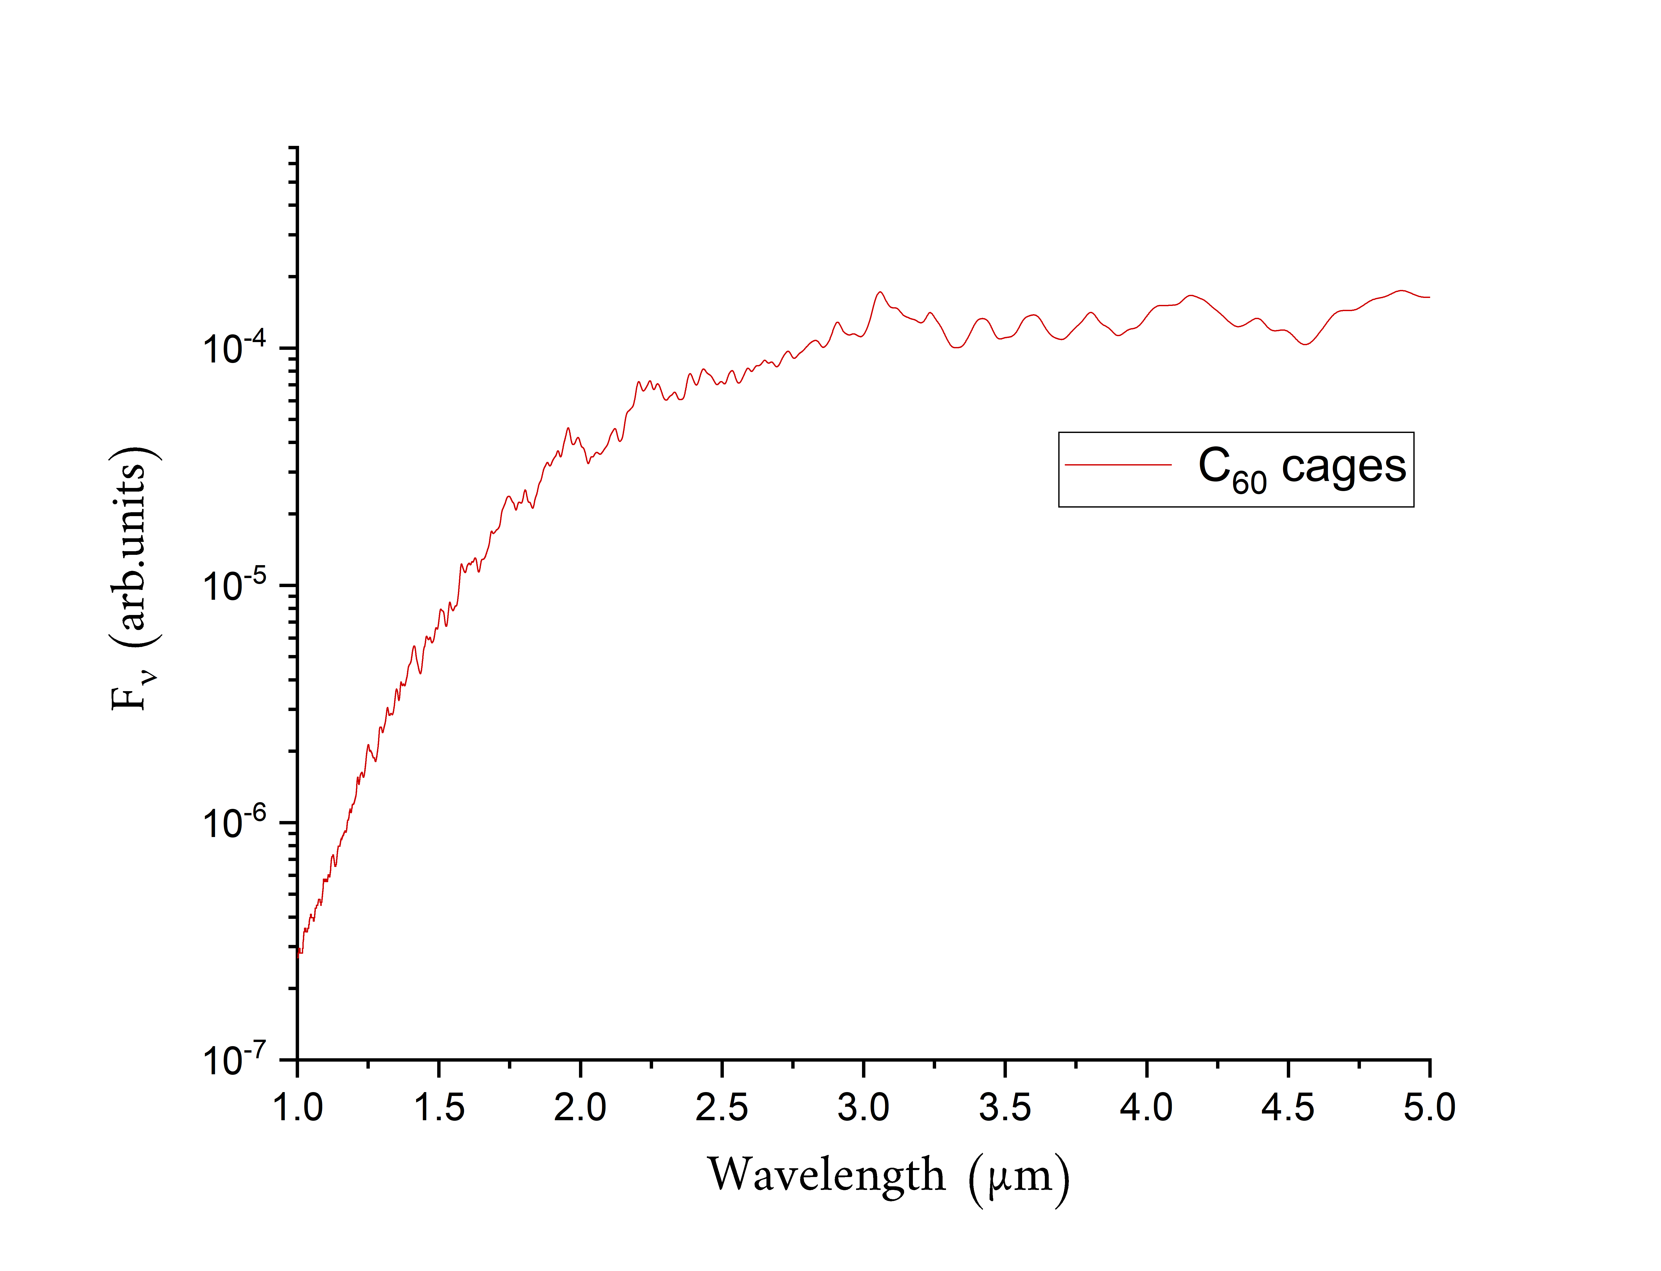
Carbon clusters - Photophysical processes - Modelisation - Results: near-IR emission
Carbon clusters abundance estimation
$$\int{F_{ν}dν=1}$$
K. Sellgren’s observation indicates that $F_{ν}^{obs}(2 µm)=6000$ mJy
and our calculation gives $F_{ν}^{th}\left(2 µm\right)=11.6×n_{C60}^{2/3}$ mJy
$$4∙{10}^{−5}$$
$$F_{ν}^{obs}\left(2 µm\right)=F_{ν}^{th}(2 µm)$$
$n_{C_{60}}=1.2∙{10}^{−2}$ cm⁻³
Furthermore,
$n_{H} \sim {10}^{5} {cm}^{−3}$ P. Martini et al., ApJ (1999)
$n_{Carbone}=2.4∙{10}^{−4} n_{H}$ J. Cardelli et al., ApJ (1996)
Spectral
intensity
Size distribution: carbon clusters should mainly contain between
30 and 60 carbon atoms (1-3% of interstellar carbon locked up)
$C_{60}^{}$ Buckminsterfullerene
in NGC 7023:
0.1 – 0.6 %
K.Sellgren et al., ApJ (2010)
3% of interstellar carbon of the observed region is locked up in $C_{60}$ cage isomers
2.5% of interstellar carbon of the observed region locked up in $C_{42}$ cage isomers

