Slide 1

Cosmic dust might condense less gas than previously thought
A laboratory study of the sticking coefficients of ice on small-grain analogues
C. Laffon
O. Grauby
D. Ferry
Ph. Parent*
Aix Marseille Univ, CNRS, CINaM, Marseille, France
*philippe.parent@univ-amu.fr

Slide 2

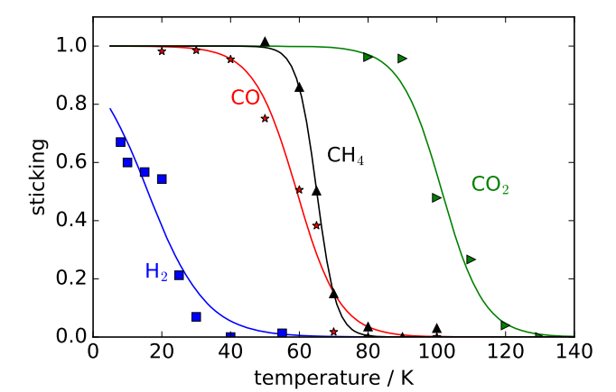
H₂O
In astrochemistry, gas-grain interactions are modeled using S=1
Silicate (olivine)
Carbon
T< 20 K
He 2016
S_{A}= Sticking coefficient of A
Number of adsorbed A / Number of available sites per surface unit (10¹⁵ cm⁻²)

Slide 3
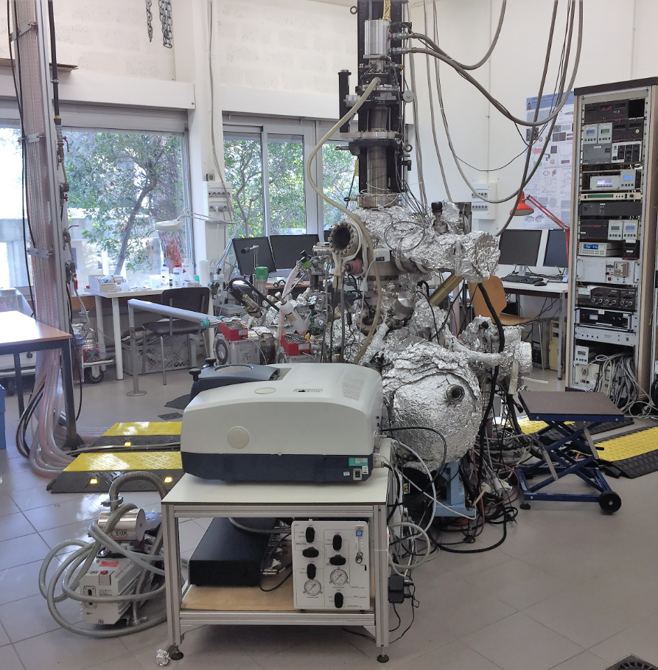
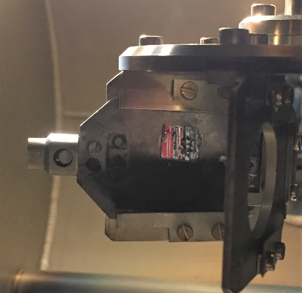
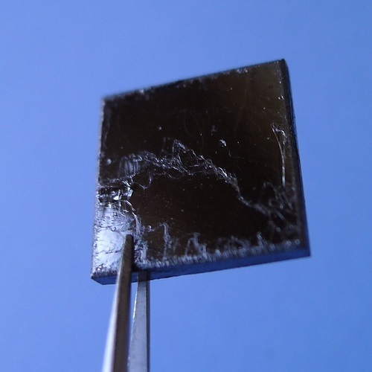
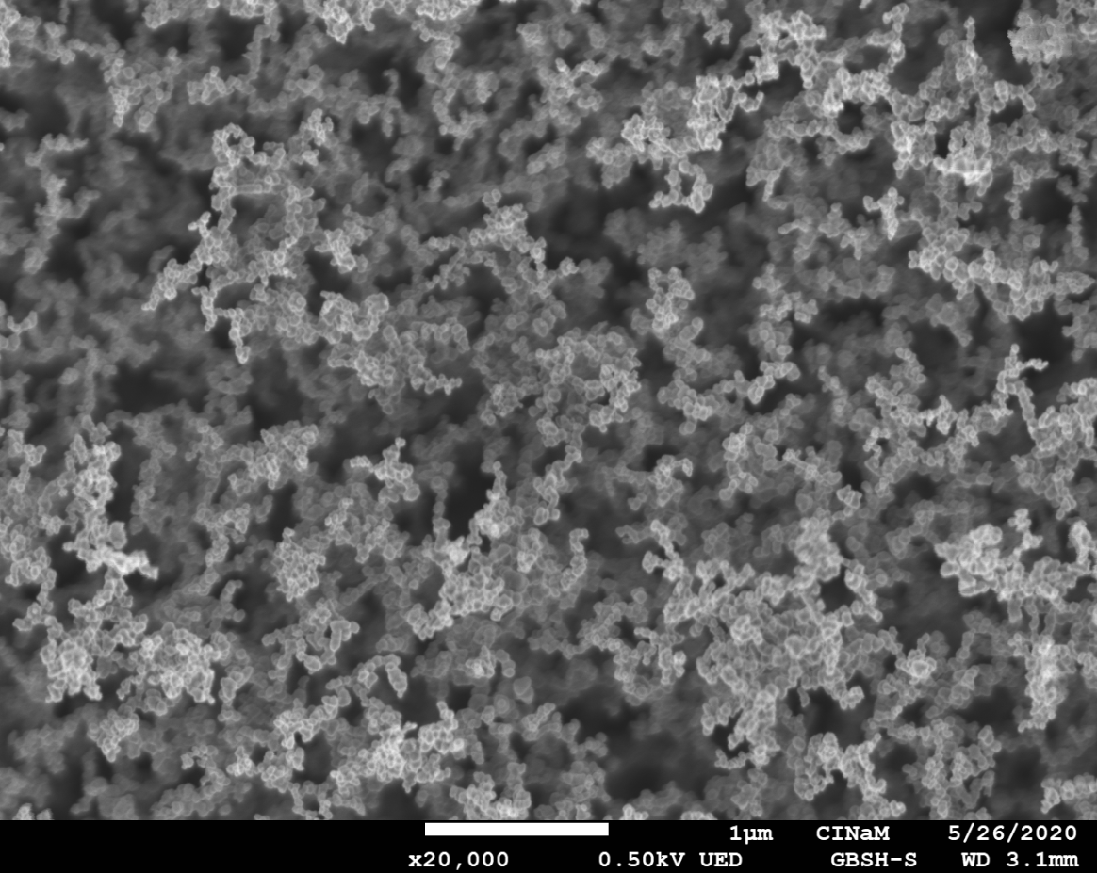
X-ray photoelectron spectroscopy XPS
SUMO ; CINaM, Marseille
H₂O or
CO₂ ice
Cooled substrate
Graphite
Carbon NP (soot)

Slide 4
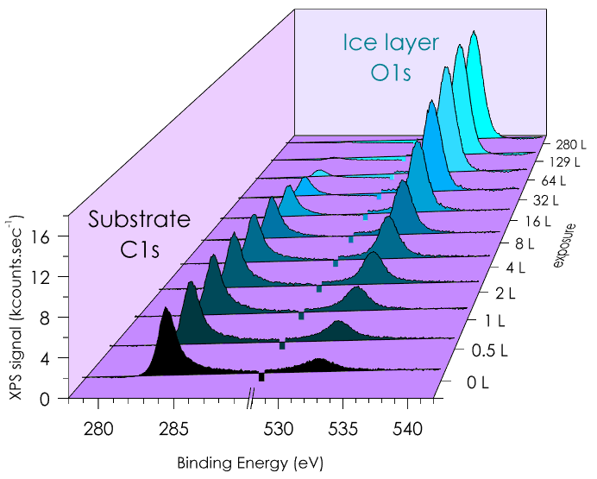
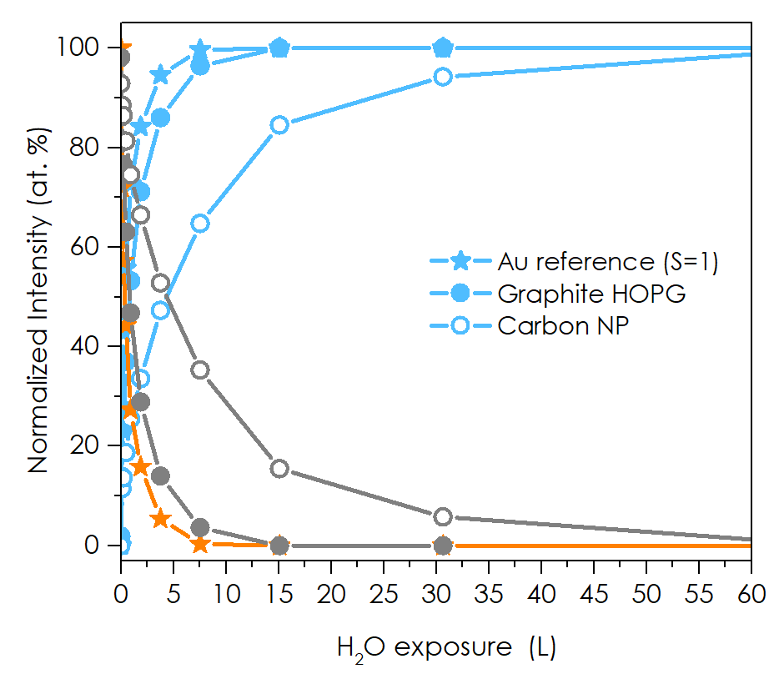
Typical XPS experiment
Data analysis

Slide 5
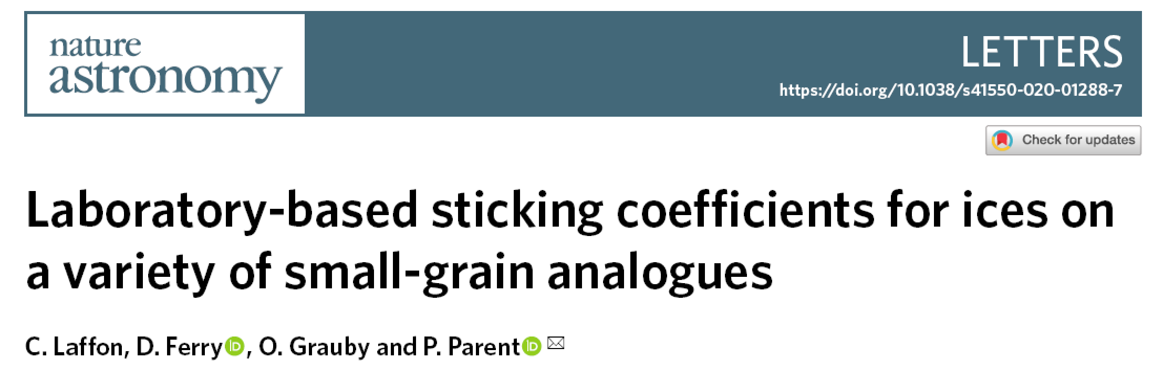
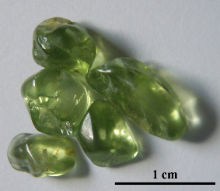

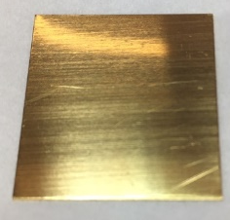
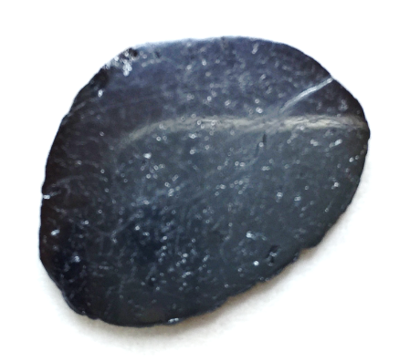
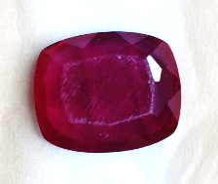
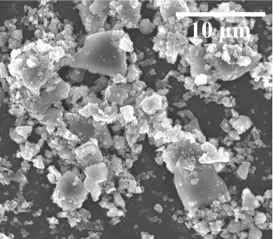
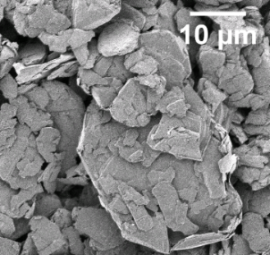
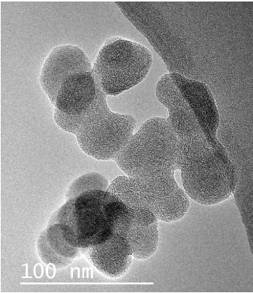
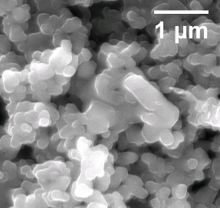
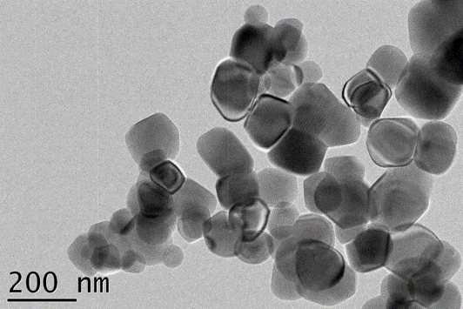
Nature Astronomy | VOL 5 | May 2021 | 445–450 |
Olivine
Carbon (graphite HOPG)
Au foil (reference)
TiO₂ rutile
Al₂O₃
Olivine NP 0.3 µm-1 µm
Carbon µP 4 µm
Carbon nP (soot)
0.10-0.02 µm
TiO₂ NP 0.24 µm
Al₂O₃ NP 0.24 µm

Slide 6
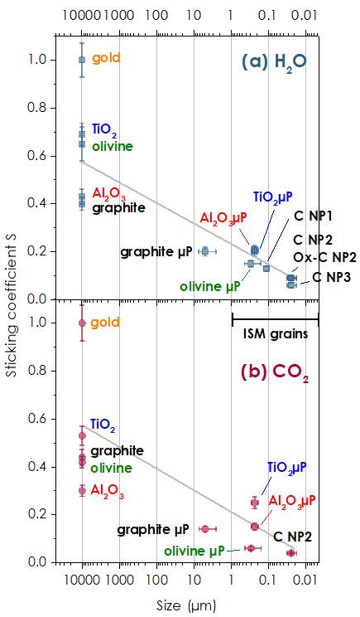
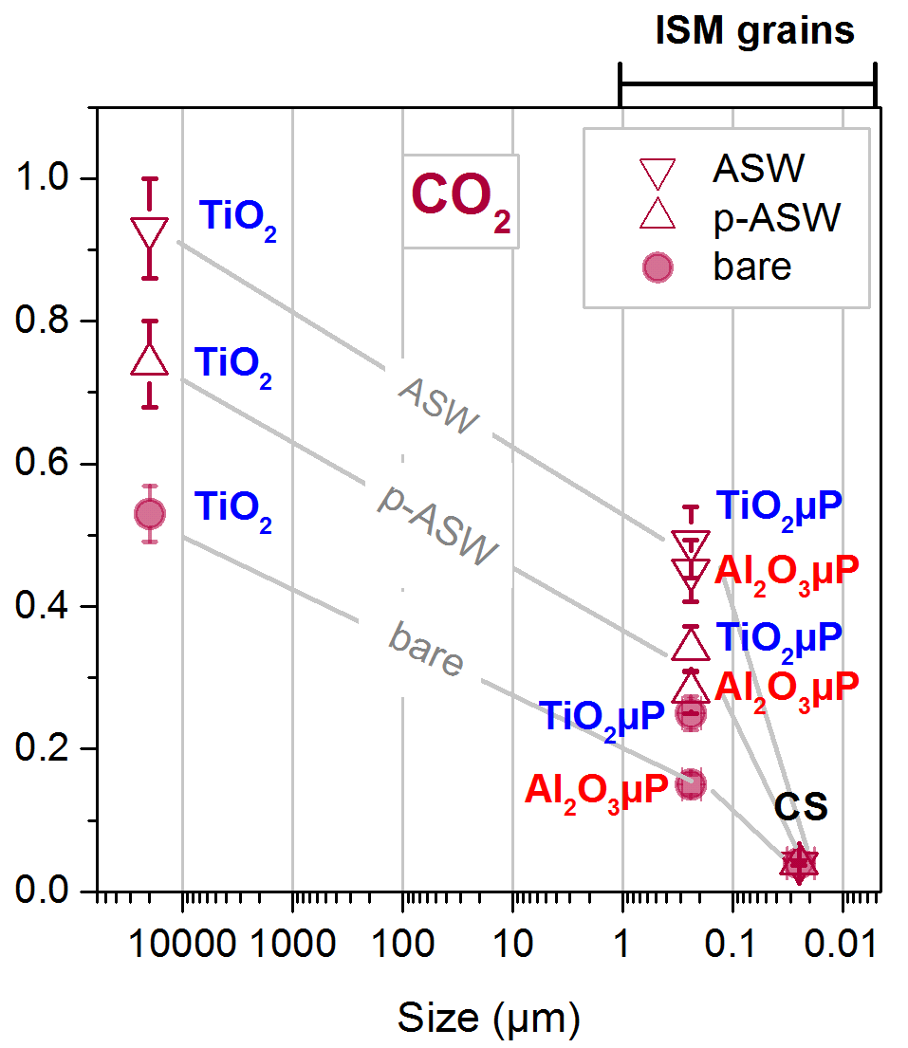
H₂O
CO₂ on grains pre-covered with H₂O ice
(3 ML porous or non-porous
amorphous solid water (p-ASW or ASW))
H₂O on bare grains
CO₂
CO₂
CO₂ on bare grains

Slide 7
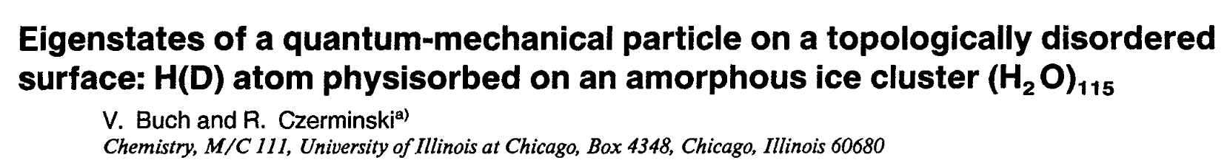
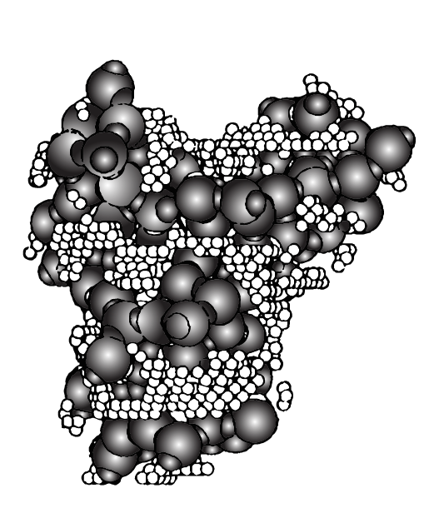
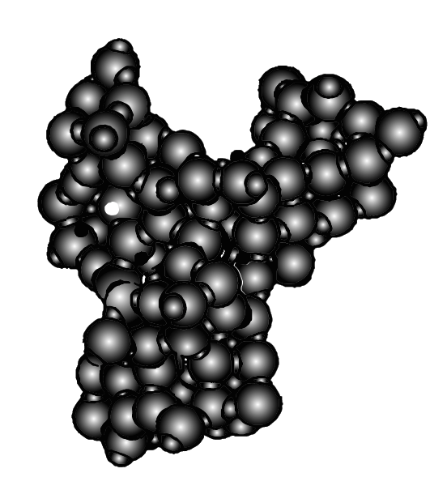
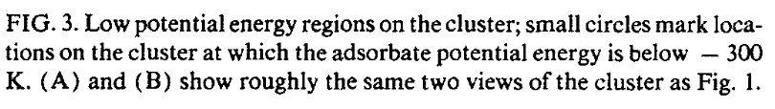
Capillary condensation
at the nanoscale
10 Å

Slide 8
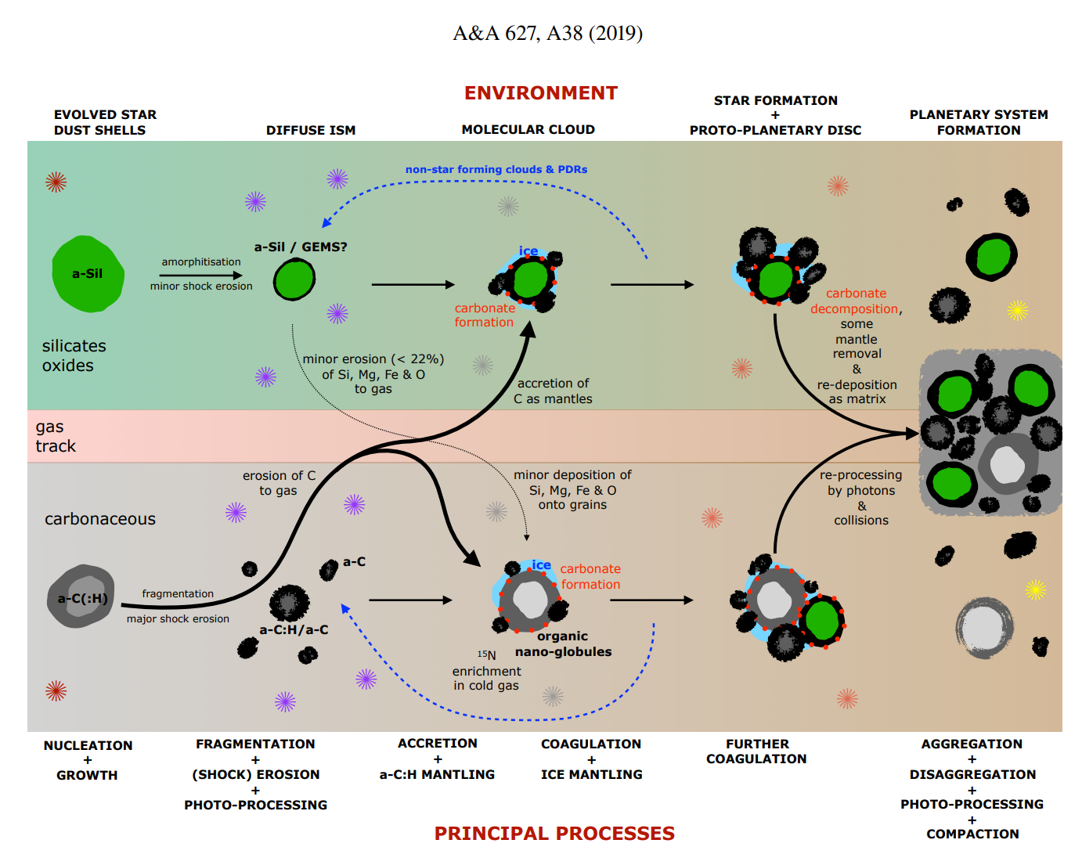
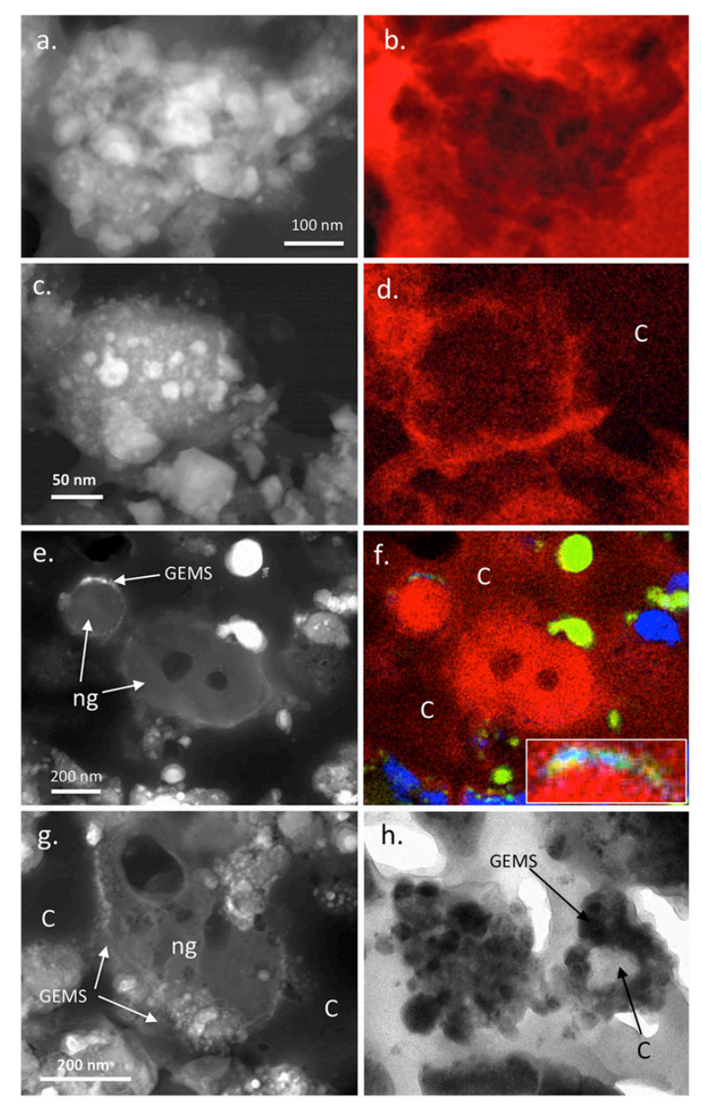
IDPs : Ishii 2018

Slide 9
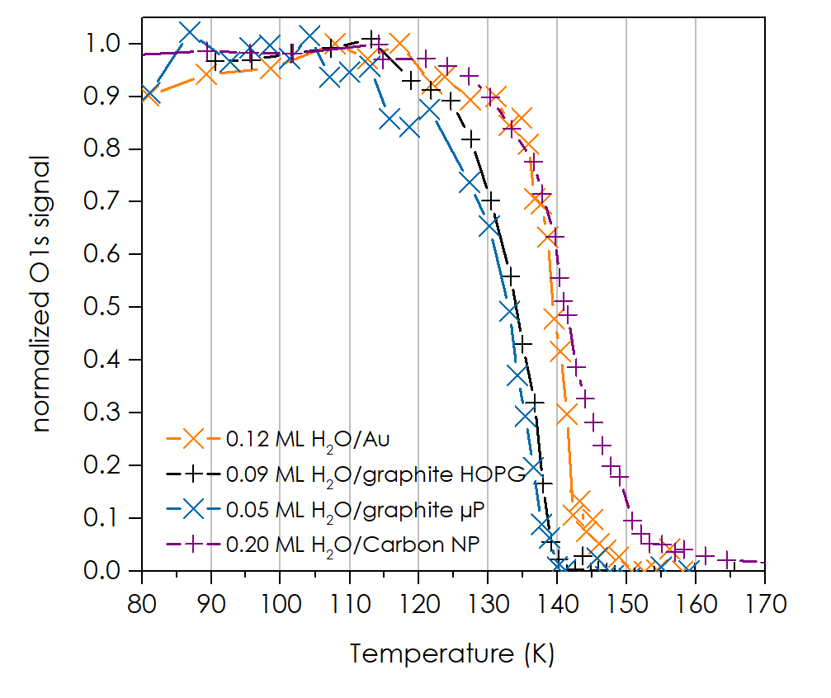
Desorption temperature

Slide 10
CONCLUSIONS
S for H₂O and CO₂
The chemical nature of the gas phase species doesn’t seem critical
(excepted for H and H₂)
1.0
0.9
0.8
0.7
0.6
0.5
0.4
0.3
0.2
0.1
0
Bare/icy grains < 0.1 µm
(and agreggates of them)
Grain composition doesn’t matter
Bare grains
> 0.1 µm
Bare Au
ice/flat substrate
Flat surfaces of graphite, olivine
(favorite laboratory astrochemist’s substrates)
Icy grains > 0.1 µm
1- S ≠ 1 on realistic grains. Gas-grain reaction rates and accretion rates should be revised accordingly
2- Gas phase species can coexist with dust grains at temperature below their snowline (only partly frozen)!
3- The snowline temperature is independant of dust size

