Slide 1
The chemical composition of cold dark clouds
M. Agúndez, C. Cabezas, N. Marcelino, E. Roueff,
R. Fuentetaja, B. Tercero, P. de Vicente, and J. Cernicharo

Slide 2
astromol (McGuire et al.; august 2022 + updates)

Slide 3
astromol (McGuire et al.; august 2022 + updates)

Slide 4
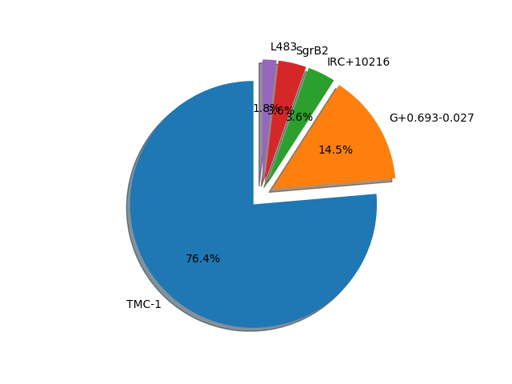
Detections in 2021-2022 by source

Slide 5
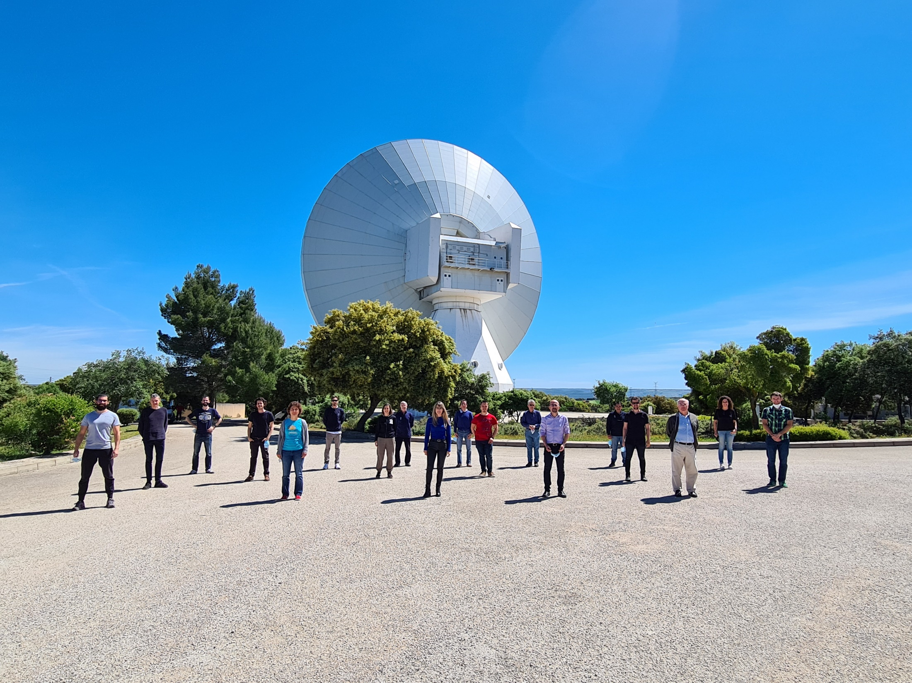
The QUIJOTE line survey of TMC-1 with the Yebes 40m telescope
Pepe Cernicharo
Belén Tercero
Carlos Cabezas
Núria Marcelino
Raúl Fuentetaja
Marcelino Agúndez
Juan Ramón Pardo
Pablo de Vicente
Félix Tercero
Juan Daniel Gallego
José Antonio López Pérez
Evelyne Roueff
Ralf Kaiser
Jean-Christophe Loison
Yasuki Endo
Laurent Margulès
Stephane Bailleux

Slide 6
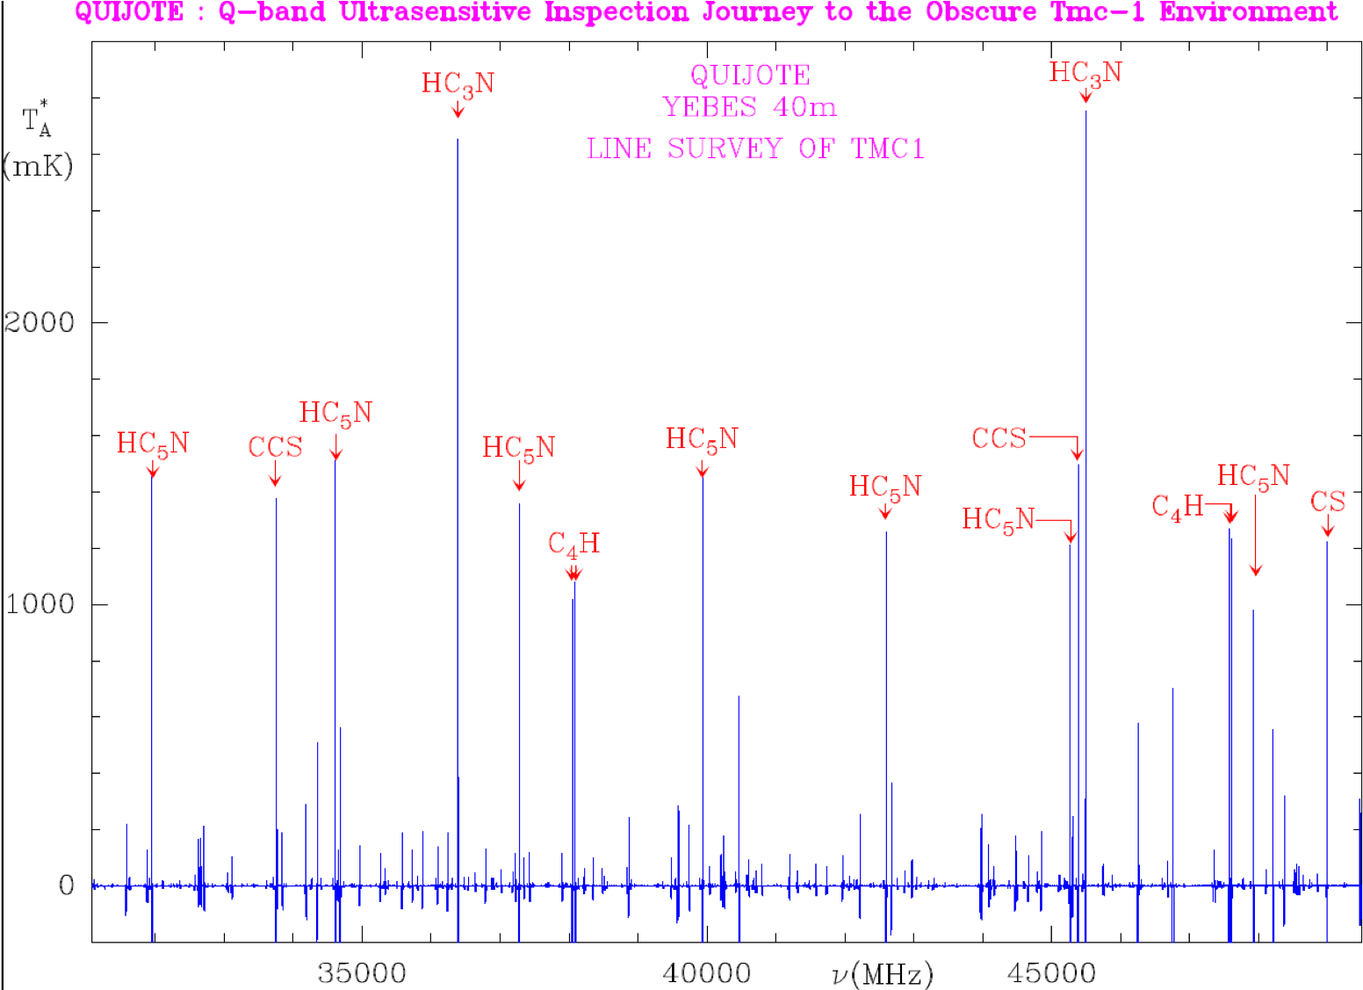
TMC-1 in the Q band (31-50 GHz)
only 22 lines
above 400 mK

Slide 7
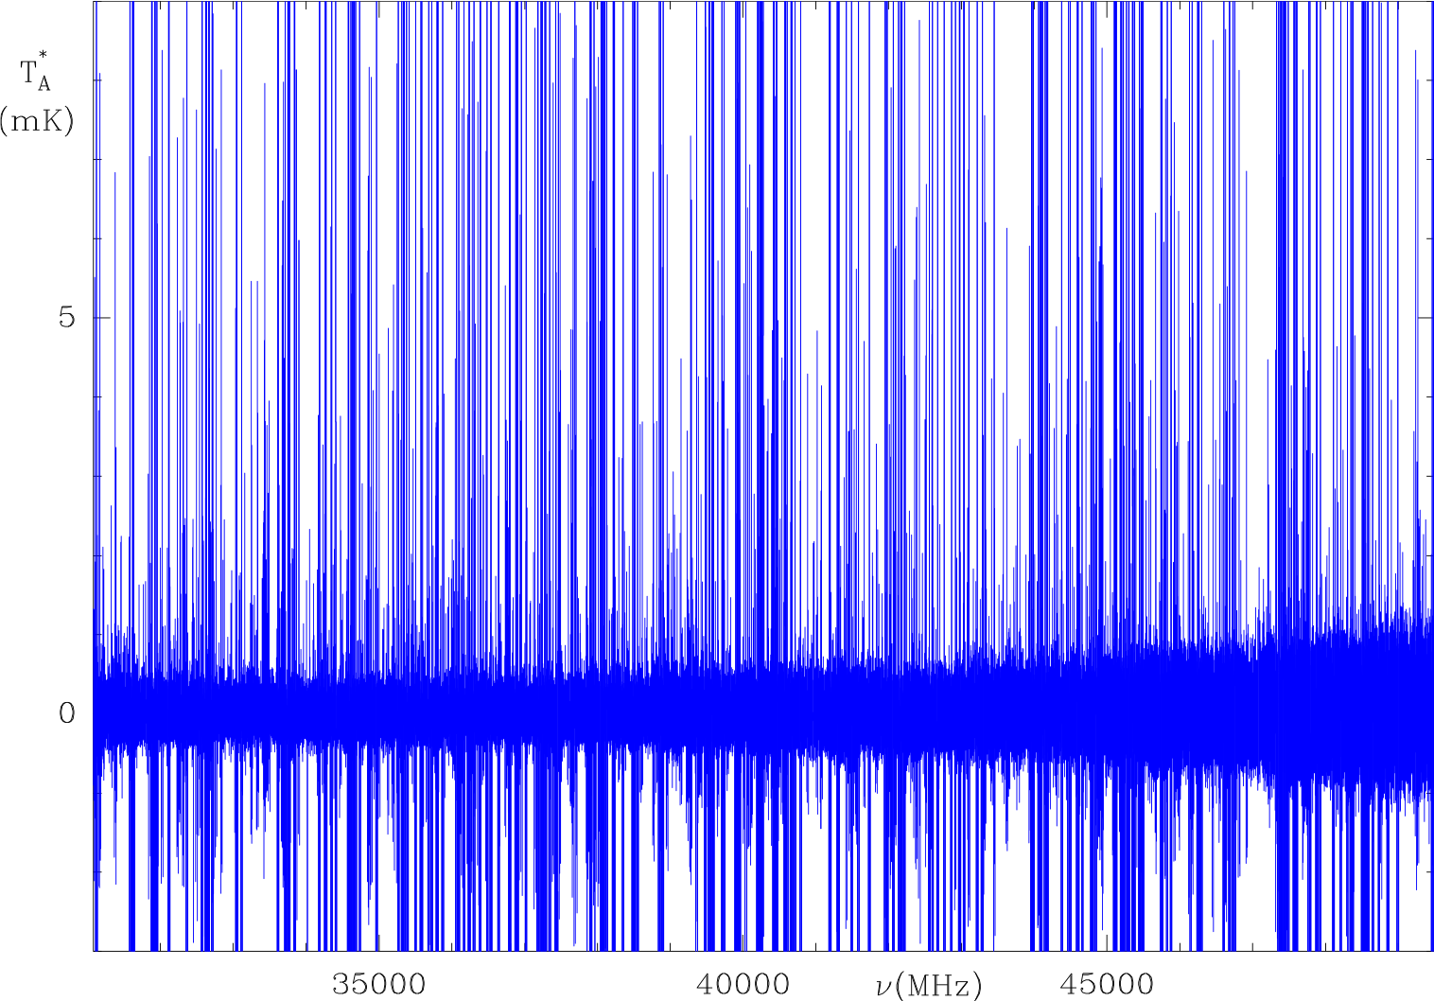
A forest of lines at the mK level
Most lines
above 2 mK
identified
Most lines
below 2 mK
unidentified

Slide 8
The noise level
Noise level by
January 2022
On-going Project:
The goal is to go
below 0.1 mK
by winter 2024

Slide 9
Protonated molecules
46 molecules discovered in 2020-2022 in TMC-1
(QUIJOTE + GOTHAM)
N-bearing molecules
HC₄NC, HCCCH₂CN, CH₂C₃N, HCCCHCHCN, H₂CCHC₃N, CH₂CCHC₃N, HC₁₁N
O-bearing molecules
HC₃O, C₅O
S-bearing molecules
NCS, HCCS, H₂CCS, H₂CCCS, C₄S, HCSCN, HCSCCH
Protonated molecules
HC₅NH⁺, HC₃O⁺, HC₃S⁺, CH₃CO⁺, HCCS⁺, C₅H⁺, HC₇NH⁺, HCCNCH⁺
Hydrocarbons (some CN-substituted)
H₂C₅, C₃H₅CN, CH₂CCHC₄H
c-C₅H, c-C₃HCCH
CH₂CCH
CH₂CHCCH, CH₂CCHCCH
c-C₆H₄
c-C₅H₆, c-C₅H₄CCH₂, c-C₅H₅CN, c-C₅H₅CCH
c-C₉H₈, c-C₁₀H₇CN
Spectroscopy in space: the case of H₂NC
Hydrocarbons

Slide 10
1
Protonated molecules

Slide 11

Protonated molecules
k_{PT}
XH⁺ + M → MH⁺ + X main formation of MH⁺ (proton transfer)
k_{DR}
MH⁺ + e⁻ → products main destruction of MH⁺ (dissociative recombination)
at steady state:
proton affinity of M →  number of proton donors →  [MH⁺]/[M]

Slide 12
Situation by 2015
Agúndez et al. (2015); discovery of NCCNH⁺

Slide 13
Situation by 2022 (after QUIJOTE)
Agúndez et al. (2022); after the discovery of HCCNCH⁺

Slide 14
Situation by 2022 (after QUIJOTE)
observed
calculated
Agúndez et al. (2022)

Slide 15
Protonated molecules
A⁺ + B → MH⁺ + C other ion-neutral formation routes
k_{PT}
XH⁺ + M → MH⁺ + X main formation of MH+ (proton transfer)
k_{DR}
MH⁺ + e⁻ → products main destruction of MH+ (dissociative recombination)
Current chemical networks underestimate [MH⁺]/[M] ratios
Missing ion-neutral reactions ?

Slide 16
2
Spectroscopy in space: the case of H₂NC

Slide 17
15 molecules detected without previous laboratory data since 2019
MgC₃N IRC+10216 Cernicharo et al. (2019), A&A, 630, L2
MgC₄H IRC+10216 Cernicharo et al. (2019), A&A, 630, L2
HC₃O⁺ TMC-1 *** Cernicharo et al. (2020), A&A, 642, L17
HC₅NH⁺ TMC-1 Marcelino et al. (2020), A&A, 643, L6
HDCCN TMC-1 Cabezas et al. (2021), A&A, 646, L1
HC₃S⁺ TMC-1 *** Cernicharo et al. (2021), A&A, 646, L3
CH₃CO⁺ TMC-1 *** Cernicharo et al. (2021), A&A, 646, L7
MgC₅N IRC+10216 Pardo et al. (2021), A&A, 652, L13
MgC₆H IRC+10216 Pardo et al. (2021), A&A, 652, L13
CH₂DC₃N TMC-1 Cabezas et al. (2021), A&A, 650, L15
H₂NC L483 Cabezas et al. (2021), A&A, 654, A45
HCCS⁺ TMC-1 Cabezas et al. (2022), 657, L4
C₅H⁺ TMC-1 Cernicharo et al. (2022), A&A, 657, L16
HC₇NH⁺ TMC-1 Cabezas et al. (2022), A&A, 659, L8
HCCNCH⁺ TMC-1 Agúndez et al. (2022), A&A, 659, L9

Slide 18
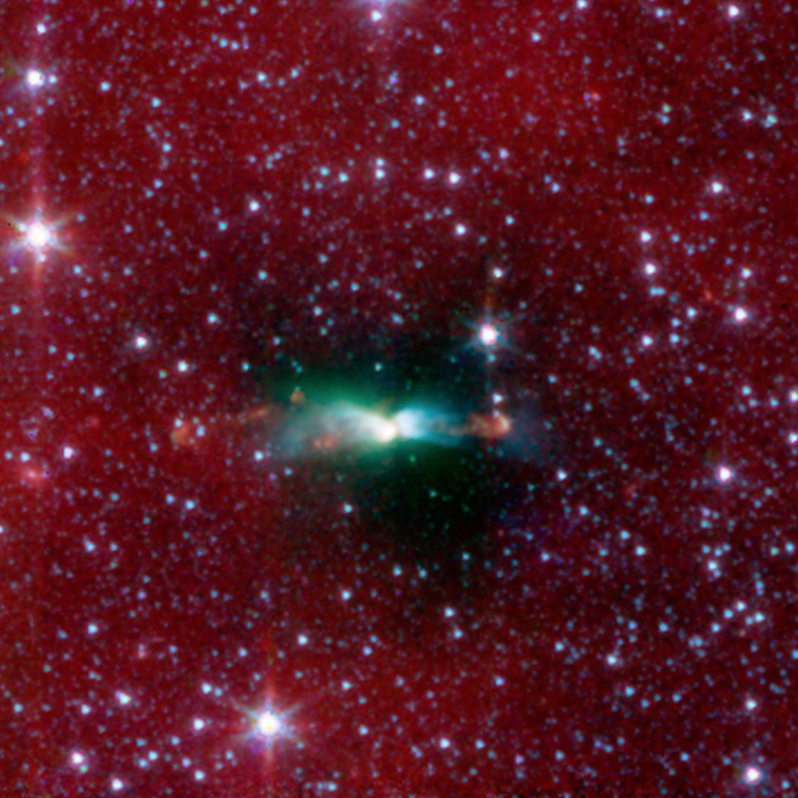
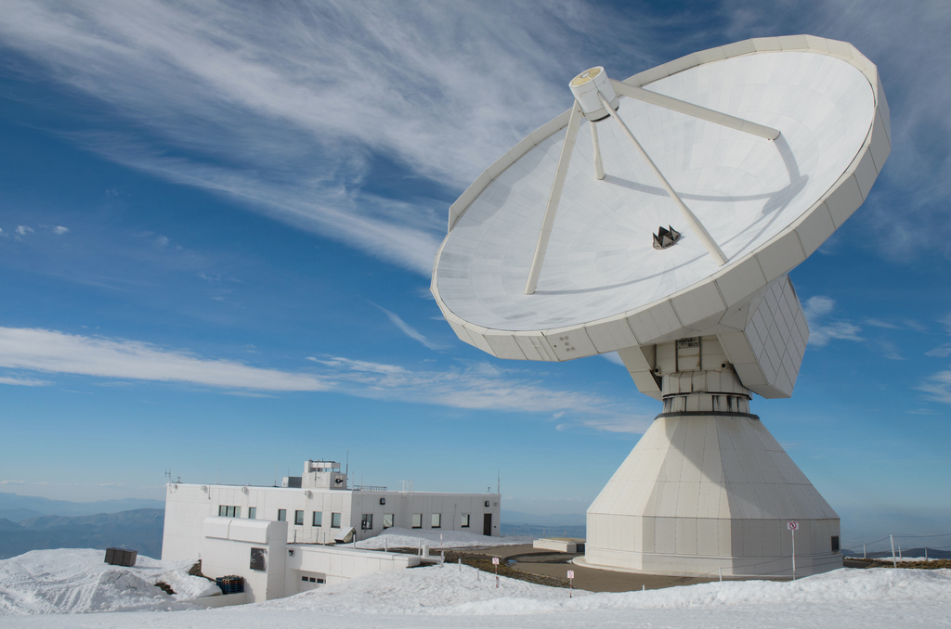
Observation of a group of unidentified lines around 72.2 GHz in the dark cloud L483
Hypothesis: transition N=1-0 of NNH_{x}, CNH_{x}, COH_{x}, NOH_{x}, CCH_{x}, OOH_{x}
Test: search for the transition N=2-1 expected at 2 x 72.2 GHz = 144.4 GHz
and the transition N=3-2 expected at 3 x 72.2 GHz = 216.6 GHz
IRAM 30m

Slide 19
Observation of a group of unidentified lines around 72.2 GHz in the dark cloud L483
Hypothesis: transition N=1-0 of NNH_{x}, CNH_{x}, COH_{x}, NOH_{x}, CCH_{x}, OOH_{x}
Test: search for the transition N=2-1 expected at 2 x 72.2 GHz = 144.4 GHz
and the transition N=3-2 expected at 3 x 72.2 GHz = 216.6 GHz

Slide 21
We have a molecule with a rotational constant of 36.1 GHz
It can be NNH_{x}, CNH_{x}, COH_{x}, NOH_{x}, CCH_{x}, OOH_{x} (neutral or ion)
The observed hyperfine structure with multiple components and a large splitting
indicate that the carrier:
- must be an open-shell molecule
- must have at least two atoms with non-zero nuclear spin (N, H)

Slide 23
H₂NC is ~30 kcal/mol less stable than H₂CN
In spite of that, the abundance ratio H₂NC/H₂CN is ~ 1 in L483
30 kcal/mol
Possible reactions of formation:
C + NH₃ → H₂NC + H
N + CH₃ → H₂NC + H

Slide 24
H₂NC is not detected toward TMC-1
Moreover, H₂CN is not detected toward TMC-1
H₂CN detection in TMC-1 claimed by
Ohishi et al. (1994), ApJ, 427, L51
H₂CN non detected by us
Cabezas et al. (2021), A&A, 654, A45

Slide 25
H₂NC is not detected toward TMC-1
But it is detected toward
many cold dark clouds
Agúndez et al., in preparation

Slide 26
Agúndez et al., in preparation

Slide 27
The reaction C + NH₃ is the most likely formation route to H₂NC
Reaction measured to be rapid down to 50 K
Hickson et al (2015), ApJ, 812, 107
H₂CN (and not H₂NC) predicted/inferred to be the major product
Bourgalais et al (2015), ApJ, 812, 106
Our astronomical results suggest that H₂NC is also formed

Slide 28
C + NH₃ → H₂CN + H
→ H₂NC + H
Octavio Roncero
is running calculations
Bourgalais et al. (2015), ApJ, 812, 106

Slide 29
3
Hydrocarbons

Slide 30
46 molecules discovered in 2020-2022 in TMC-1
(QUIJOTE + GOTHAM)
N-bearing molecules
HC₄NC, HCCCH₂CN, CH₂C₃N, HCCCHCHCN, H₂CCHC₃N, CH₂CCHC₃N, HC₁₁N
O-bearing molecules
HC₃O, C₅O
S-bearing molecules
NCS, HCCS, H₂CCS, H₂CCCS, C₄S, HCSCN, HCSCCH
Protonated molecules
HC₅NH⁺, HC₃O⁺, HC₃S⁺, CH₃CO⁺, HCCS⁺, C₅H⁺, HC₇NH⁺, HCCNCH⁺
Hydrocarbons (some CN-substituted)
H₂C₅, C₃H₅CN, CH₂CCHC₄H
c-C₅H, c-C₃HCCH
CH₂CCH
CH₂CHCCH, CH₂CCHCCH
c-C₆H₄
c-C₅H₆, c-C₅H₄CCH₂, c-C₅H₅CN, c-C₅H₅CCH
c-C₉H₈, c-C₁₀H₇CN

Slide 31
Vinyl acetylene
CH₂CHCCH
Allenyl acetylene
CH₂CCHCCH
Cernicharo et al (2021), A&A, 647, (L2, L3)
Partially saturated molecules, unlike the previously known unsaturated acetylenic chains
They are very abundant for being that large, with abundances relative to H₂ of 1.3x10⁻⁹
Neutral-neutral reactions likely behind their formation:
CH + CH₃CCH/CH₂CCH₂
C₂H + C₂H₄ C₂H + CH₃CCH/CH₂CCH₂
C₂ + C₂H₆ C₂ + CH₂CHCH₃
Rapid at low temperatures, but uncertainties remain on the branching ratios of different isomers
Allow to probe the non-polar precursor allene CH₂CCH₂ (predicted as abundant as CH₃CCH)

Slide 32
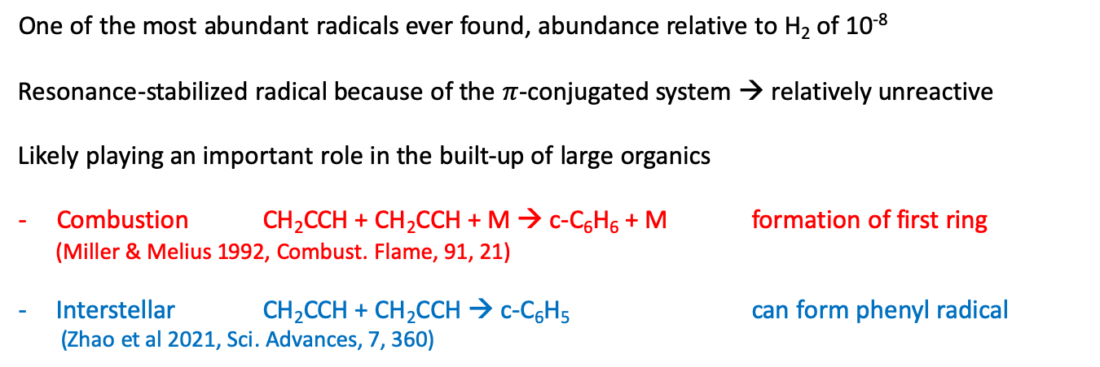
Propargyl radical
CH₂CCH
Agúndez et al (2021), A&A, 647, L10
(2022), A&A, 657, A96
One of the most abundant radicals ever found, abundance relative to H₂ of 10⁻⁸
Resonance-stabilized radical because of the $π$-conjugated system → relatively unreactive
Likely playing an important role in the built-up of large organics
Combustion CH₂CCH + CH₂CCH + M → c-C₆H₆ + M formation of first ring
(Miller & Melius 1992, Combust. Flame, 91, 21)
Interstellar CH₂CCH + CH₂CCH → c-C₆H₅ can form phenyl radical
(Zhao et al 2021, Sci. Advances, 7, 360)

Slide 33
The big (aromatic) hydrocarbon cycles
Cyclopentadiene and derivatives
Benzene derivatives
N
CN
CCH
Cernicharo et al A&A, (2021, 649, L15; 2021, 655, L21; 2022, 663, L9)
McCarthy et al (2021), Nat Astron, 5, 176
Lee et al (2021), ApJ, 910, L2
McGuire et al (2018), Science, 359, 202
Cernicharo et al (2021), A&A, 655, L21
Indene and CN derivative
Naphtalene CN derivative
Cernicharo et al (2021), A&A, 649, L15
Sita et al (2022), ApJ, 938, L12
McGuire et al (2021), Science, 371, 1265

Slide 34
How are these big (aromatic) cycles formed?
Bottom-up mechanism from smaller hydrocarbons
Cernicharo et al (2022), A&A, 663, L9

Slide 35
Bottom-up mechanism to cyclopentadiene and benzene
by Ralf Kaiser
Cernicharo et al (2021), A&A, 655, L1

Slide 36
Bottom-up mechanism to cyclopentadiene and benzene
including l-C₃H₃⁺ + C₂H₄
(fast but uncertain if c-C₅H₆ is a product)
So, there is still much to investigate
to understand the formation of
large cycles in cold dark clouds
Cernicharo et al 2022, A&A, 663, L9
only neutral-neutral routes

Slide 37
Children of 4-5 years old drawing indene at school
NAUKAS (by Natalia Ruiz Zelmanovitch)

