Slide 1

Can we seriously search for prebiotic compounds in the interstellar medium?
Jean-Claude Guillemin, Houda Gazzeh
Institut des Sciences Chimiques de Rennes
UMR CNRS 6226
Ecole Nationale Supérieure de Chimie de Rennes
Paris-PCMI-2022

Slide 2

The Interstellar Medium
About 260 molecules have been detected in the Interstellar Medium (ISM).
◆ Most of them are organic compounds
◆ Sugars and Amino acids are considered as “Prebiotic compounds”
◆ For glucides (sugars), only the glycolaldehyde (HOCH₂CHO) has been detected in the ISM
◆ Glycine (H₂NCH₂CO₂H) has been detected 3 times in the ISM since 1980 but, each time, the discovery has been rejected.
◆ Possible precursors of amino acids have been detected in the ISM: HCN, CH₂O and other aldehydes, Ammonia, aminoacetonitrile (H₂NCH₂CN)…

Slide 3
PREBIOTIC….
The first question is "Which compounds are prebiotic?”
Many articles claim the discovery of a new prebiotic compound in the ISM:
Exemples:
Prebiotic Precursors of the Primordial RNA World in Space: Detection of NH₂OH
ApJL 899:L28 (2020).
Abundant Z-cyanomethanimine in the interstellar medium: paving the way to the synthesis of adenine
MNRASL 483:L114-L119 (2019).
First detection of the pre-biotic molecule glycolonitrile (HOCH₂CN) in the interstellar medium
MNRASL 484:L43-L48 (2019).
Precursors of the RNA World in Space: Detection of (Z)-1,2-ethenediol in the Interstellar Medium, a Key Intermediate in Sugar Formation
ApJL 929:L11 (2022).
NC-CH=NH, HOCH₂CN, HOCH=CHOH are too unstable at rt to be delivered on the Earth by meteorites
The most important in the simple prebiotic compounds is probably Hydrogen Cyanide, HCN.

Slide 4
Is HCN prebiotic?
2nd referee: Here are my comments:
In general, the discussion of molecules in the ISM is difficult, because the true limit is the molecular weight. This means, that substituted cyanamides or imines probably exist, but they are in a condensed phase and not accessible by the available spectroscopic techniques. Another difficulty is, that hydrogen cyanide decomposes at temperatures beyond 400°C …. It can be assumed that the temperature of the atmosphere of the early Earth was significant higher. …
Wikipedia:
The early Earth is loosely defined as Earth in its first one billion years (Ga, 10⁹y). The “early Earth” encompasses approximately the first gigayear in the evolution of our planet, from its initial formation in the young Solar System at about 4.55 Ga to sometime in the Archean eon at about 3.5 Ga.
The 6th detected imine in the ISM: HCC-CH=NH: L. Bizzocchi, D. Prudenzano, V. M. Rivilla, A. Pietropolli-Charmet , B. M. Giuliano, P. Caselli, J. Martín-Pintado, I. Jiménez-Serra, S. Martín, M. A. Requena-Torres, F. Rico-Villas, S. Zeng, and J.-C. Guillemin A&A 2020, 640, A98.

Slide 5
PREBIOTIC….
"Which compounds are prebiotic?"
Prebiotic - Wiktionary
Adjective
Before the advent of life.
So that means all the molecules between the formation of the Earth and the advent of life => several thousand of different compounds.
In this case, most of the kinetically fairly stable compounds detected in ISM are prebiotic in the sense that the same compounds were present on the prebiotic Earth.
=>The concept of building blocks of life

Slide 6
Building blocks of life
Glucides (sugars)?
Amino acids?

Slide 7
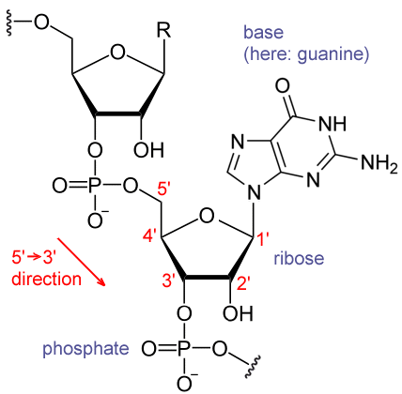
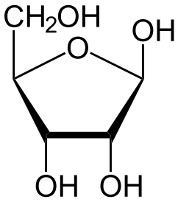
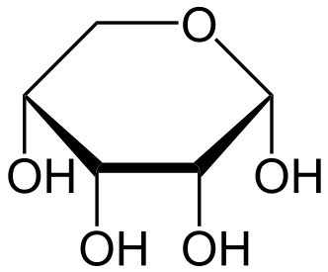
1- Glucides: which ones?
Ribose or glycolaldehyde and glyceraldehyde
Ribose is a simple sugar and carbohydrate with molecular formula C₅H₁₀O₅ and the linear-form composition H−(C=O)−(CHOH)₄−H. The naturally-occurring form, d-ribose, is a component of the ribonucleotides from which RNA is built, and so this compound is necessary for coding, decoding, regulation and expression of genes.
β-D-ribofuranose
α-d-ribopyranose
Structure of a fragment of an RNA, showing a guanosyl subunit.

Slide 8
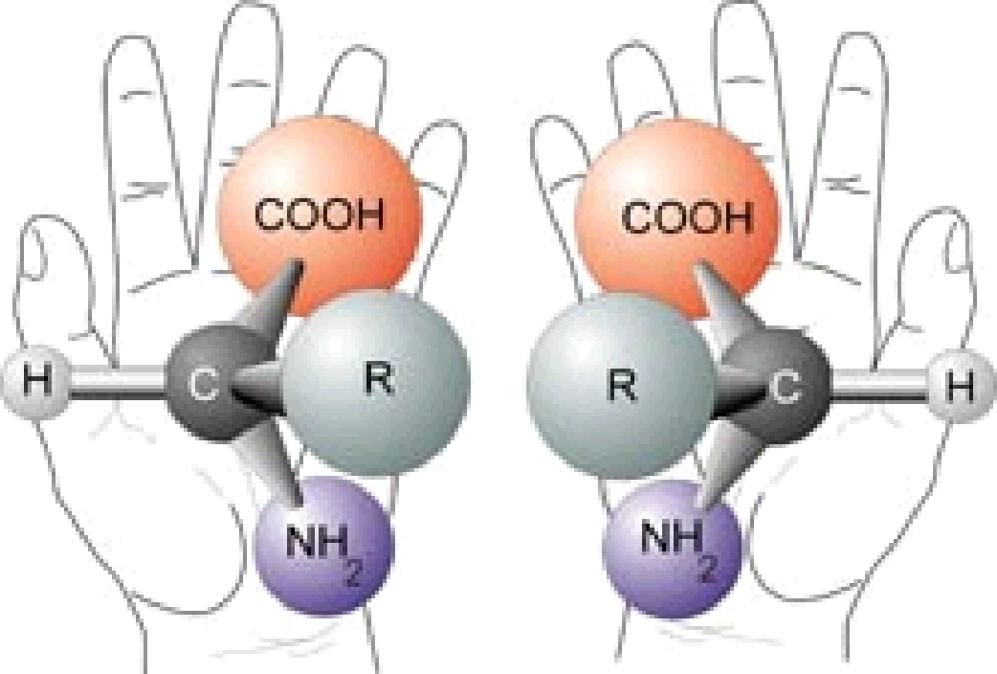
Living systems contain mainly homochiral compounds: L-amino acids, D-sugars
About 150 years ago, Pasteur, Le Bel and Van’t Hoff raise the fascinating question of the origin of homochirality.
Chemistry gives easily chiral compounds but in racemic mixtures
8

Slide 9
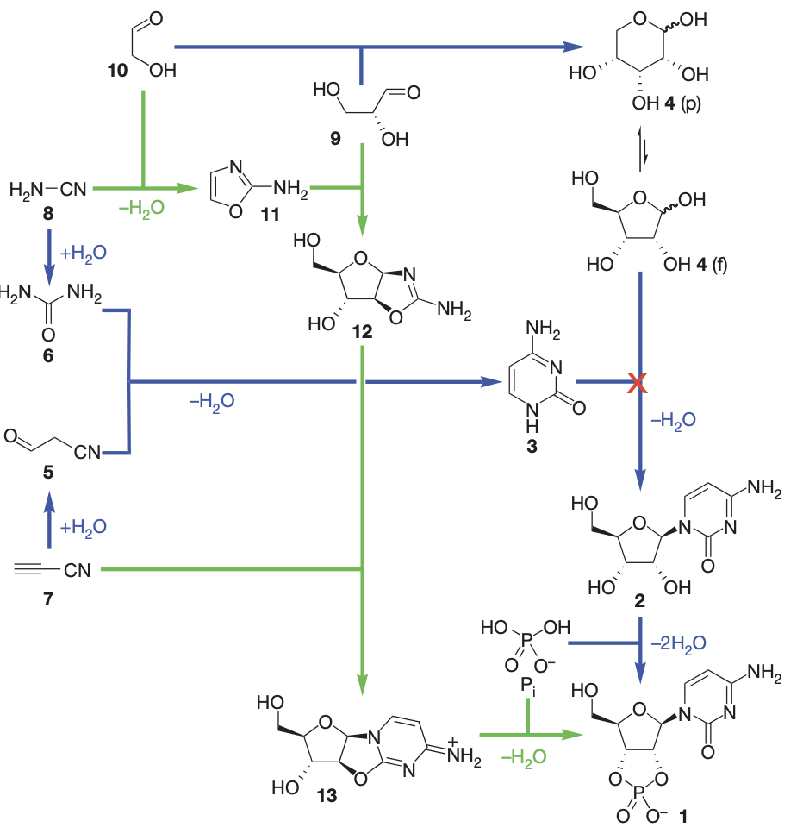
Ribose or glycolaldehyde and glyceraldehyde?
M. W. Powner, B Gerland, J. D. Sutherland, Nature, 2009, 459, 239

Slide 10
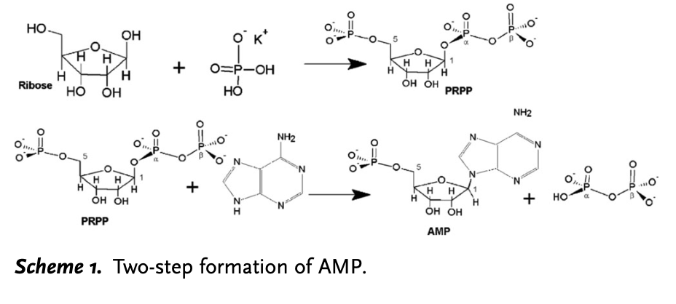
Ribose or glycolaldehyde and glyceraldehyde?
M. Akouche, M. Jaber, M.-C. Maurel, J.-F. Lambert, T. Georgelin, Angew. Chem. Int. Ed. 2017, 56, 1-5
Up to date, probably we need glycolaldehyde and homochiral glyceraldehyde but we are not sure we need riboses.

Slide 11
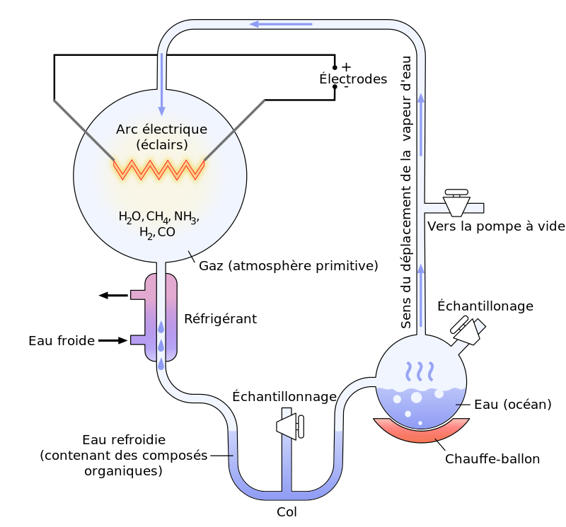
2-Amino acids: perhaps the history of a bias?
Miller-Urey experiments: Several amino acids and many other compounds were observed
Miller, Science, 1953, 117, 528

Slide 12
Amino acids: perhaps the history of a bias?
Hydrolysis of tholins
« We report chromatographic and spectroscopic analyses of both Titan and Triton tholins, organic solids made from the plasma irradiation of 0.9:0.1 and 0.999:0.001 N₂/CH₄ gas mixtures, respectively.
…We report yields of amino acids upon hydrolysis of Titan and Triton tholins »
McDonald, Thompson, Heinrich, Khare, Sagan Icarus, 1994, 108, 137-145

Slide 13
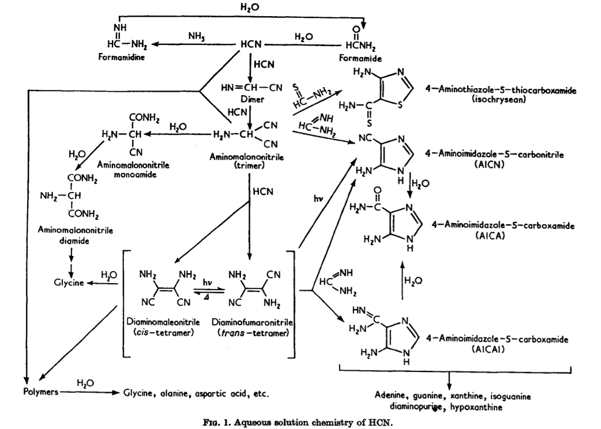
Amino acids
HCN polymers
Sanchez, Ferris, Orgel, J. Mol. Biol. 1967, 80, 223-253

Slide 14
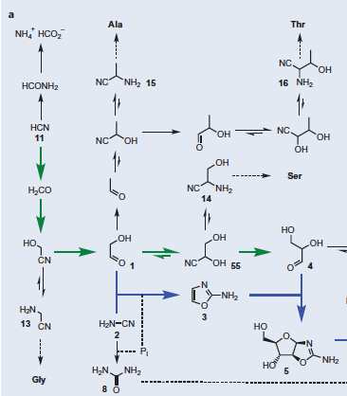
Many amino acids can be formed from HCN:
Sutherland et al. Nature Chemistry 2015, 7, 301–307.
14

Slide 15
Annual Meteorites Bombardment
40 000 tons (mainly dusts, micrometeorites, meteorites).
1 comet or asteroide > 1 km per 500000 years
50000 different molecules identified after acidic aqueous dilution in meteorites.
In meteorites (carbonaceous chondrites) but often after acidic hydrolysis, natural and non-natural amino acids have been observed.
In 1980, Cronin and Pizzarello showed that some amino acids are present in meteorites with an enantiomeric excess.

Slide 16
Synthesis of amino acids in lab
When they do not come from Space, amino acids may have been formed very easily on the Primitive Earth
1st step: Strecker Reaction
2nd step: Acidic hydrolysis of α-aminonitriles
16
16

Slide 17
Proteinogenic Acid from Cyanoacetylene
In all these reactions, only racemic compounds are obtained.
17

Slide 18
Synthesis of peptides in lab
Peptides are usually synthesized starting from amino acids derivatives in organic solvent with reagents like carbodiimides
A possible prebiotic compound to do this coupling is cyanamide H₂NCN working in water (Danger, …Pascal, Angew. Chem. Int. Ed, 2013, 52, 611)
However many problems are present, the most important being homochirality

Slide 19
Lack of knowledge
Without enantioenriched samples, peptides coupling gave more or less statistical mixtures of peptides which are not, for most of them, possible building blocks of life.
We have several ways for abiotic enantioenrichment but many are not realistic for the primitive Earth.
The reversibility of the coupling reaction could promote the formation of homochiral peptides but that has never been demonstrated.
In water, peptides very slowly yield amino acids which racemize.
19

Slide 20
Lack of knowledge
Who decided that, on the primitive Earth, peptides have been synthesized starting from (free) amino acids?
Why not from tholins followed by a partial hydrolysis?
Or from polymers of HCN partially hydrolyzed? Or from HCN and formamide?
Or from reactions starting from α-aminonitriles and then leading to peptides by a partial hydrolysis?
=> What is the nature of compounds leading to amino acids before hydrolysis of tholins, HCN polymers or meteorites ? Are they precursors of amino acids or peptides?
20

Slide 21
Conclusion
Nature finds ways to synthesize compounds under abiotic conditions that depend on starting materials, thermodynamics and kinetics, all dependent on the temperature.
Reactions between 2, 3 or a few more reagents have taken place on the primitive Earth in the presence of many other compounds which can play the role of solvent, inhibitor, catalyst...
=> We are really far from knowing the building blocks of life that acted on the primitive Earth.
Unambiguously, the ISM is full of prebiotic compounds, that is, the same compounds present on early Earth. Some or more of them led to the building blocks of life on early Earth.

Slide 22
Financial supports:
- Program CNRS-INSU PCMI.
- Centre National d’Etudes Spatiales (CNES)

Slide 23
Non quia difficilia sunt, non audemus, sed quia non audemus, difficilia sunt
It is not because things are difficult that we do not dare, it is because we do not dare that things are difficult.
Lucius Annaeus Seneca

