Slide 1
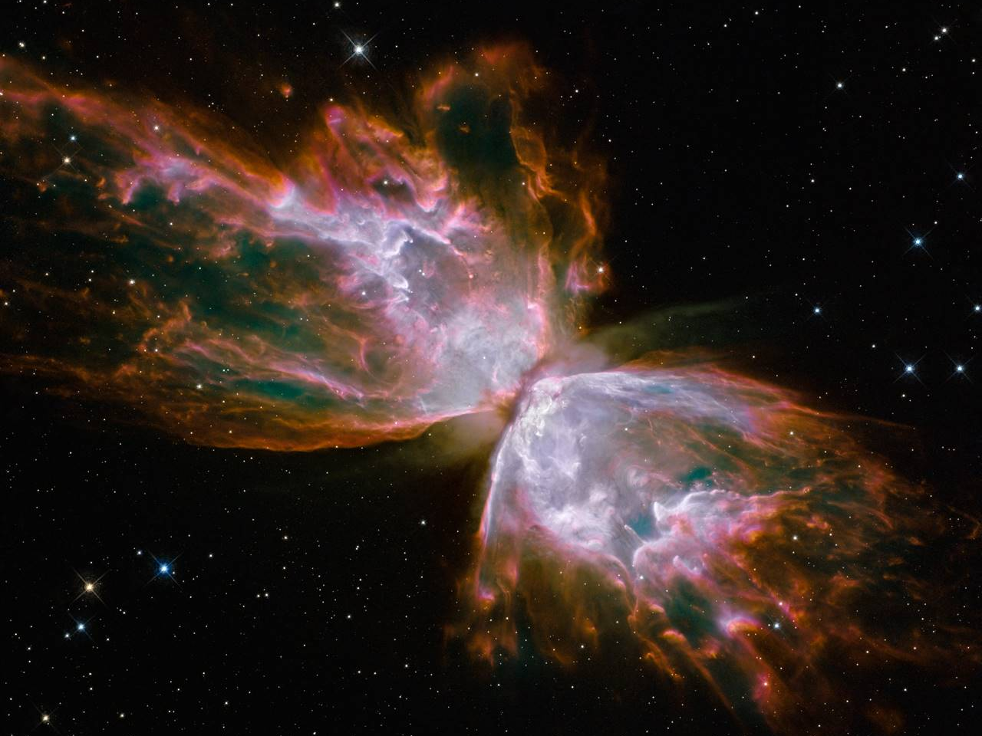
In Search of Shock Tracers in the Low Velocity Shocked Region of ISM
Dr. Shubhadip Chakraborty
Institut de Physique de Rennes, Université de Rennes1, France
PCMI 2022
26/10/2022

Slide 2
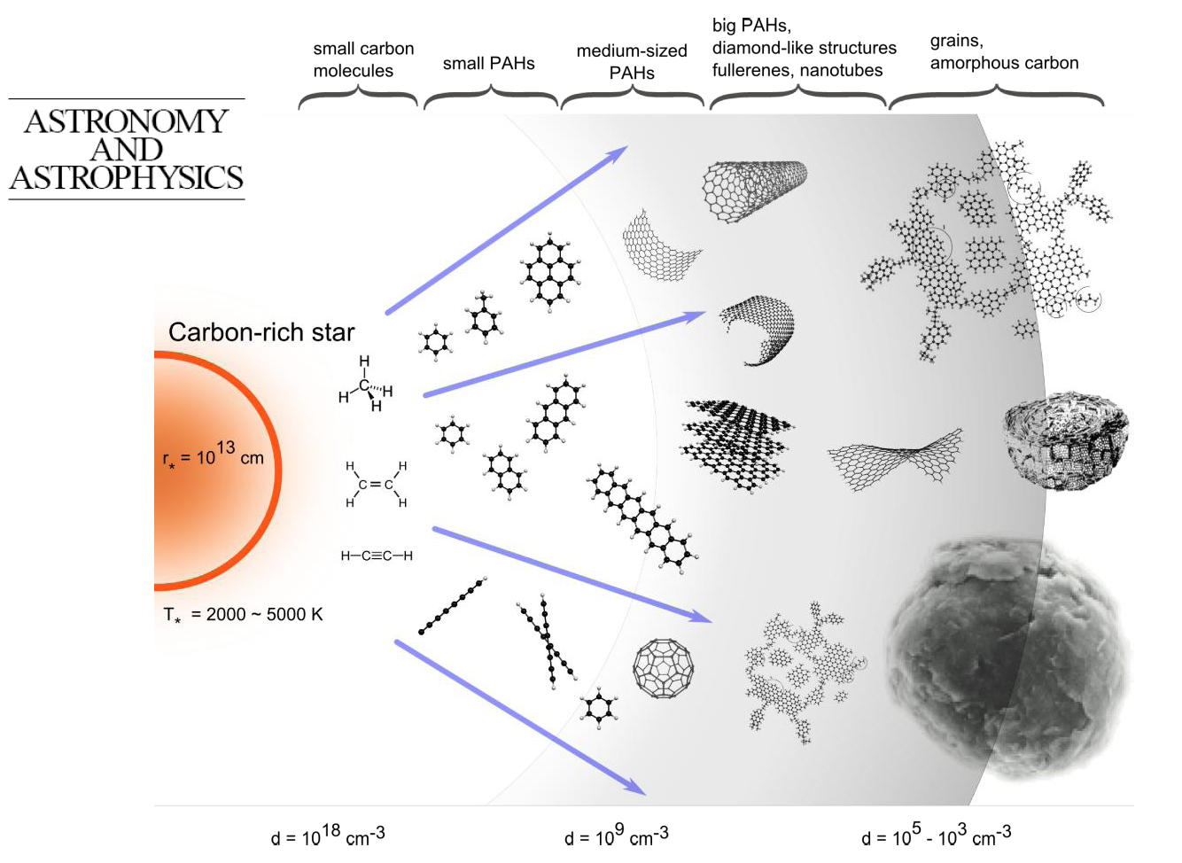
Dust Evolution in the Interstellar Medium (ISM)
ISM is dusty icy and chemically rich.
Dust grains in the ISM is mainly composed of silicates, oxides, carbonaceous materials
Dust evolution is driven by a great diversity of physical and chemical processes such as photon irradiation, electron and ion bombardment.
Contreras & Salama ApJ, 2013, 208,1
Thermal processing of dusts in the ISM
Burke at al. Phys. Chem. Chem. Phys. 2010, 12, 5947
Ehrenfreund et al. A&A 1998
Shock processing of the interstellar dusts is less explored area
What is the fate of the carbonaceous molecules under the exposure of shock wave?

Slide 3
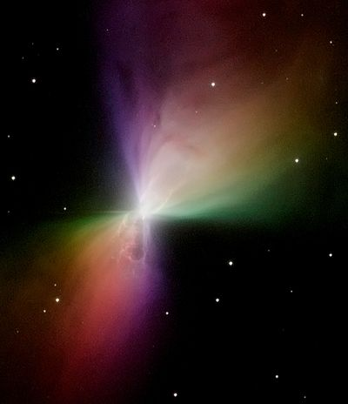
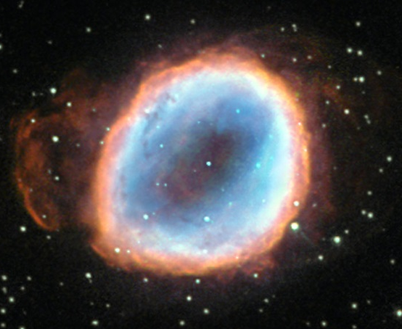
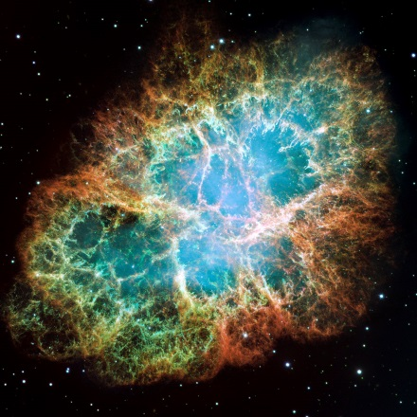
Astrophysical shock waves
Shocks are ubiquitous in the interstellar medium ; associated to star formation (through jets and bipolar outflows), evolution (via stellar winds), and death (in AGB stellar winds or supernovae explosion).
Shocks affect strongly dust evolution.
Dust in turn plays important roles and can be considered as:
  a chemical agent (influence on gas chemistry)
  a dynamical agent (e.g. dust couples the magnetic field to the gas,…)
  a physical agent (e.g. source of heat in postshock gas) (Anderl 2016)
Bi-polar outflows
Stellar winds
Supernovae explosions
Welty, D. E. et al. 2002, ApJ, 579, 304, Díaz-Cano, L. S. & Jones, A. P. 2008, A&A, 492, 127

Slide 4
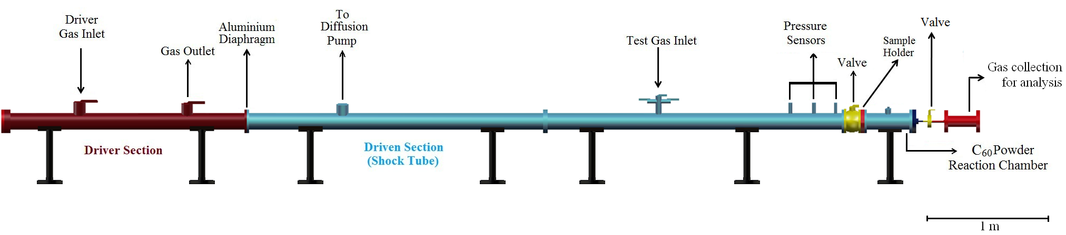
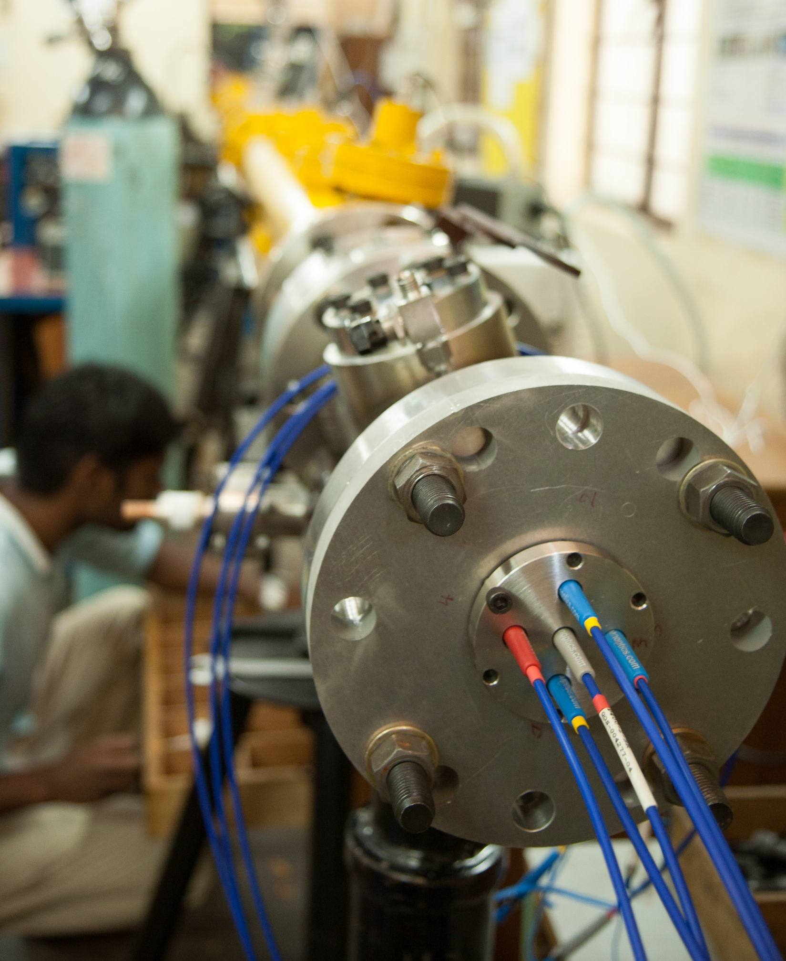
Shock tube facilities at the Indian Institute of Science Bengaluru, India
Shock tubes are widely used for reaction kinetics, combustion studies, ignition delays, vehicle re-entry, hypersonic flights…
IISc shock tube facilities (7-m long, 80 mm diameter) can generate short (few ms) heat waves ( T_{max} ~ 8000 K).

Slide 5
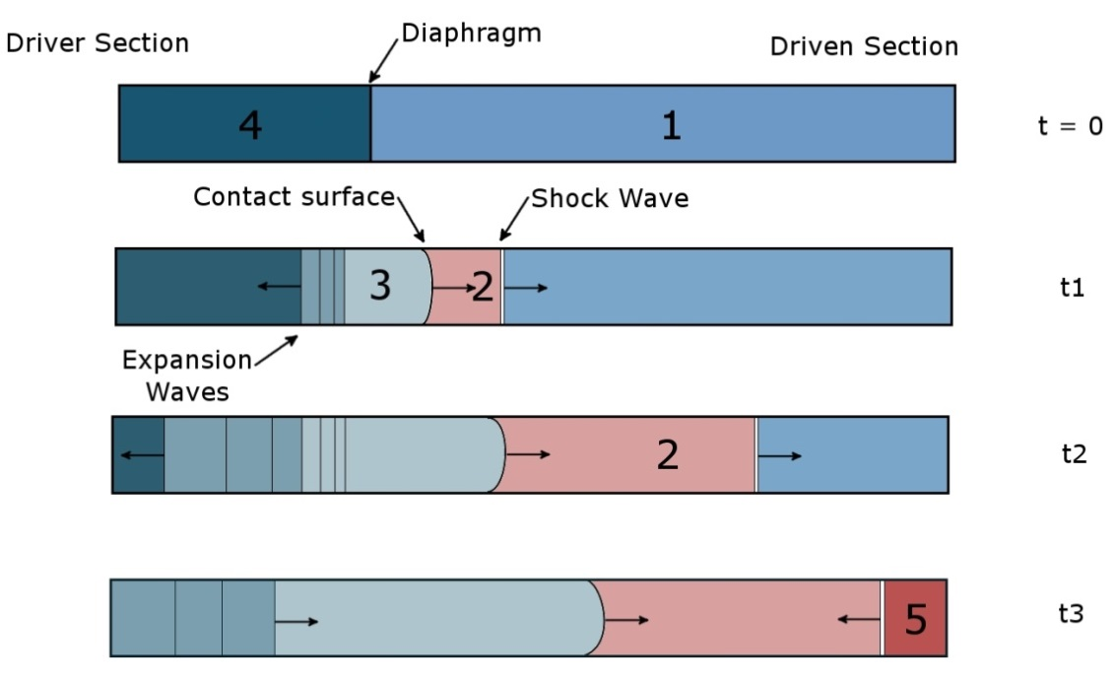
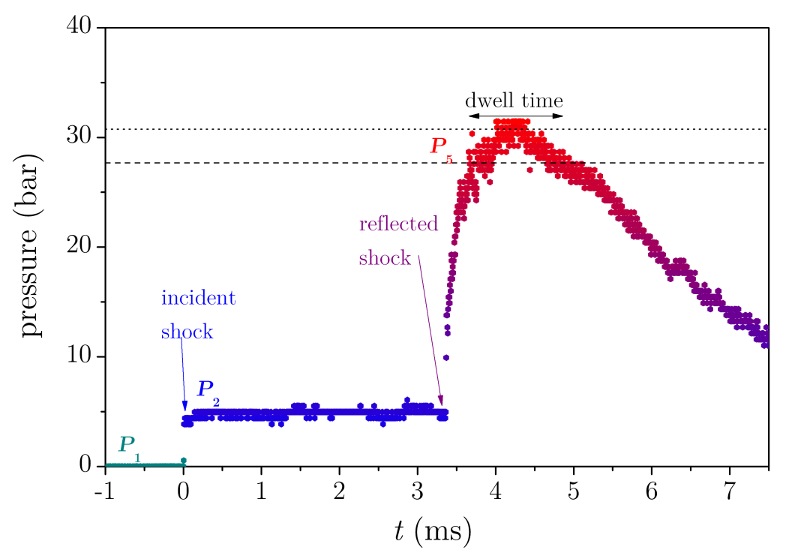
Basics of a Shock tube

Slide 6
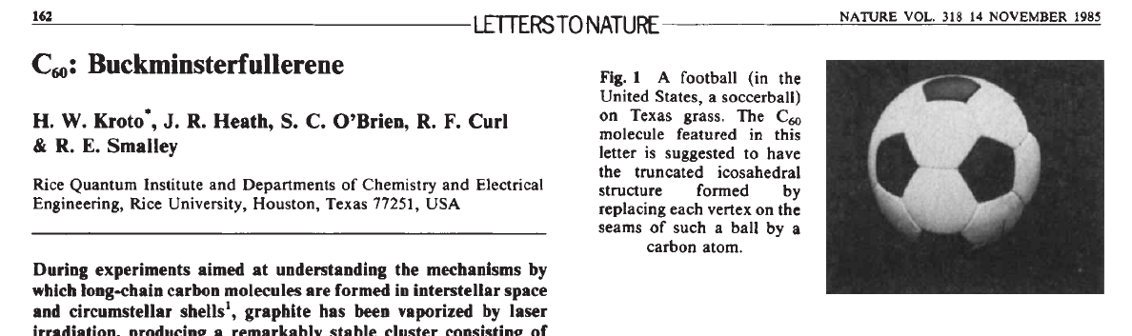
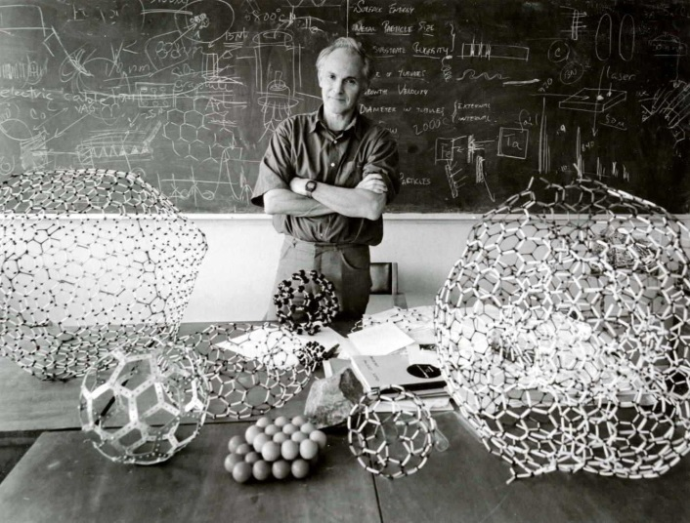
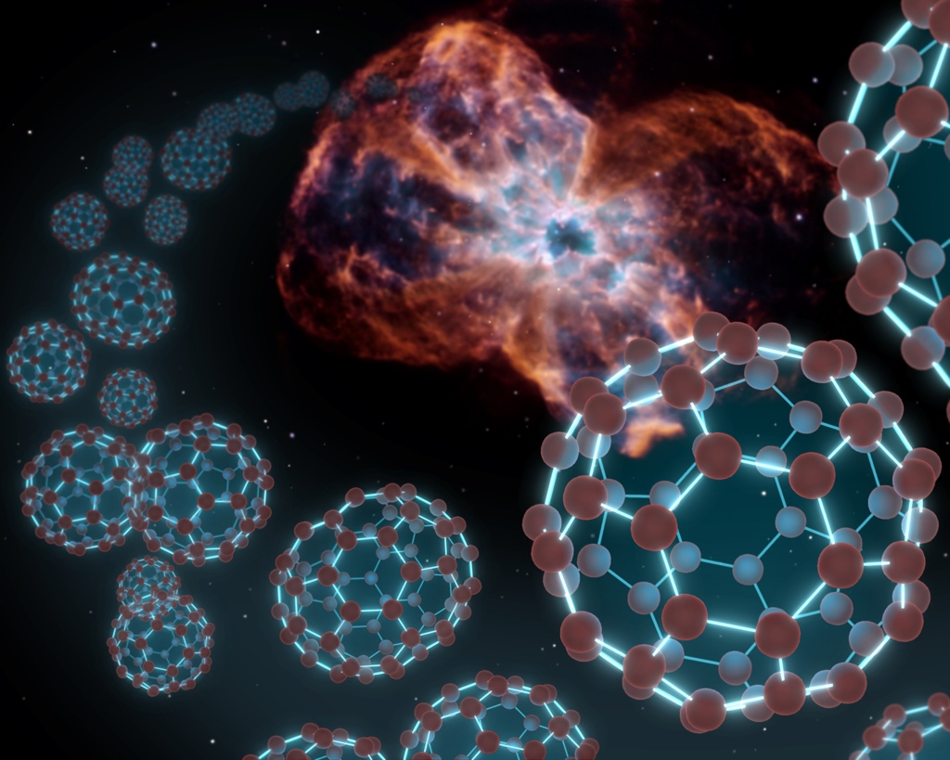
Shock Wave Evolution of C₆₀
C₆₀ detected in emission in PNe (Cami 2010, Garcia Hernandez 2012, Otuska 2014), PDRs (Sellgren 2010, Castellanos 2014) and C₆₀⁺ in absorption in diffuse ISM (Campbell 2015),…
Benchmark system because of huge set of data on e.g. photophysics,…
Investigate link PAHs -C₆₀.
Adapted from J. Cami

Slide 7
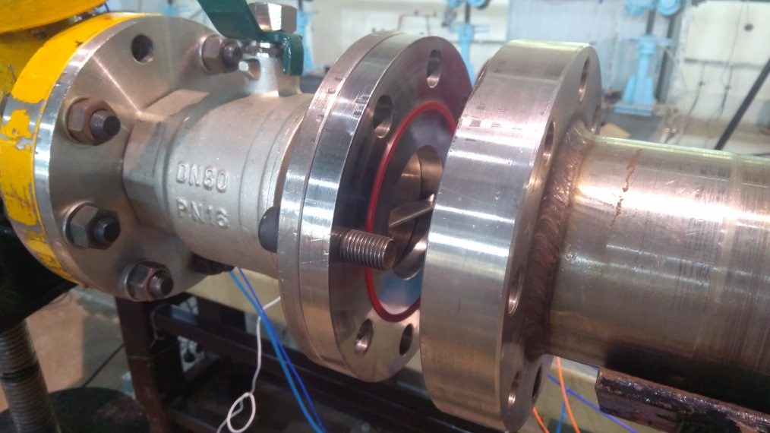
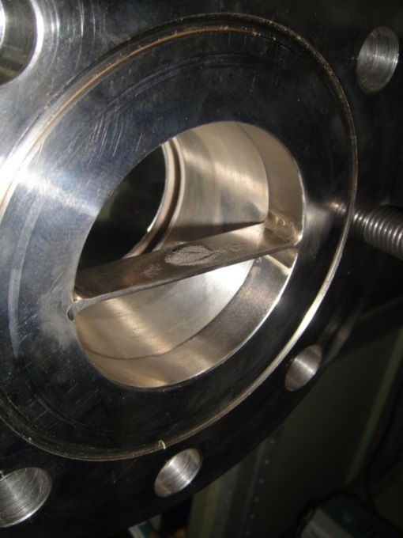
Sublimation of C₆₀
C₆₀
Incident shock mixes a small qty of C₆₀ microcrystals (10 mg) - deposited on a plate - with the Ar bath.
Behind the reflected shock, T_{p} catches up with the T_{g} and the leads to sublimation of the crystals.
Thermalization occurs within hundreds of μs.
Notes:
Conservation de la masse, quantité de mouvement et del’énergie

Slide 8
Ex situ chemical analysis of the shock induced C₆₀ in presence of H₂

Slide 9
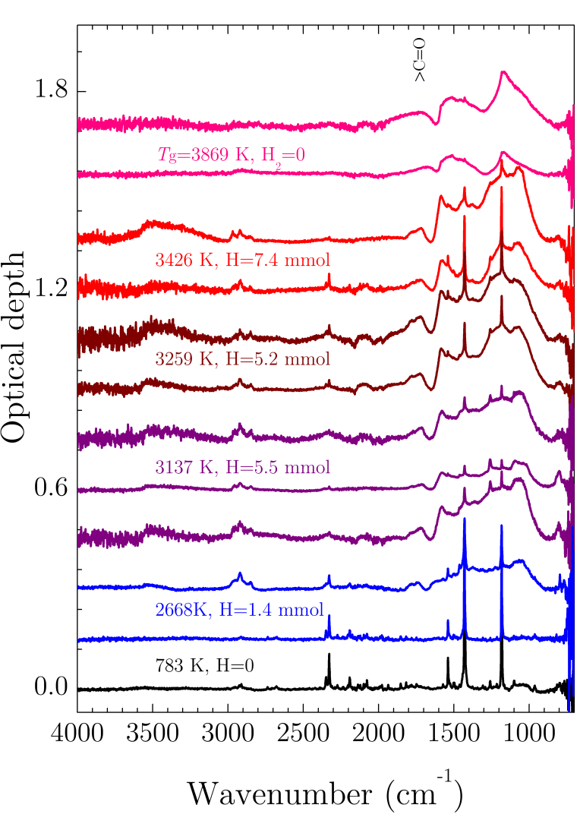
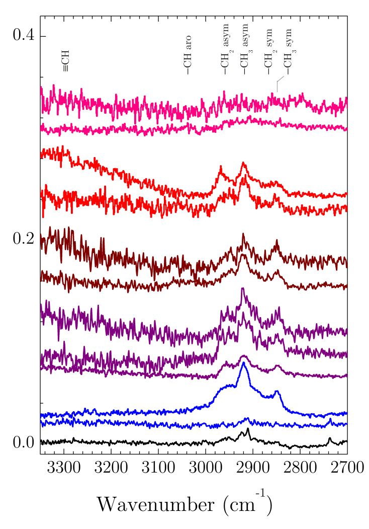
C₆₀ + H₂ in the Shock Tube
IR micro-spectroscopy (SMIS beamline SOLEIL)
Biennier et al. A&A 2017

Slide 10
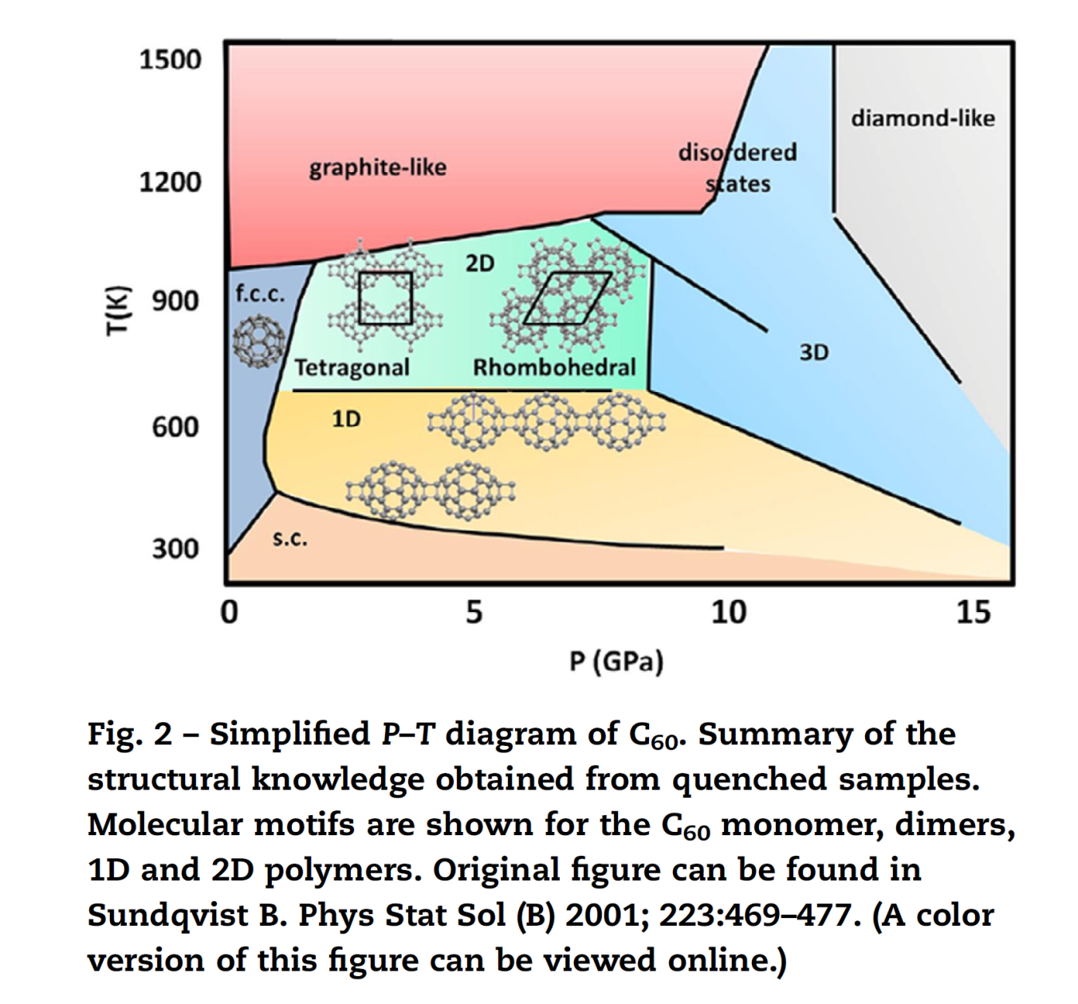
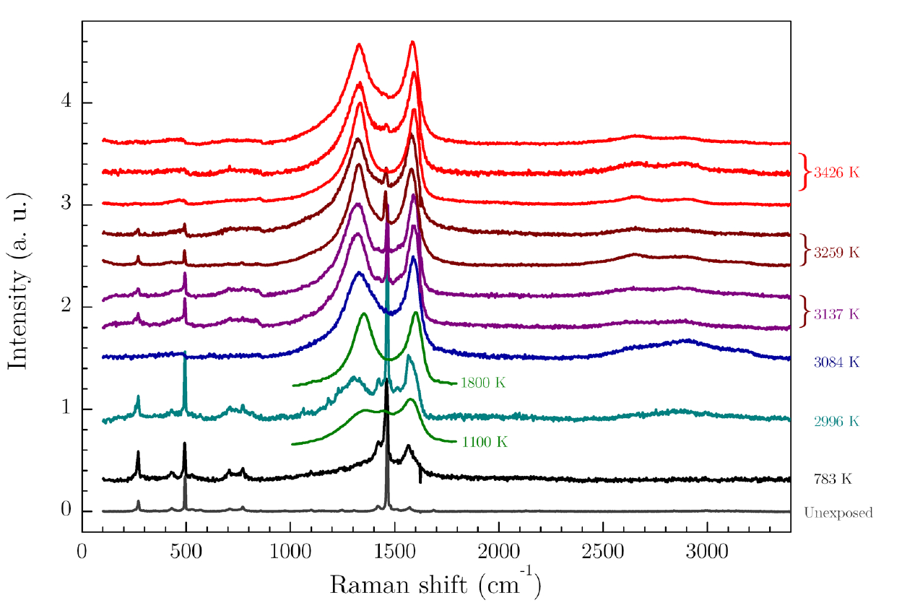
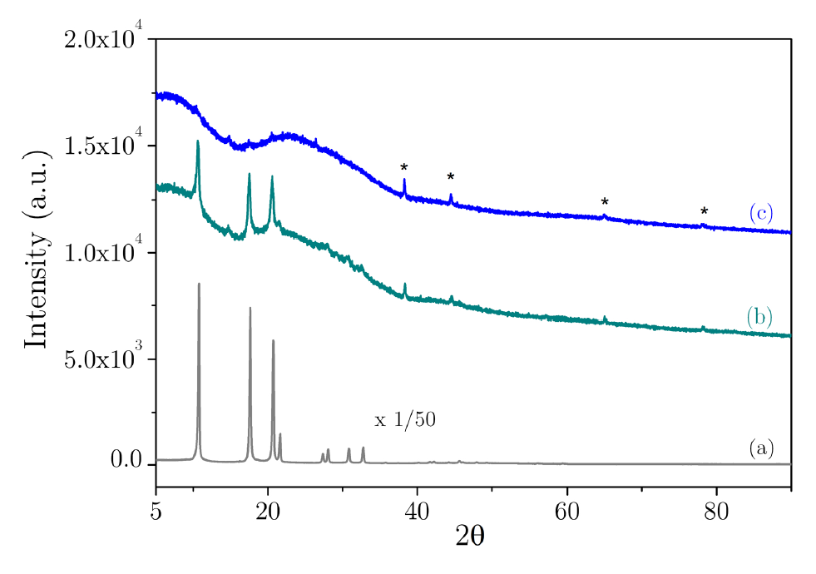
Phase diagram of C₆₀
Region of interest for the present experiment
Temperature = around 5000 K
Pressure = around 30 bar
Shock processing of C₆₀ leads to the formation of graphite like material
Indeed it is what observed in the C₆₀ paper [Biennier et al. A&A (2017)]

Slide 11
In situ chemical analysis of the shock induced C₆₀

Slide 12
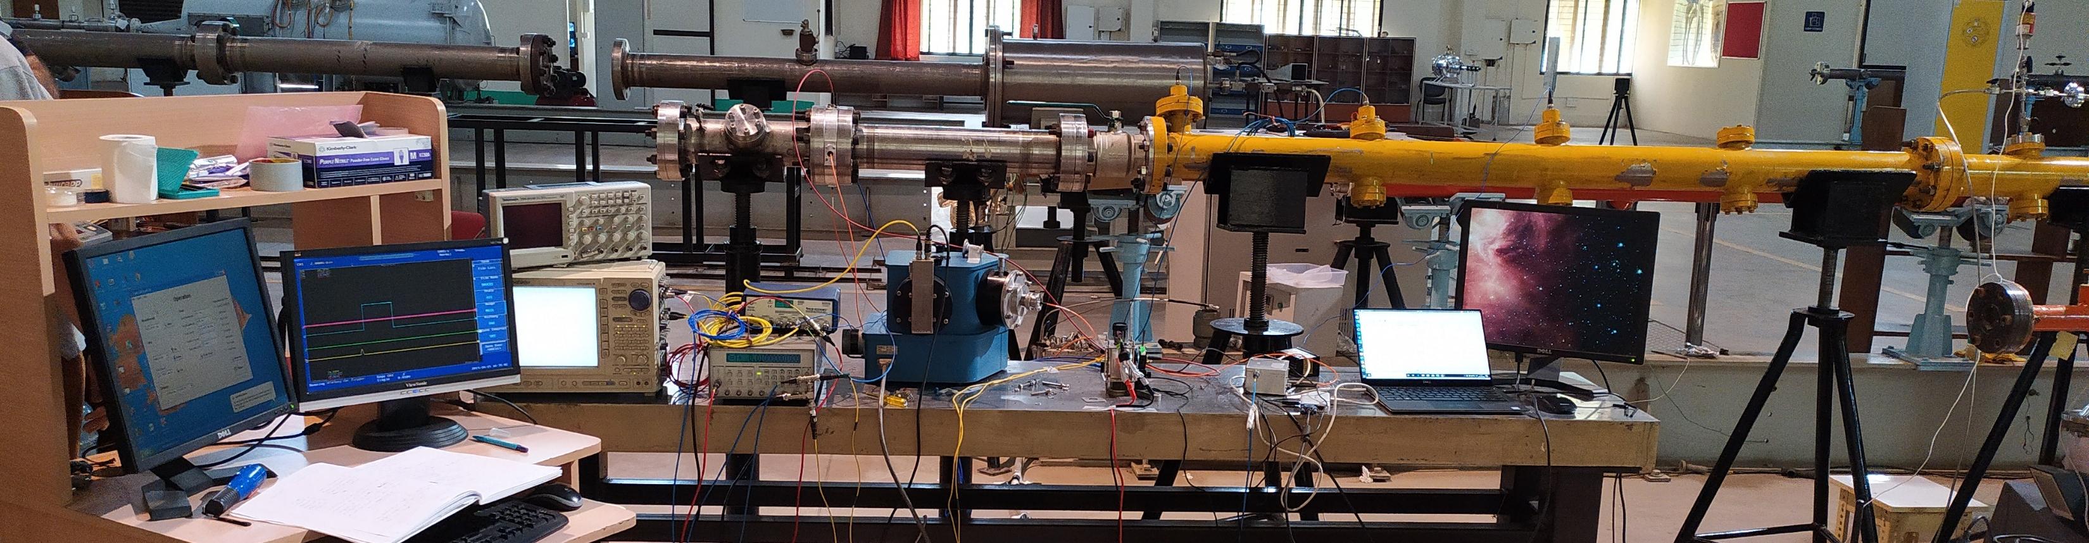
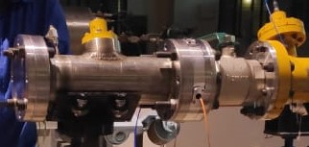
In situ shock-induced decomposition of C₆₀
T =5000 K
Measurement of integrated emission spectrum of shock-induced fragmentation of C₆₀ at T~5000 K.
Well known signature of C₂ (Swan bands).
No C₃ emission observed.
Sequential fragmentation
C₆₀ → C₅₈+ C₂
C₅₈ → C₅₆+ C₂
…
Presence of a broad component.
[Chakraborty et al. In prep.]

Slide 13
Probable shock induced decomposition scheme of C₆₀
[Chakraborty et al. In prep.]

Slide 14
Simulated C₂ emission spectrum
Exocross package was used to simulate the emission spectra.
List of transitions and partition functions of C₂ radical were obtained from Yurchencko et al. MNRAS, 2018, 480, 3397-3411
C₂ spectra were simulated from 4000 up to 7500 K under LTE approximation.
Pressure dependence in the simulation was considered using Voigt profile.

Slide 15


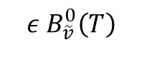





Self-absorption in Hot and Optically Thick Medium
HOT GAS
Self-absorbed C₂ emission
$$B_{\tilde{v}}^{0}\left(T\right)[1−τ]$$
‘Object’ emission
$${ε B}_{\tilde{v}}^{0}\left(T\right)$$
FLUX TOTAL
$$B_{\tilde{v}}^{0}\left(T\right)[1−τ+ε]$$
Black-body radiance
Transmittance = $e^{−σ\left(\tilde{v}\right)nl}$
$$σ(\tilde{v})$$
absorption cross section
$$n$$
concentration
$$l$$
path length
[Georges et al. Rev. Sci, Instrum. 2013, 90, 093103]

Slide 16
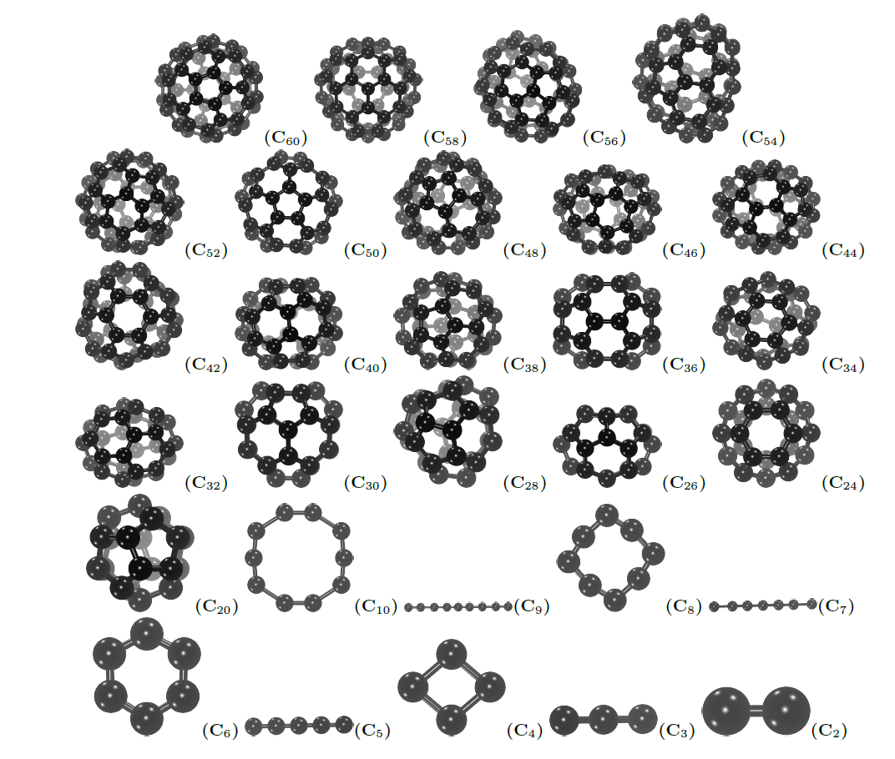
Self-absorption of C₂ in Hot and Optically Thick Medium
T(K)

Slide 17
Self-absorption of C₂ in Hot and Optically Thick Medium
T(K)

Slide 18
Self-absorption of C₂ in Hot and Optically Thick Medium
T(K)

Slide 19
Self-absorption of C₂ in Hot and Optically Thick Medium
T(K)

Slide 20


Inclusion of blackbody-like emission
$$L_{\tilde{v}}^{0}\left(T\right)[1−\left(1−ε(\tilde{v})\right)τ]$$
Increasing$ε(\tilde{v})$

Slide 21
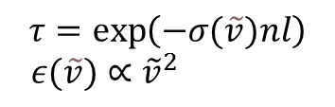

Inclusion of blackbody-like emission
$$L_{\tilde{v}}^{0}\left(T\right)[1−\left(1−ε(\tilde{v})\right)τ]$$
$$τ=\exp\left(−σ(\tilde{v})nl\right)$$
$ε(\tilde{v})∝$ ${\tilde{v}}^{2}$
[C₂]= 2.8x10¹⁶ cm⁻³ ~ 3.5 [C₆₀] ~ 8% conversion
Nature of the broad spectral component: particles? C clusters?

Slide 22
MD Simulations of C₆₀ dissociation at constant T (A. Simon)
MD simulations with a DFT tight binding potential. DeMonNano code.
Repulsive wall included.
Simulations with random velocities are run and the fragment size distributions are analyzed as a function of time.
Decomposition starts only above 3500 K for times < 4 ns. In experiments (ms scale), we see fragments above 2500 K.
At 5000 K, only clusters #C<14 remain → the combined emission of these numerous isomers possibly responsible for blackbody-like emission (see O. Lacinbala’s talk)

Slide 23
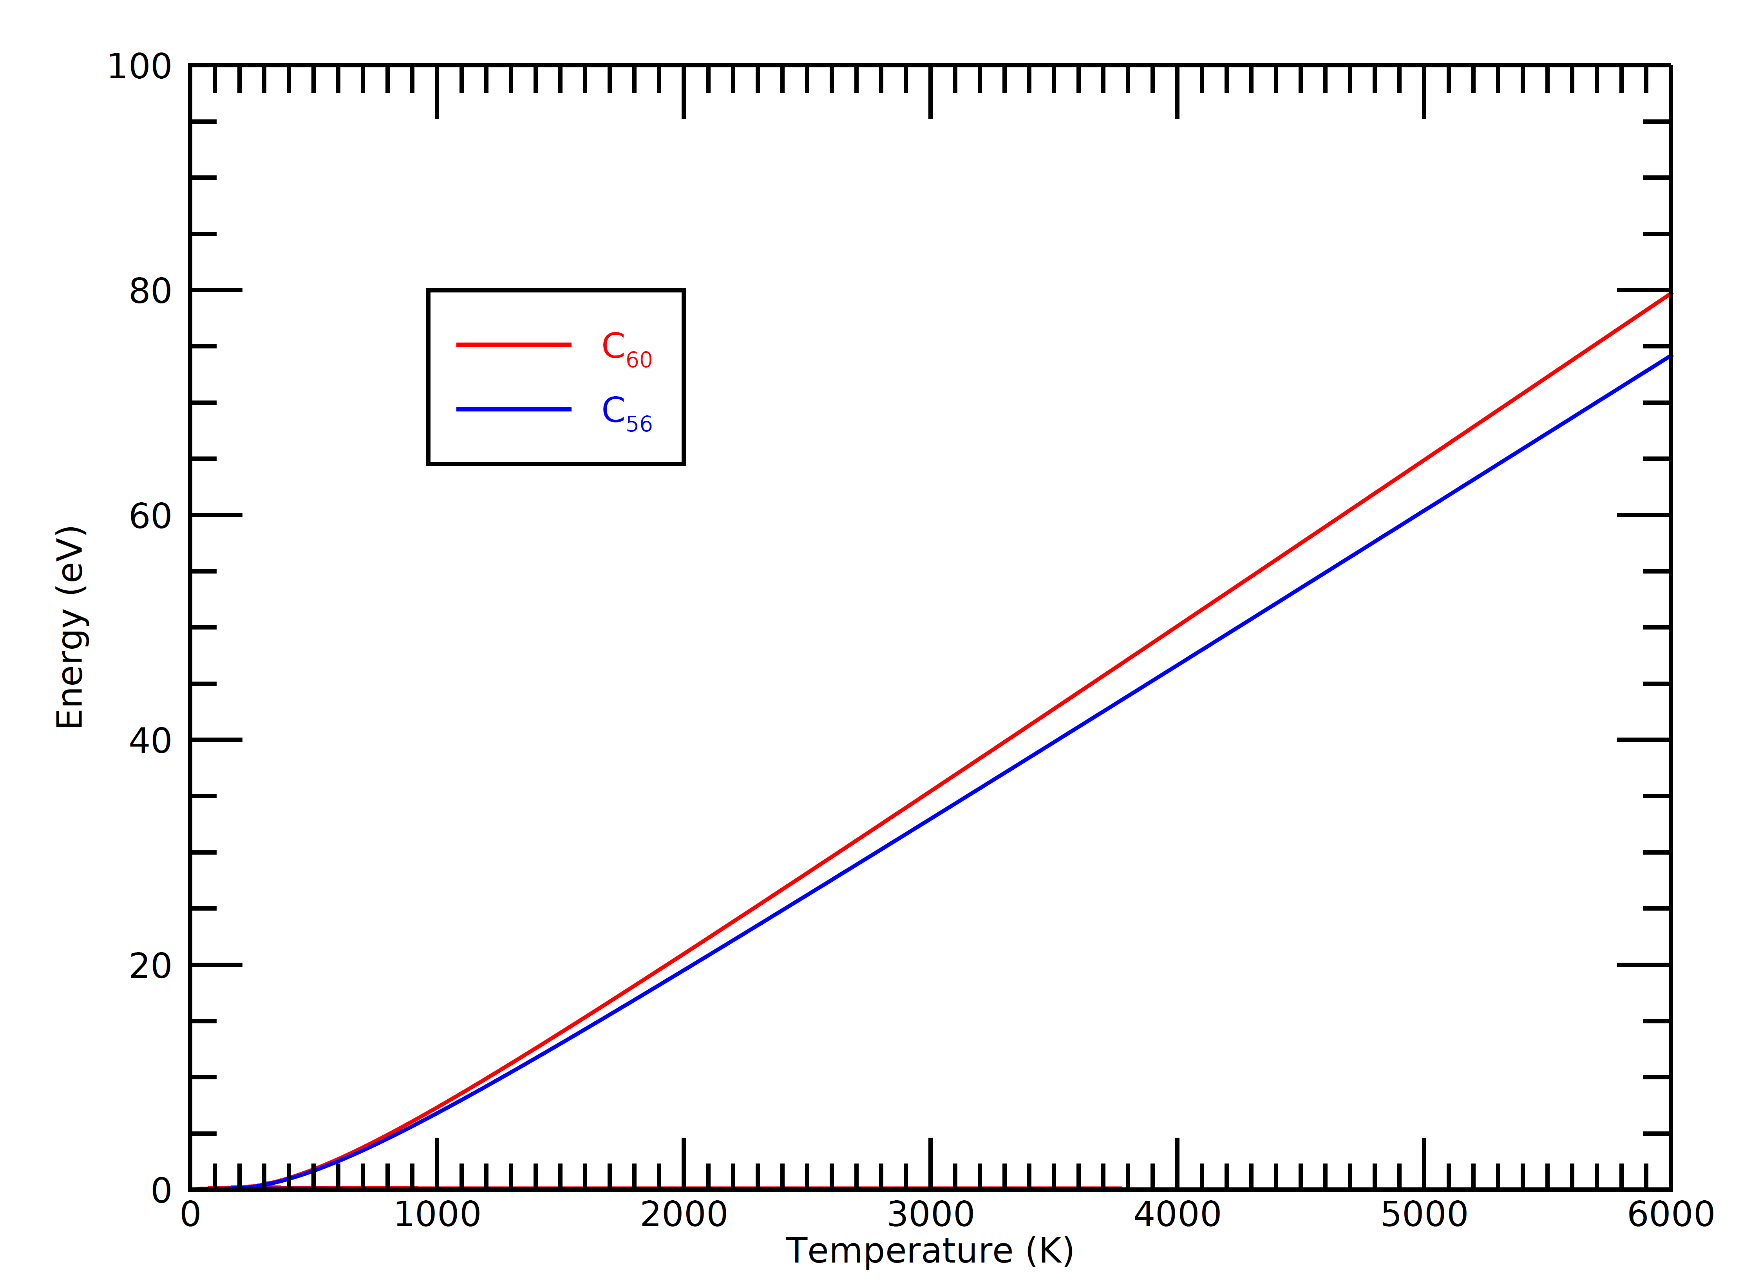
Energetic considerations
At 5000 K, ~60 eV can be stored in vibrational modes of C₆₀.
Shocktube: acess to high energy regime

Slide 24
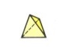
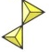
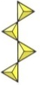

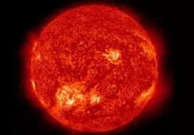
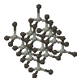
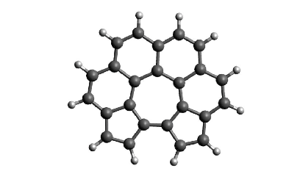
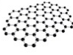
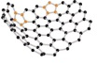


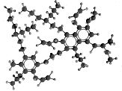

Summary and perspectives
First applications of shock tubes to laboratory astrophysics. Emergence of a new tool for the community.
Complementary expertise (combining experiments, physical and chemical analysis, theory) required to tackle this problem.
Our aims: contribute to the study of the dust cycle & identify new shock tracers
What’s next?
Wide variety of IS dust analogs (HAC, PAHs, graphene, silicates…)
Time resolved emission profiles of C₂
Multispecies broadband spectral monitoring (cavity based spectroscopy)
SiO
H₂
H
Si
C₂H
C₂

Slide 25
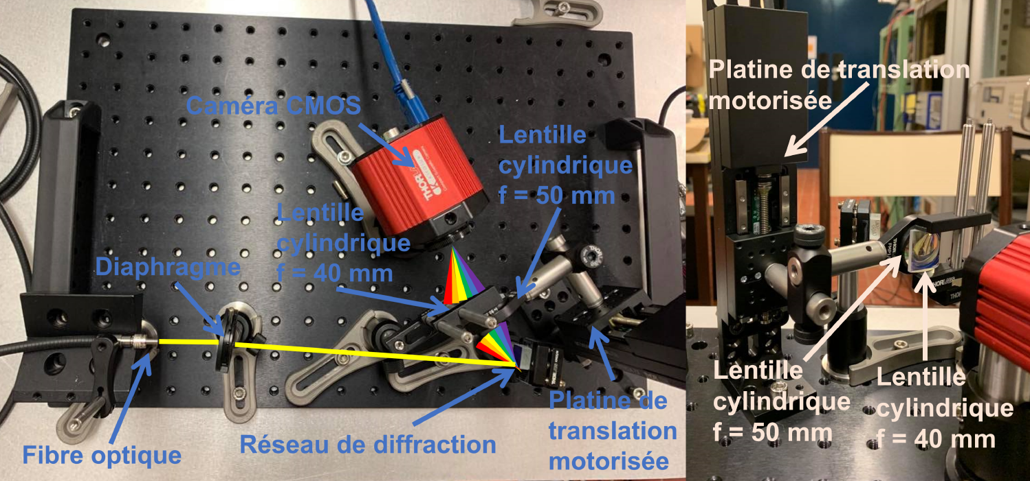
Towards time-resolved spectroscopy
Multispecies monitoring through visible emission spectroscopy
Development of new transportable instrument associating a grating, a spining mirror and a CMOS camera

Slide 26

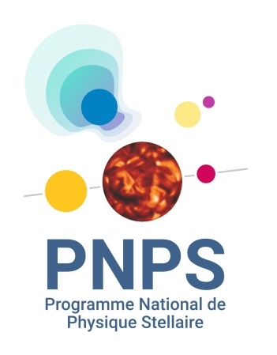




Acknowledgements
Financial support
CEFIPRA, PN PNPS
People (France)
Robert Georges – IPR Rennes
Ludovic Biennier – IPR Rennes
Sergey Yurchencko –UCL, London
Lucile Rutkowski – IPR Rennes
Nicolas Suas-David - IPR Rennes
Samir Kassi – LIPhy Grenoble
Emmanuel Dartois – IAS Orsay
Antoine Gusdorf – LPENS
Pierre Lesaffre – LPENS
Aude Simon – LCPQ, Toulouse
Jonathan Courbe – IPR Rennes
Jonathan Thievin – IPR Rennes
People (India)
K.P.J. Reddy – IISc Bangalore
E. Arunan – IISc Bangalore
V. Jayaram – IISc Bangalore
V. Chandrasekaran – VIT Vellore

