Slide 1







X-ray photodesorption from molecular ices: indirect mechanism and astrophysical implications
R. Basalgète, D. Torrez-Díaz, R. Dupuy, G. Féraud, C. Romanzin, X. Michaut, J. Michoud, L. Philippe, L. Amiaud, A. Lafosse, J-H. Fillion, M. Bertin

Slide 2

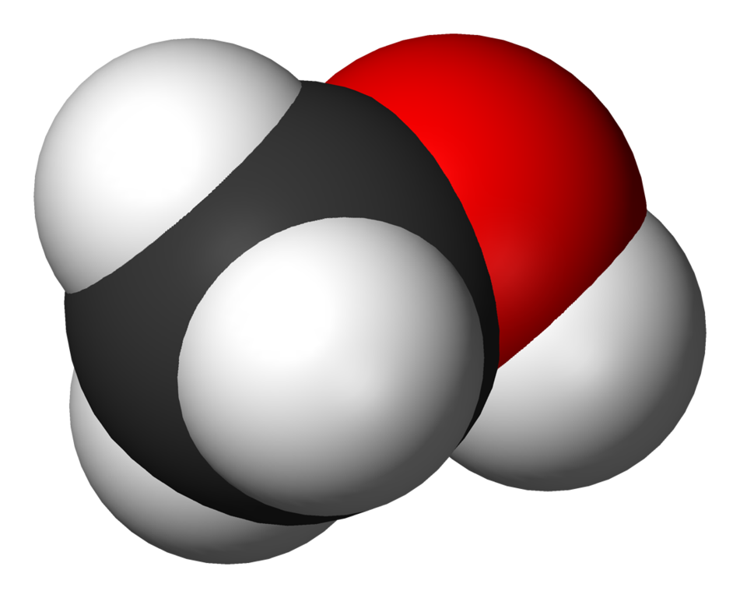
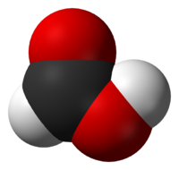


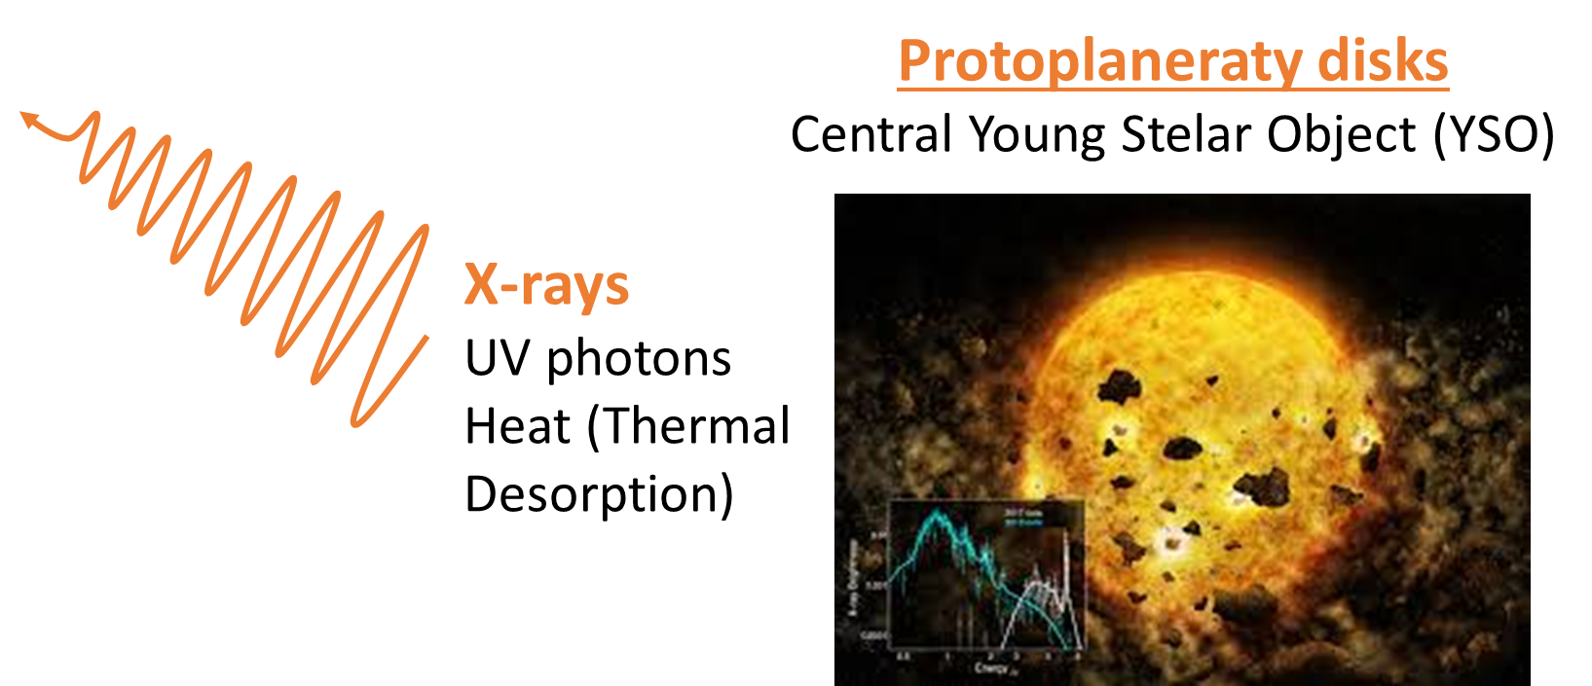


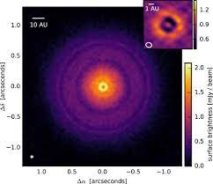
X-ray photodesorption in the cold and dense interstellar medium
Gas phase
T ≈ 10 - 100K
Exchanges
X-rays have been prooven to induce desorption from pure H₂O and CO ice (Dupuy et al. 2018, 2021) and from complex mixtures (Jiménez-Escobar et al. 2018, Ciaravella et al. 2020)
Recently, a disk modeling study showed that X-ray photodesorption significantly influences gas phase abundances in cold regions (Notsu et al. 2021)
Solid phase
Condensation
Non-thermal
desorption
Dust
grains
Photodesorption
H₂O
CO, CO₂
CH₃OH
PMS Star
X-rays
Ices
What are the fundamental mechanisms ?
What about COMs ?
CO:N₂
CH₃OH, CH₃CN, HCOOH
Molecular clouds - XDR
Protoplanetary disks

Slide 3
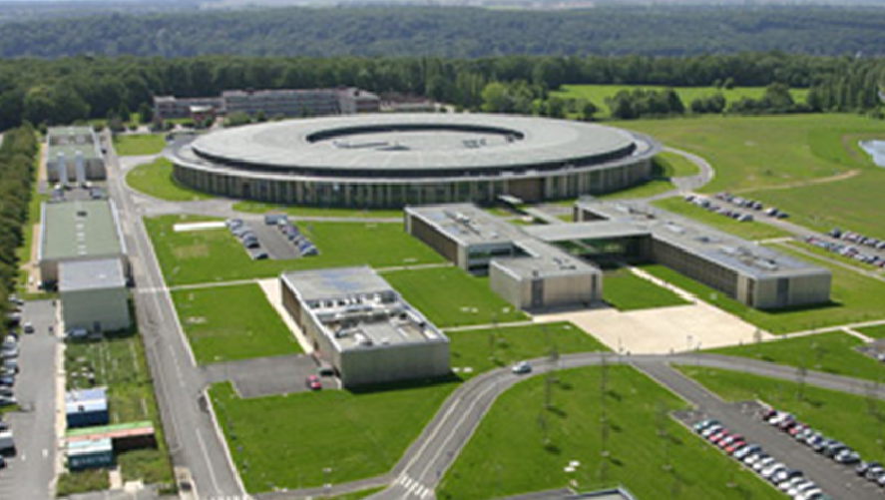
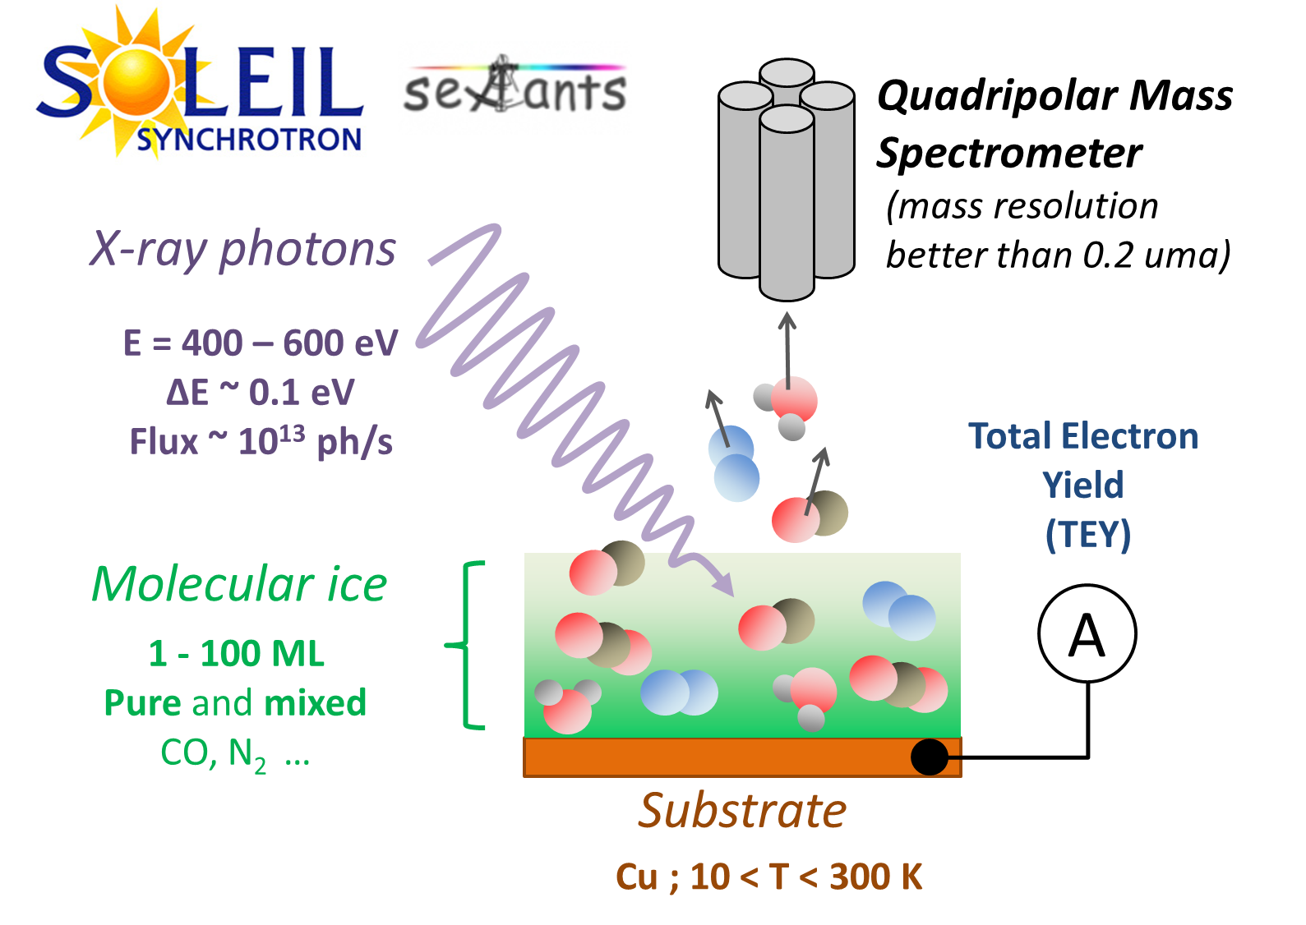
Experiment approach: synchrotron studies
X-ray Photodesorption yields = f (E)
X-rays
Photodesorption
Yield
(molecule/photon)
~10¹³ ph/s
ΔE ~ 0.1 eV
E = 400 – 600 eV
Molecular ice
(~ 100 ML)
@15 K
Photon Energy
Effect of the ice composition ?
P ~ 10⁻¹⁰ Torr
Cu (15 K < T < 300 K)

Slide 4


Indirect X-ray photodesorption from mixed CO:N₂ (1:1) ice
N K edge
X-rays
QMS
?
CO:N₂ ice
(1:1)
Desorption relevant depth λ_{des}= ?
Indirect desorption mechanism

Slide 5
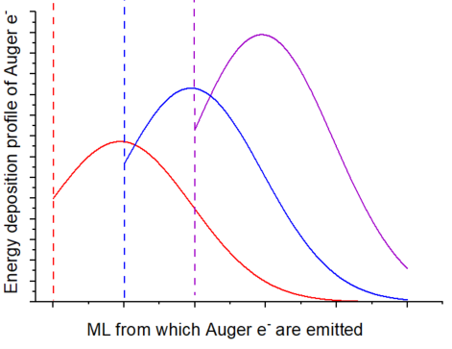
Modeling of the energy deposited on the top layer by Auger scattering
Layers of CO
X-rays
(401 eV)
Thick N₂ ice
Auger e⁻ (380 eV)
*
Top layer
Auger e⁻
*
•
*
Auger e⁻
QMS
λ_{des} = 30 – 40 ML
Valkealahti (1989)
Consistent with X-ray induced
Electron-stimulated Desorption (XESD)

Slide 6


Astrophysical implications
X-rays
Any photo-absorbing molecule can induce desorption of surface molecules
e⁻
Dust
grains
2. What is the role of the Auger electron for the X-ray photodesorption of COMs ?
Photodesorption
λ_{des} = a few tens of ML in the soft X-ray range

Slide 7
X-ray photodesorption from COMs-containing ices
X-rays
(560 eV)
QMS
COM
desorption
COM:CO
or
COM:H₂O
(1:10)
COM = CH₃OH, CH₃CN or HCOOH
(all detected in disks)
X-ray photodesorption can play a role for gas phase COMs
Significant dependence of the yield with the ice composition.
Why ?

Slide 8
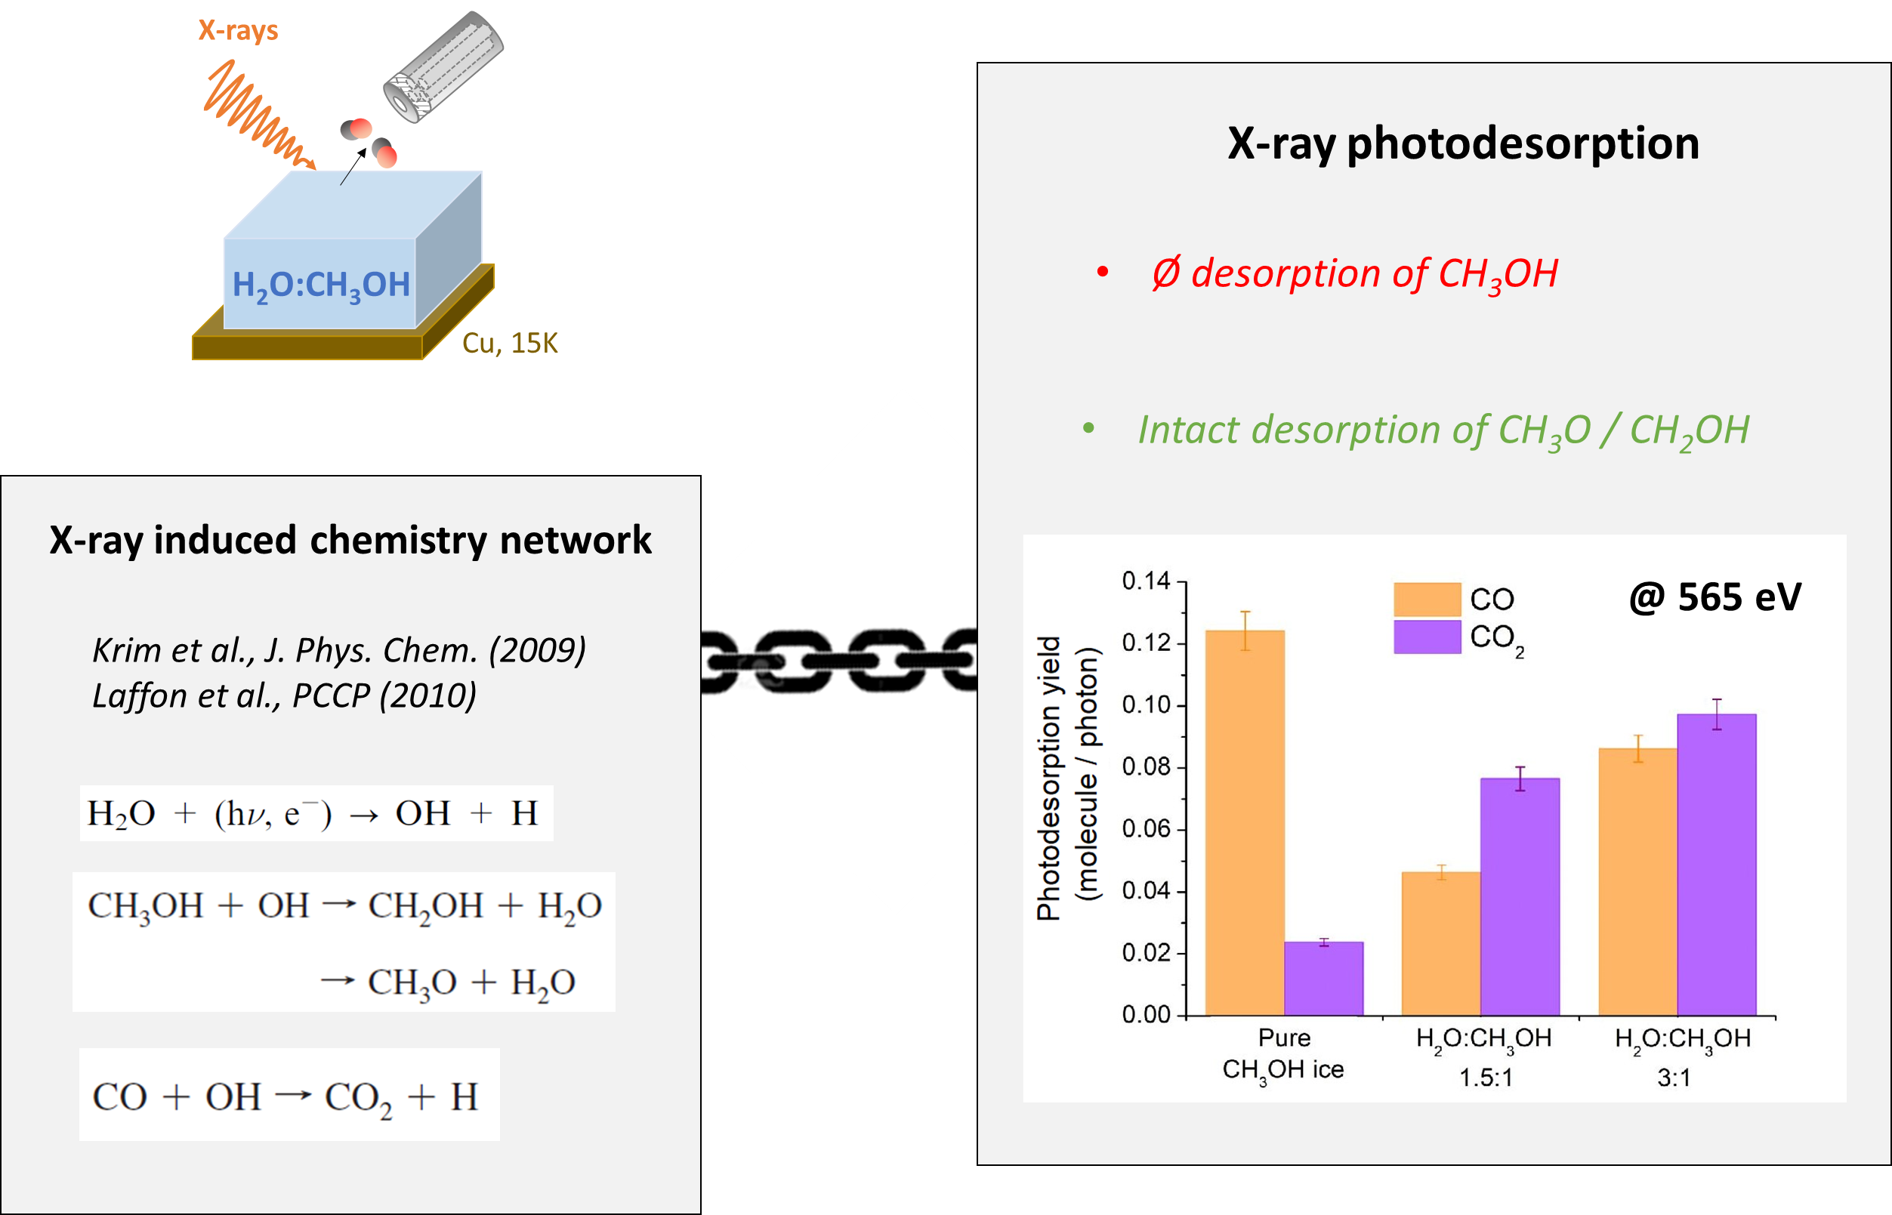
X-ray induced chemistry and photodesorption – The case of CH₃OH

Slide 9
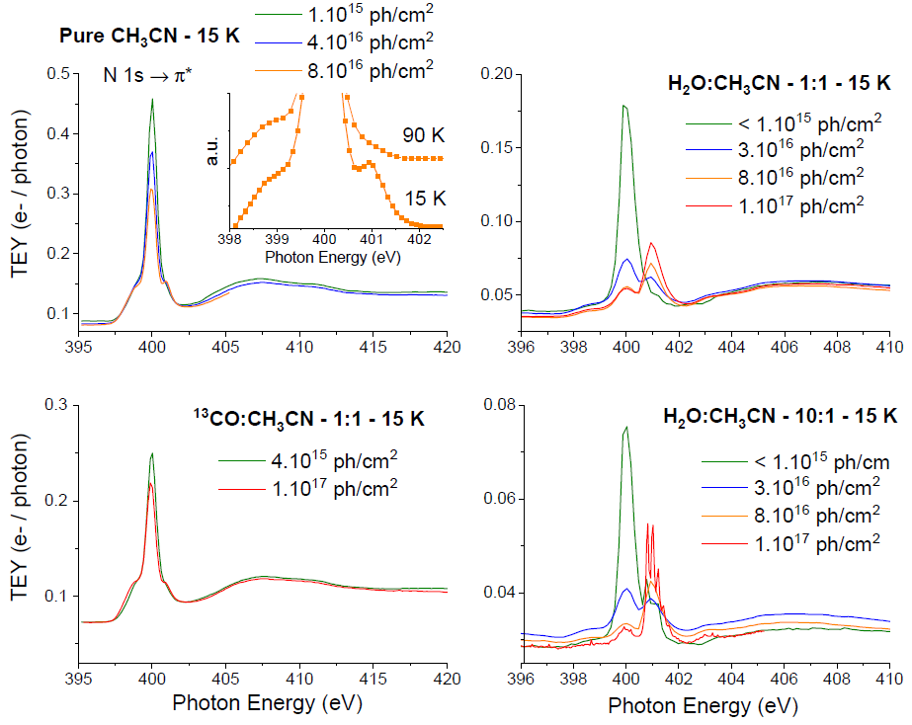
X-ray induced chemistry and photodesorption – The case of CH₃CN
There is a clear sign of a faster photo-destruction of CH₃CN in H₂O-dominated ices
CH₃CN significantly present near the ice surface (first tens of ML)
One photo-product is N₂ but we do not have the full chemistry picture
As for CH₃OH, the destruction of CH₃CN initiated by H₂O may compete with its desorption

Slide 10
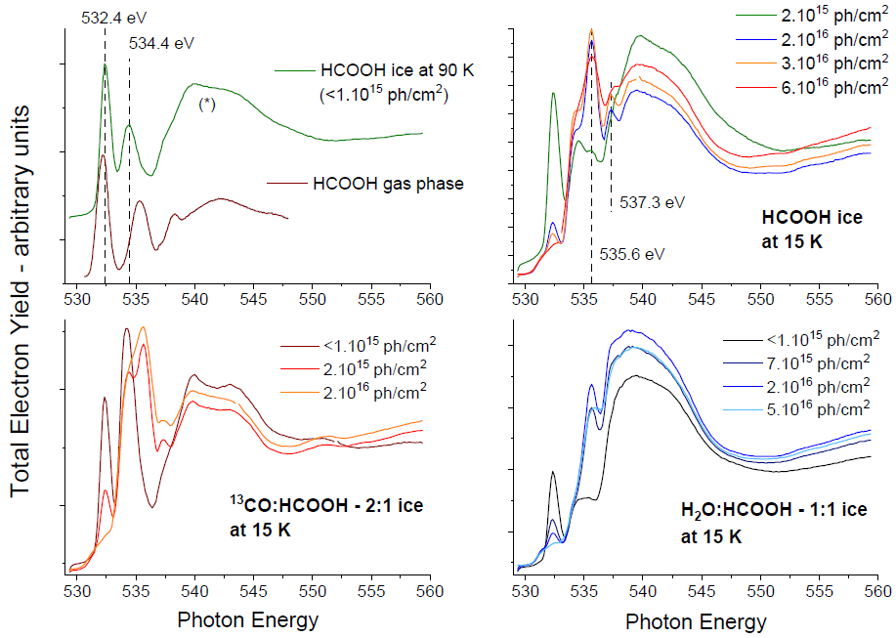
X-ray induced chemistry and photodesorption – The case of HCOOH
No clear sign of a different chemistry in pure, CO or H₂O-dominated ices
The non-desorption of HCOOH from H₂O-dominated ices might be due to different adsorption energies

Slide 11



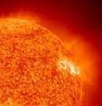
Conclusions and astrophysical implications
X-ray photodesorption is an indirect process mediated by the thermalization of
Auger electrons and X-ray induced chemistry can compete with the desorption of COMs
X-ray photodesorption of COMs should be region-dependent in disks
Studies at higher energies are required
Disk modeling is mandatory to conclude on the quantitative role of each desorption process
UV, CRs
Disk Gas Phase
CO snowline
PMS star
H₂O snowline
X-ray photodesorption of COMs is weak
X-ray photodesorption of COMs is favored
X-rays

Slide 12
Thank you for your attention !

Slide 13
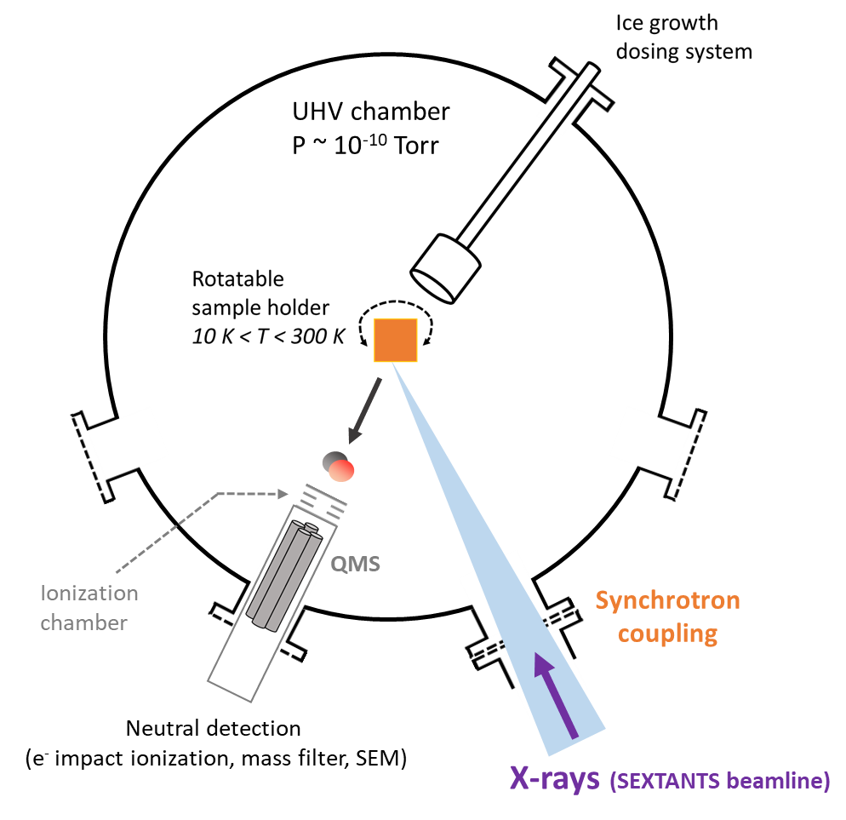

X-ray photodesorption experiments at the synchrotron SOLEIL
SPICES

