Slide 1


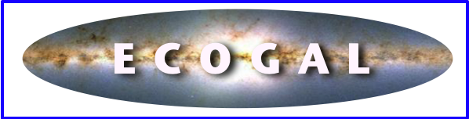
The ECOGAL project: a multi-scale and multi-technique approach to the interstellar medium
Patrick Hennebelle
Adnan Ahmad, Noé Brucy, Tine Colman, Ugo Lebreuilly, Tung Ngo
Cédric Colling, Sam Geen, Valeska Valdivia, Antoine Verliat
Benoit Commerçon, Olivier Iffrig, Yueh-Ning Lee, Anaelle Maury, Eva Ntormousi
Gary Fuller, Ralf Klessen, Frédérique Motte, Sergio Molanari, Leonardo Testi

Slide 2
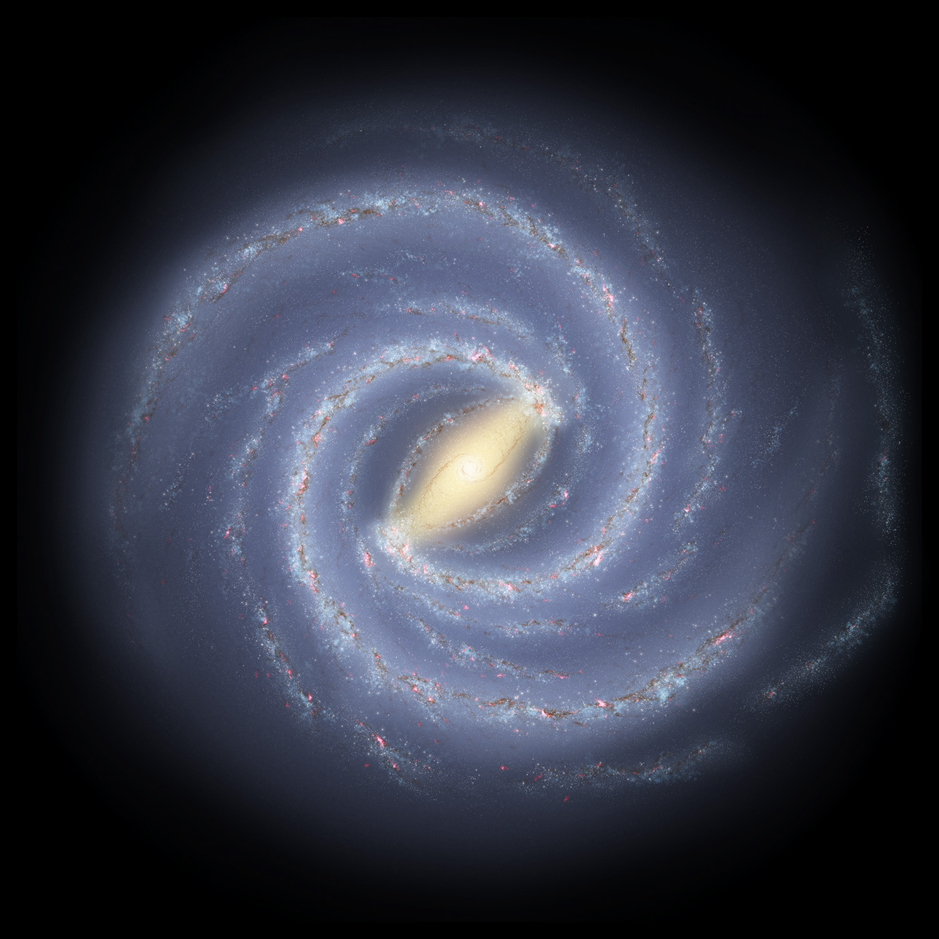
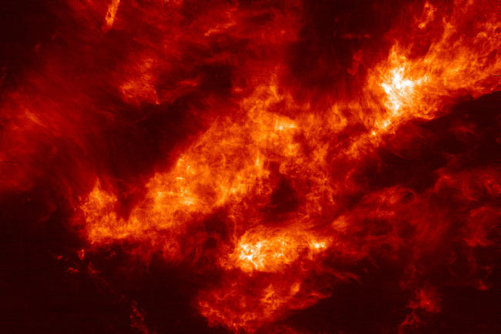
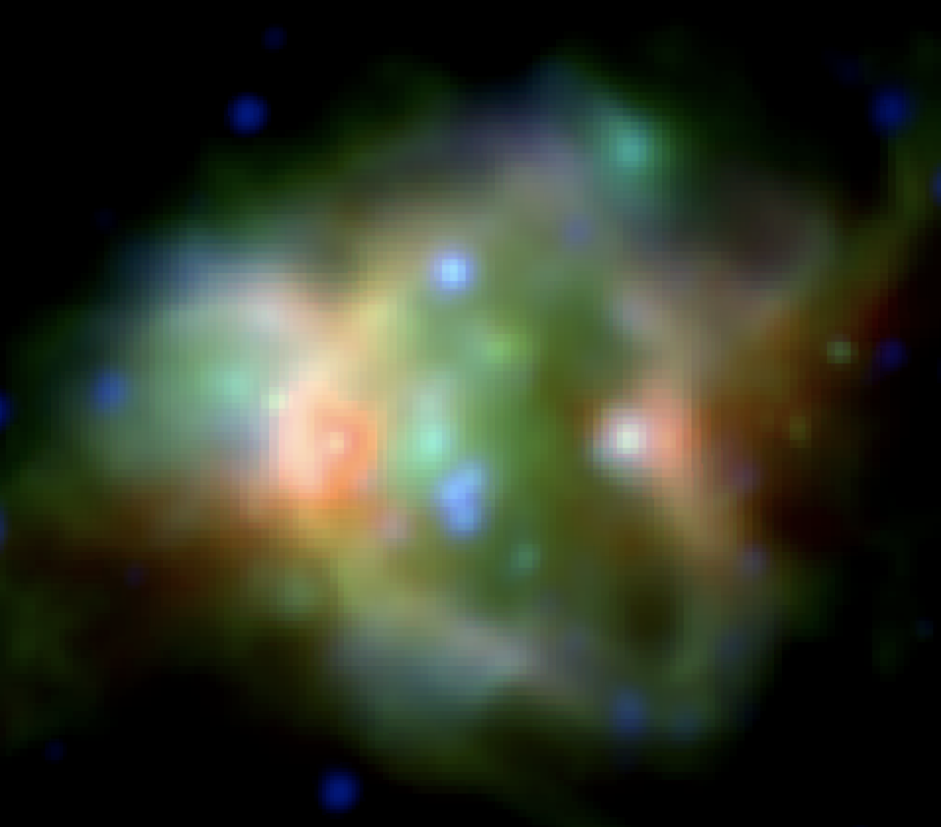
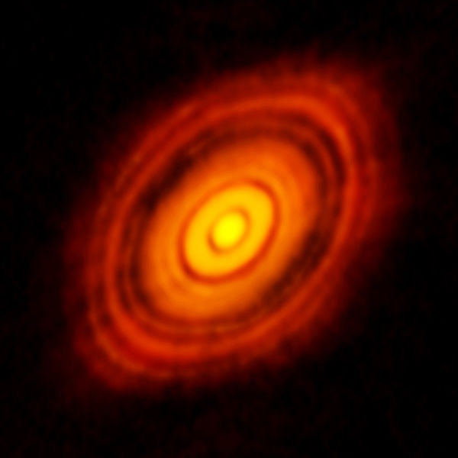
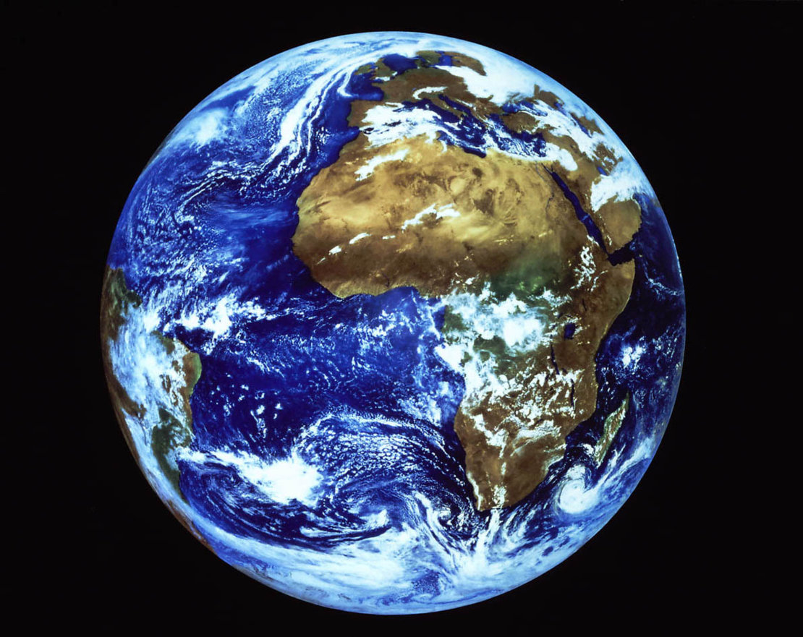
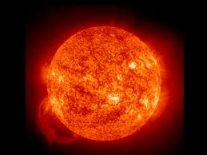
Top-down cascade:
gravo-magneto-turbulent fragmentation
Bottom-up cascade:
radiative & dynamical feedback
GOAL: a predictive model for the Galactic ecosystem
Three fundamental issues:
PLANETS → How do planet-forming disks relate to the Galactic environment?
STARS → What processes regulate the birth of stars?
GALAXY → Can we understand galaxy-scale star formation?
The challenges
All physical agents active at the same time on all scales
The Milky Way as one multi-scale non-linear ecosystem
Realistic illustration of Milky Way (NASA/JPL-Caltech)

Slide 3
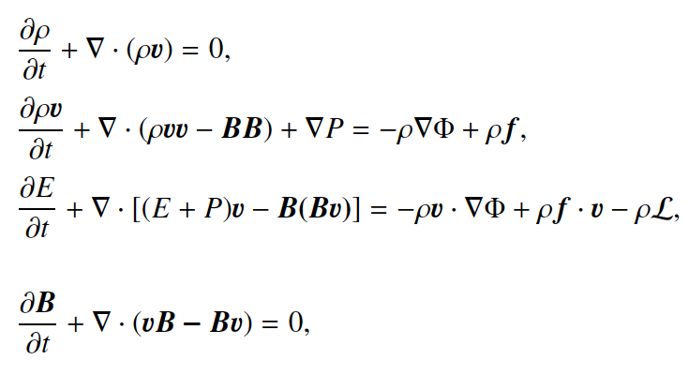
Model for star forming interstellar medium
RAMSES code is used (Teyssier 2002, Fromang+2006, Bleuler & Teyssier 2013)
MHD equations
External gravity due to stars and dark matter
Self-gravity, MHD turbulence, standard ISM cooling
Sink particles mimics star formation. Given the typical resolution their mass is typically 10³-10⁵ Ms => they represent clusters
Each time 120 Ms is accreted, a massive star forms and therefore its feedback is applied.
Mass distribution follows Salpeter.
When a massive star forms:
-the supernovae momentum is injected after a time that corresponds to the stellar age and at a distance proportional to its age.
-ionising radiation is treated (M1 method) and applies 4 Myr after the formation of the massive star.
-the UV heating is proportional to the star formation rate
Series of kpc simulations:
-resolution from 1-2 to 0.004 pc
-variations of physical and numerical parameters

Slide 4
1kpc
1pc
1- Getting the initial conditions: simulating kpc box
2- The dense ISM, clumps and cores
3- The very small scales, disks and IMF
1kpc
1 mpc
1pc
1AU

Slide 5
1kpc
1pc
1- Getting the initial conditions: simulating kpc box
2- The dense ISM, clumps and cores
3- The very small scales, disks and IMF
1kpc
1 mpc
1pc
1AU

Slide 6
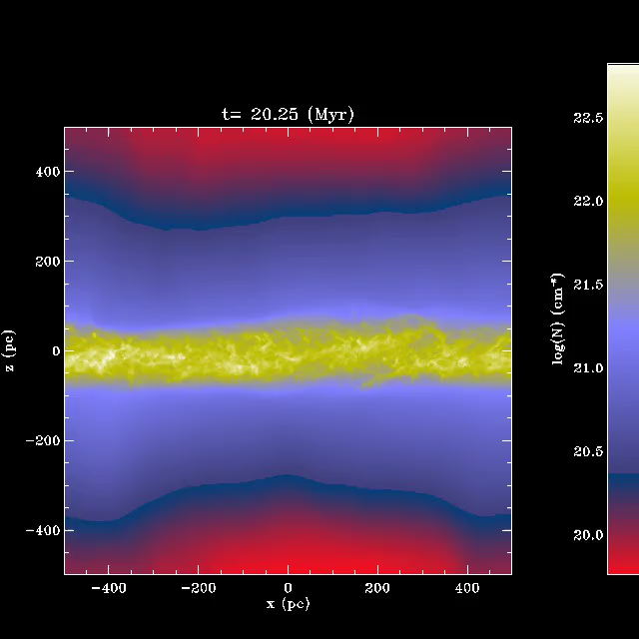
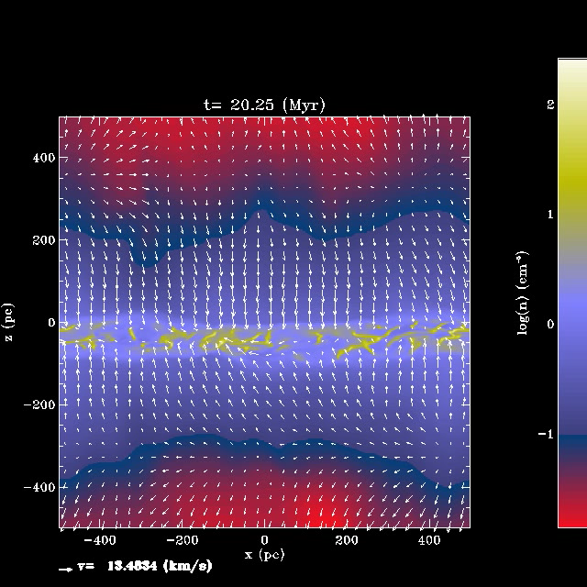
Supernovae regulated ISM (from few 100 pc to 1kpc)
(Slyz et al. 2005, de Avillez & Breitschwerdt 2005,2007, Joung & MacLow 2006,
Hill et al. 2012, Kim et al. 2011, 2017, H & Iffrig 2014, Gatto et al. 2014, Walch et al. ….)
External gravitational field (due to stars and DM), multi-phase ISM, self-gravity, magnetic field
Feedback (different schemes)
Column density
density
H&Iffrig 2014
1kpc

Slide 7
Influence of various feedback
Total mass of stars
Density PDF
More feedback =>
more intermediate density gas
Colling+2018

Slide 8
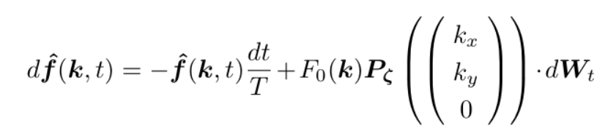
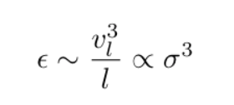
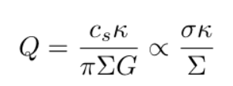


The role of externally driven turbulence
What sources of turbulence do we foresee?
The gas orbital energy of the galaxy which is tapped by gravitational instabilities
(Bournaud et al. 2010, Klessen & H 2010, Krumholz et al. 2018)
Maximum ε ? ε∼V_{rot}³/R => enormous source of free energy
How do we drive?
(Schmidt+2006,2009)
75% solenoidal modes – compressible forcing change our conclusion quantitatively
How intensively do we drive?
(incidently note that feedback provides “only” P_{inj} α Σ^{1.4})
Brucy+ApJ 2020

Slide 9
Evidence for large scale driven turbulence I:
Externally driven turbulence can explain Schmidt-Kunnicutt relation
Brucy+2020

Slide 10
1kpc
1pc
1- Getting the initial conditions: simulating kpc box
2- The dense ISM, clumps and cores
3- The very small scales, disks and IMF
1kpc
1 mpc
1pc
1AU

Slide 11
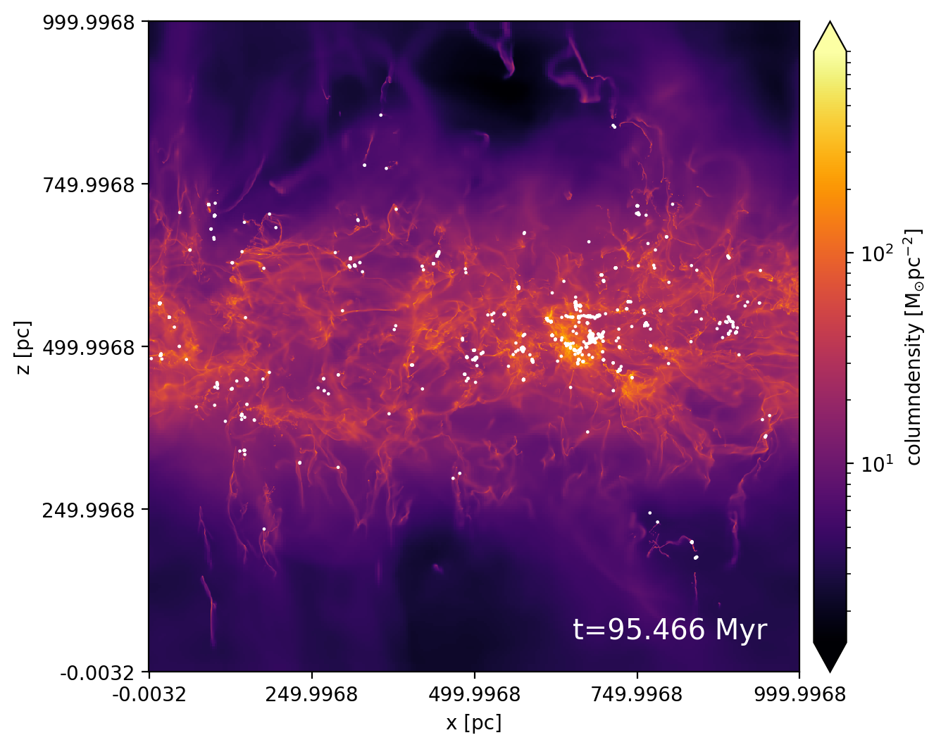
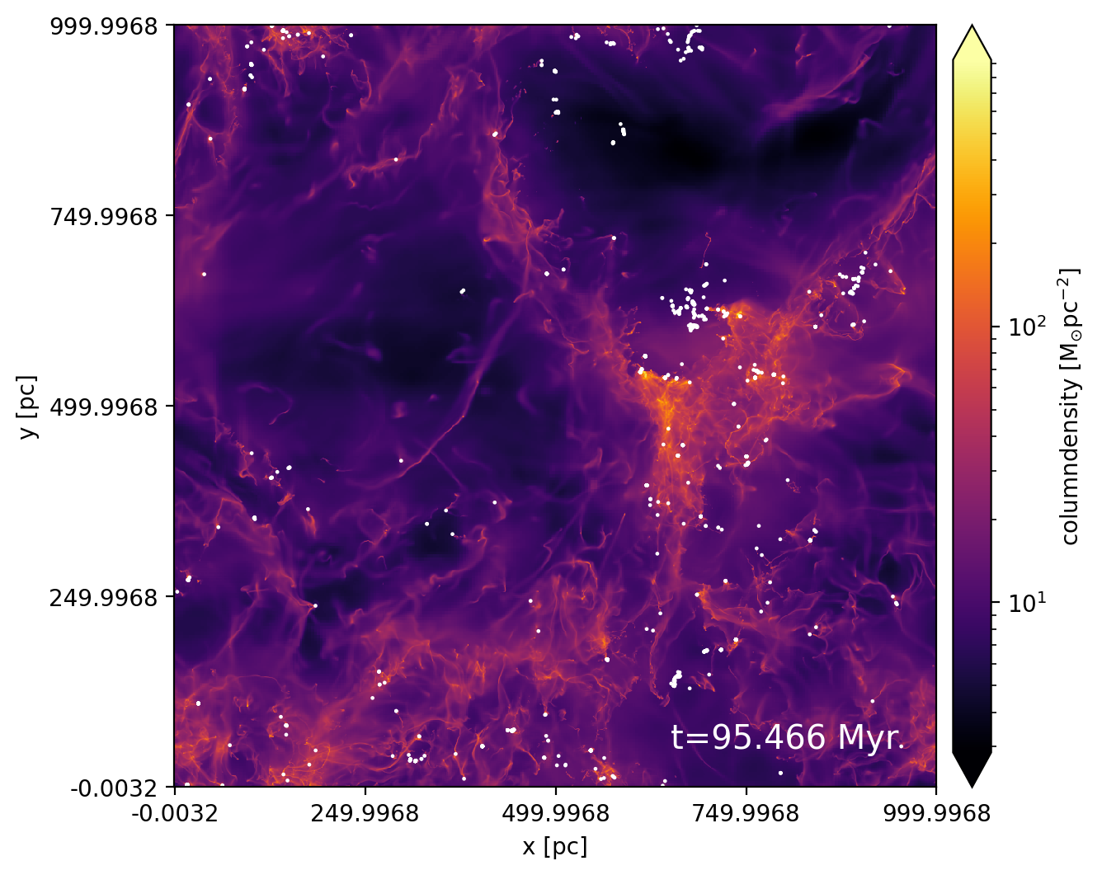
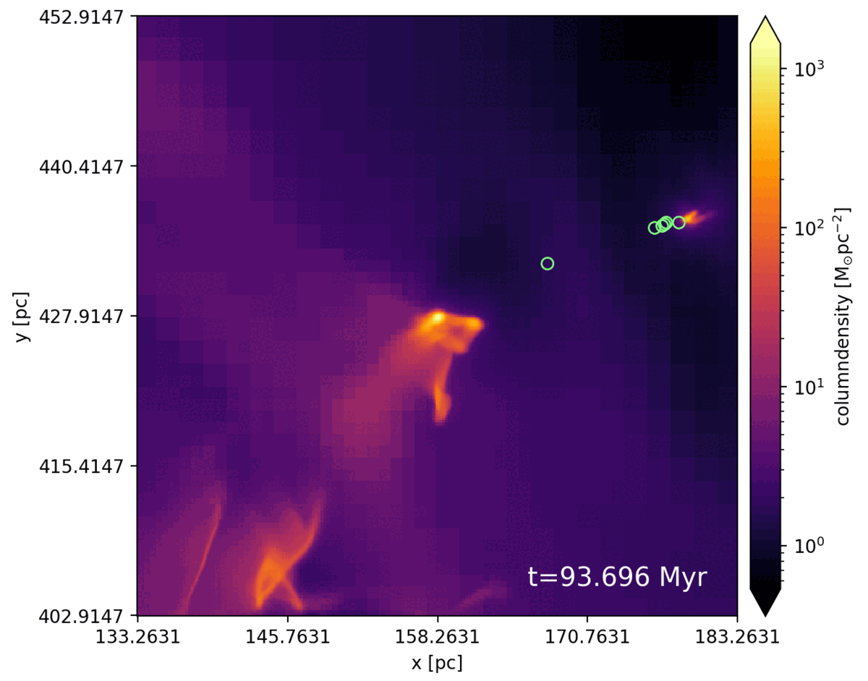
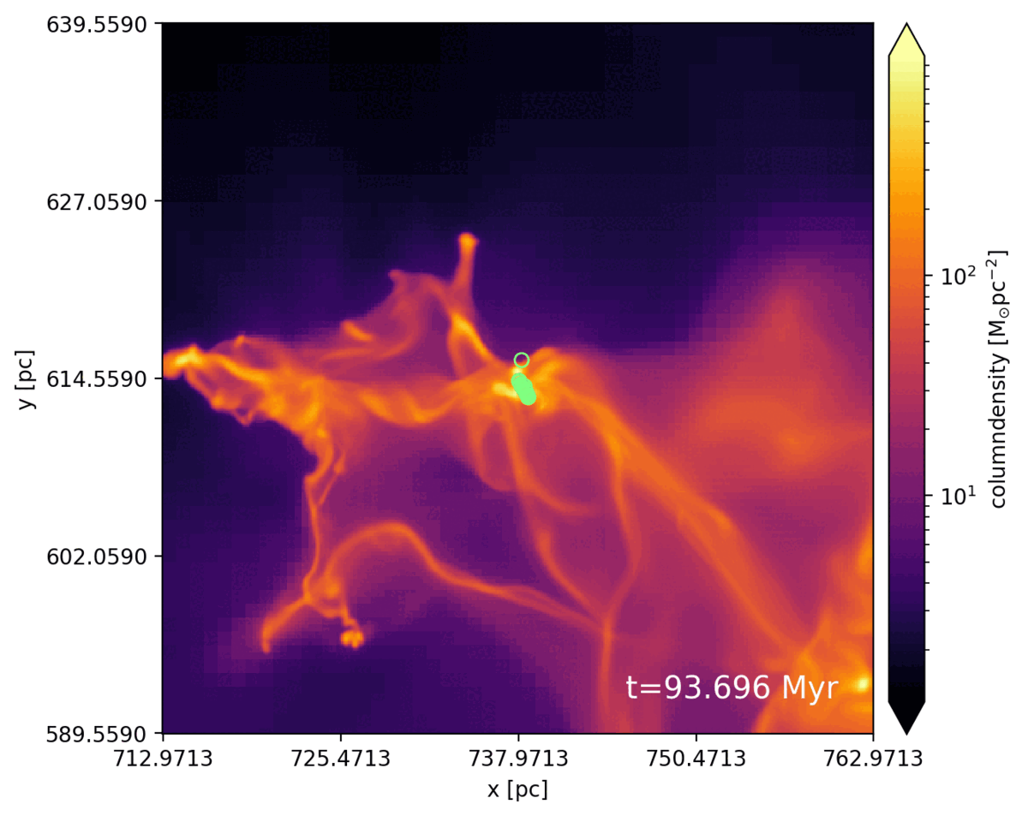
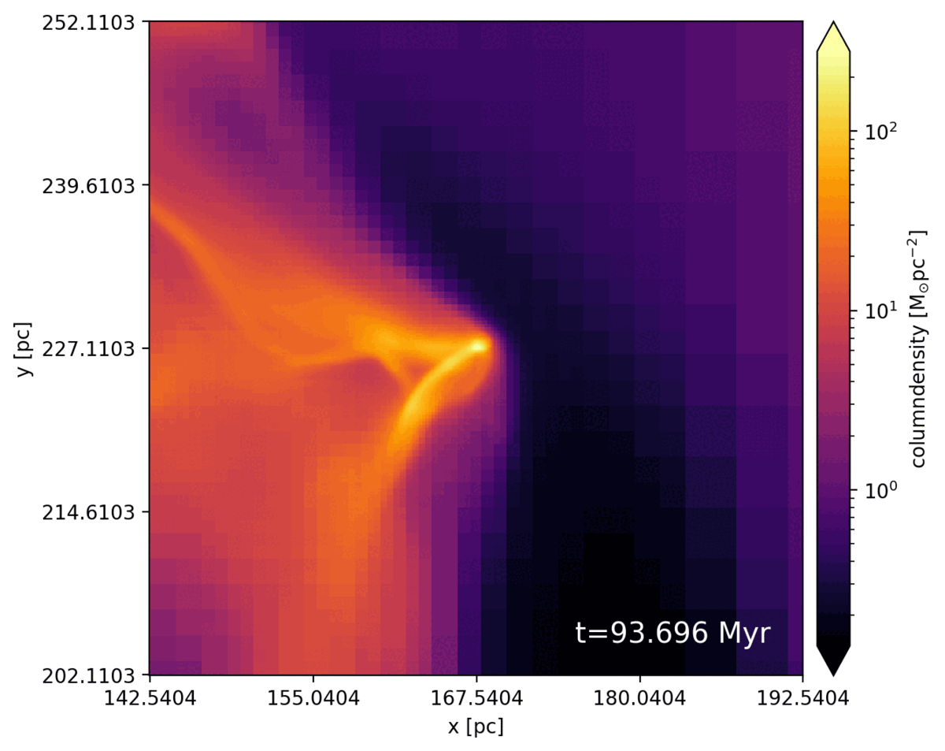
From 1 kpc to 10⁻² pc : getting star forming clump

Slide 12
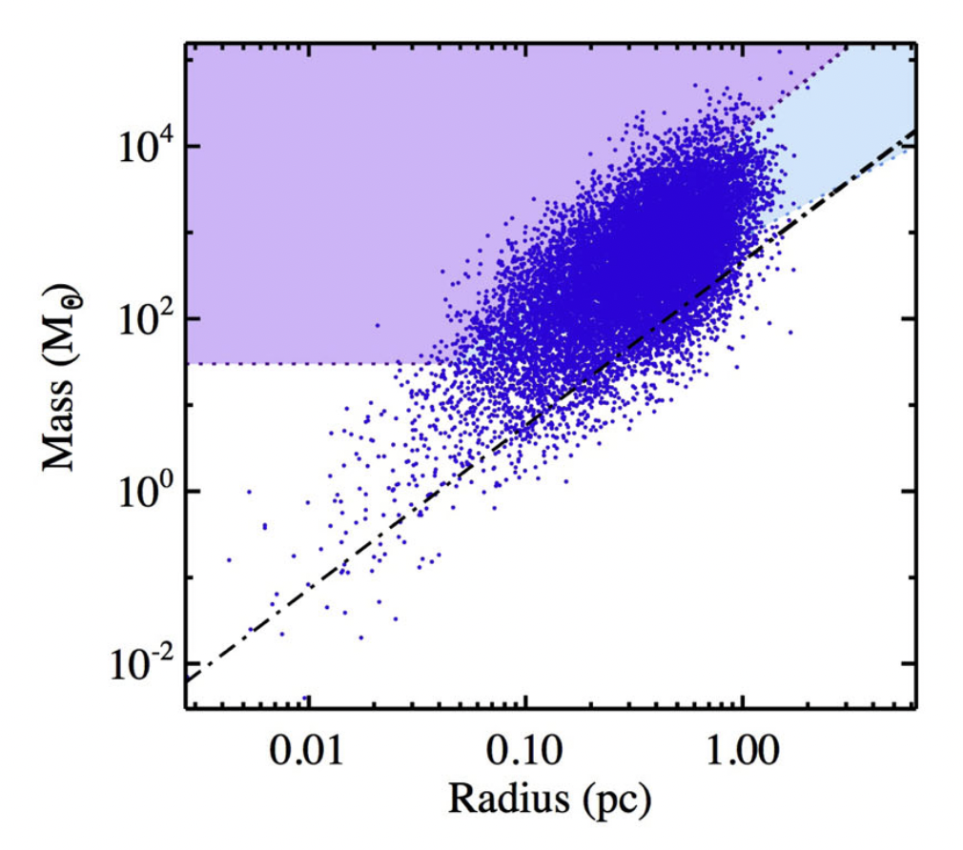
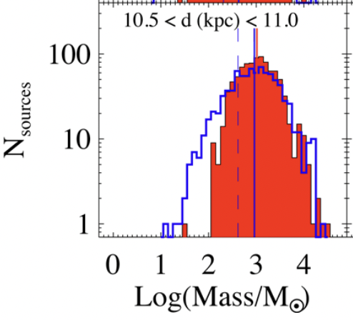
Some properties of star forming clump
Clump mass spectrum
Mass-size relation
From simulations
Colman+in prep
From HIGAL observations
Elia+2018

Slide 13

From Intermediate Galactic scales to self-Gravitating cores
Goal : obtain a self-consistent description from few 100pc to less than 0.1 pc (spatial numerical resolution of 0.004/0.002 pc)
H 2018

Slide 14
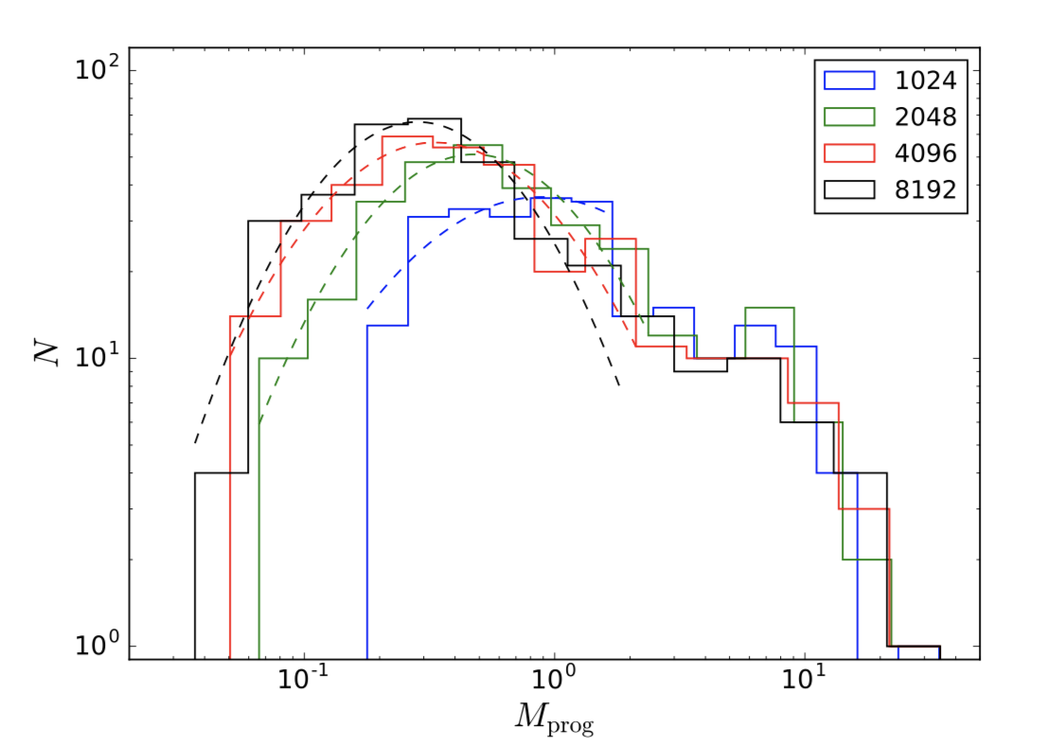
Getting the “core” mass function from zooming-in simulations
The slope is about “right”, close to Salpeter
values but:
The peak of the core mass function is
resolution dependent!
(see also Pelkonen et al. 2020, Louvet et al. 2021)
H 2018
Pelkonen et al. 2020

Slide 15
1kpc
1pc
1- Getting the initial conditions: simulating kpc box
2- The dense ISM, clumps and cores
3- The very small scales, disks and IMF
1kpc
1 mpc
1pc
1AU

Slide 16
Performing a series of cluster type numerical experiments to investigate the dependences of the stellar mass spectrum and the protoplanetary disks
-RAMSES code is used (Teyssier 2002, Fromang+2006)
-1000 Ms clouds
-shallow density profile initially
-”turbulence” added (random phase) but the cloud is relaxed before gravity is switched on
-full radiative transfer using FLD (Commercon et al. 2011)
-non-ideal MHD – magnetic resistivities from Marchand+2016
-sink particles being used (Bleuler & Teyssier 2013). Density threshold 10¹³ cm⁻³
-numerical resolution goes 1 AU
H+2020, 2022, Lebreuilly+2021,2023

Slide 17
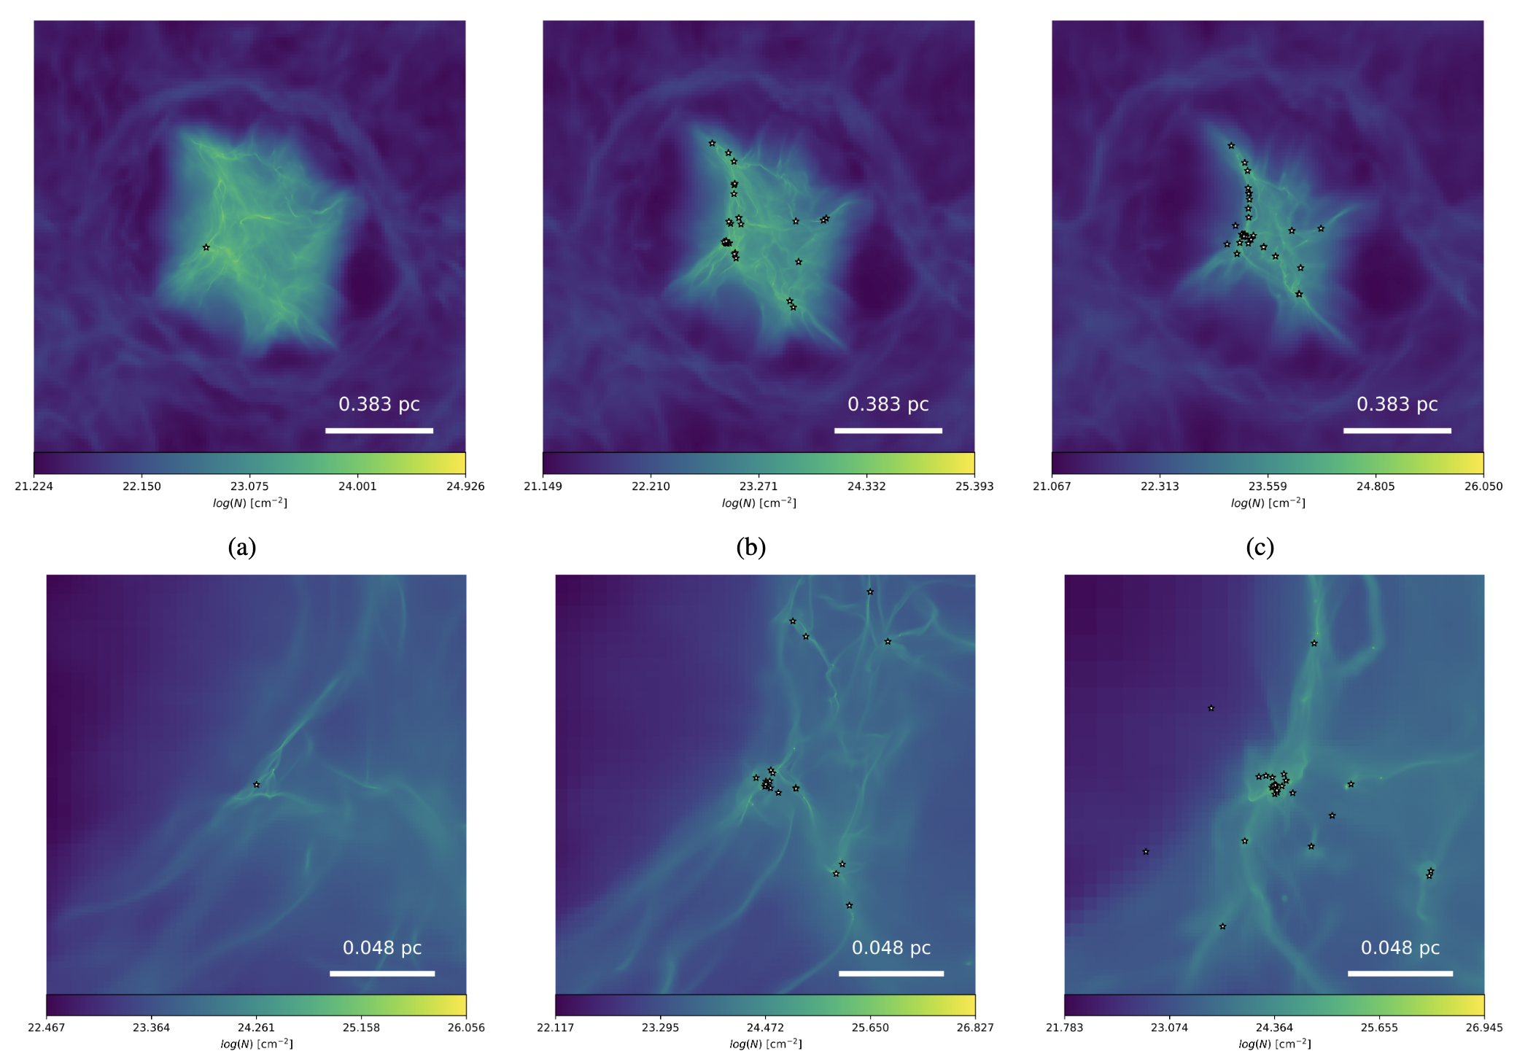
Time evolution of a 1000 Ms clump
Lebreuilly+ in prep

Slide 18
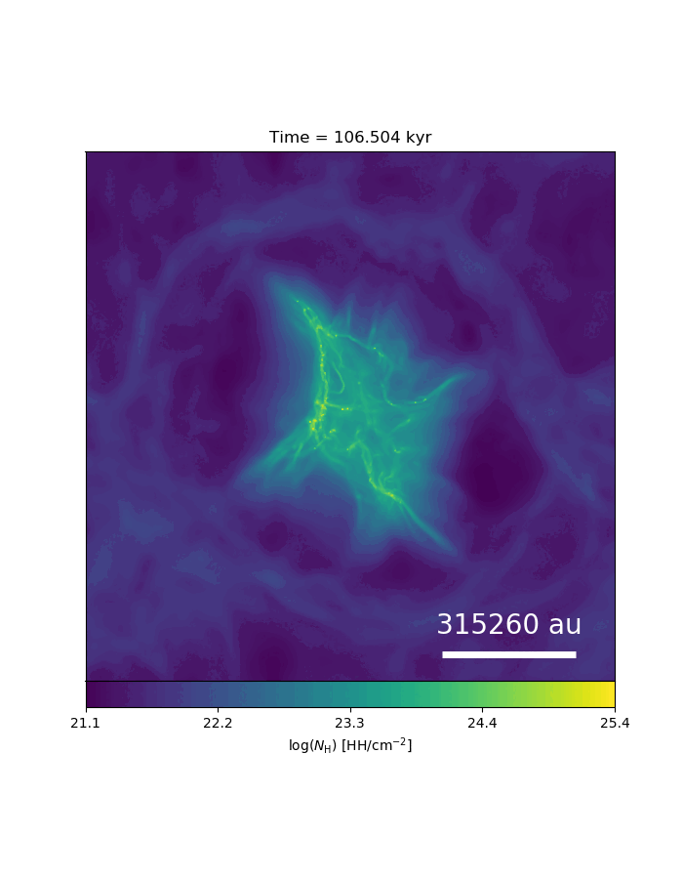
Zooming-in from pc to AU
Lebreuilly+ in prep

Slide 19
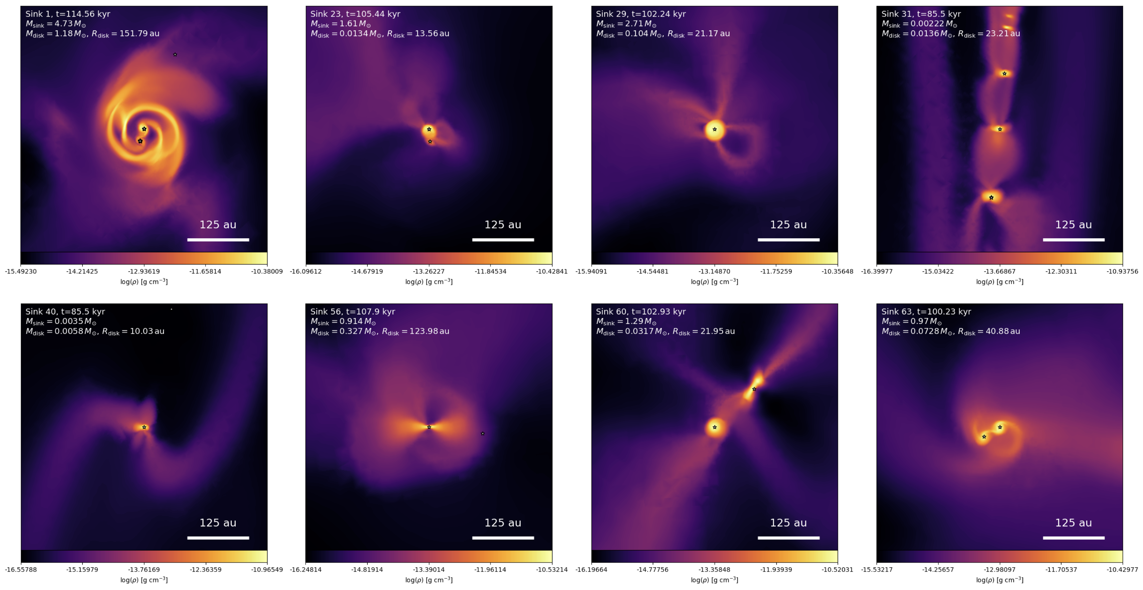
A diversity of disks
Lebreuilly+ in prep

Slide 20
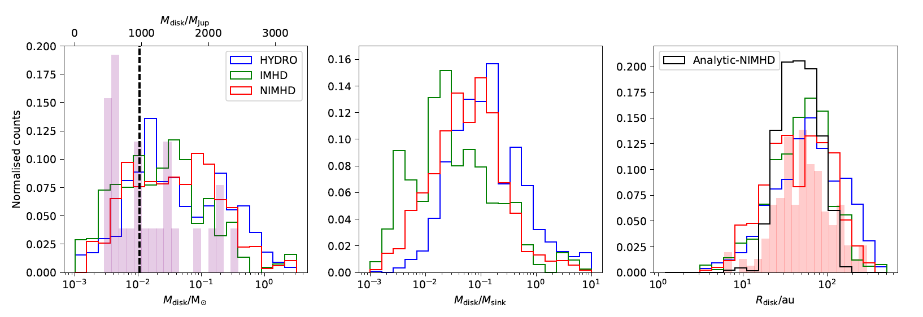
Comparison between disk population from simulations and observations
Comparison with class-0 disk survey
(Tobin+2018, Maury+2019)
Lebreuilly+ 2021

Slide 21
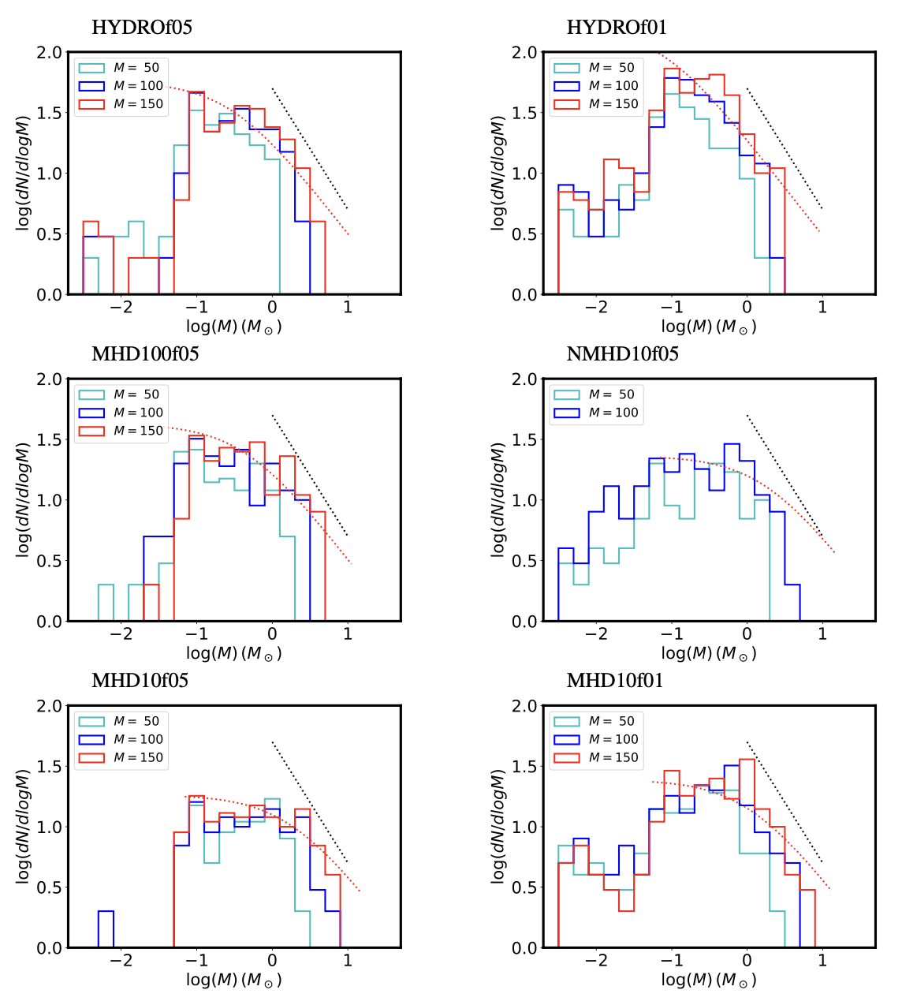
Getting the stellar Initial Mass Function
H+2022

Slide 22
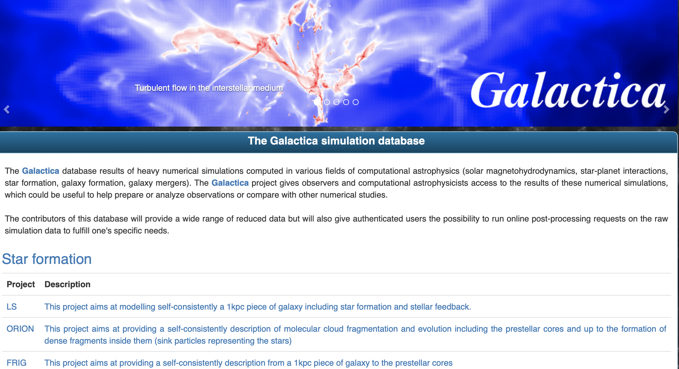
The Galactica data base aims at hosting and manipulating simulations from several fields
…and remember 1 Mcpuh ~ 3-4 teq CO₂
dev: Damien Chapon
http://www.galactica-simulations.eu/db/

Slide 23
Conclusions
-muti-scale and self-consistent ISM model is on the way
Usage of database for simulations should become standard
-kpc box start producing reasonable self-consistent regulated ISM for MW type column densities
-Feedback does not seem to be strong enough to reproduce the Schmidt-Kenicutt relation
=> Large scale driving of turbulence is needed
-zooming leads to encouraging results regarding the clump statistics and the prestellar cores
BUT: convergence is a major issue for the peak
-disk scale is now reachable from clump scale
Disk populations can be predicted even with full physics
First results are encouraging

Slide 24
Full radiative transfer calculation: what is the exact influence ?
Bate 2009, 2012, Urban+2010, Krumholz+2012
H+2020
Taking into account G M dM/dt / R*
Excluding G M dM/dt / R*

